Slide 1
Community Advisory Boards:
Introduction & Overview
The HIV Vaccine Trials Network is supported through a cooperative agreement with the National Institute of Allergy and Infectious Diseases

Slide 2
Topics
What is a Community Advisory Board (CAB) and why do they exist ?
How does the HVTN involve CABs?
Getting started, forming a CAB
Ongoing CAB education, roles and responsibilities.
Site support for CABS
Notes:
During this presentation we will cover the following themes [read slide]

Slide 3
What is a Community
Advisory Board?
A formal advisory group that is coordinated by the research site.
Made up of diverse community members varying in age, race, gender, education, religion and sexual orientation.
Meets regularly to provide feedback to the site on research and its relevance to the local community.
Provides 2-way communication channel for information between the research site and the broader community.
Notes:
Here are some of the basic components of what a CAB is [read slide]

Slide 4
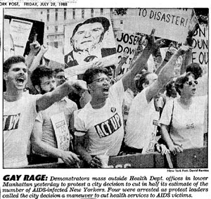

Before CABs…
AIDS activists were concerned about the slow response of the US government and private pharmaceutical companies to respond to the AIDS epidemic.
Notes:
In the 1980s, government response to AIDS in the US was slow and anemic. There was a lot of anger, and people started to organize. The protests that grew out of the public frustration led to greater advocate oversight of public health issues, and community advisory groups began to be formed.
[Optional: Information about photos]
Left: “Stonewall” (from Wikipedia) Stonewall riots were a series of spontaneous, violent demonstrations by members of the gay community against a police raid that took place in the early morning hours of June 28, 1969, at the Stonewall Inn, in the Greenwich Village neighborhood of New York City. They are widely considered to constitute the single most important event leading to the gay liberation movement and the modern fight for gay and lesbian rights in the United States. http://en.wikipedia.org/wiki/Stonewall_riots
Right: “ACT-UP” (from Wikipedia) AIDS Coalition to Unleash Power (ACT UP) is an international direct action advocacy group working to impact the lives of people with AIDS (PWAs) and the AIDS pandemic to bring about legislation, medical research and treatment and policies to ultimately bring an end to the disease by mitigating loss of health and lives. ACT UP was effectively formed in March 1987 at the Lesbian and Gay Community Services Center in New York. http://en.wikipedia.org/wiki/ACT_UP

Slide 5





With research Networks, came CABs
US government funding through the National Institute of Allergies and Infectious Diseases (NIAID)
Notes:
The National Institute of Allergy and Infectious Diseases saw the wisdom of involving the community in their decision making processes, and began to include patients in treatment research that was occurring. The first such group created was with the AIDS Clinical Trials Group (ACTG), which is the network that does HIV/AIDS treatment research. Individual CABs then began to be formed to advise local research as well as the other networks.
As NIAID research network the HVTN is required have CAB involvement, but the HVTN also truly believes that the best way to conduct its research is by working with communities. Since the network was formed in 1999, the HVTN has maintained its commitment to having strong program of community engagement through funding and allocation of staff resources and development. Having community participation at all levels of network decision making leads to the development of studies that are better thought out, with fewer participants concerns and increases the likelihood of community buy-in. Community buy-in or support allows studies to enroll faster and increases the chance individuals would be willing to get an HIV vaccine in the future, once licensed.
Community Advisory Boards play an essential role in bridging communication between the scientific community which may feel great excitement for the research, and the general community which may feel great anxiety by this same research.

Slide 6
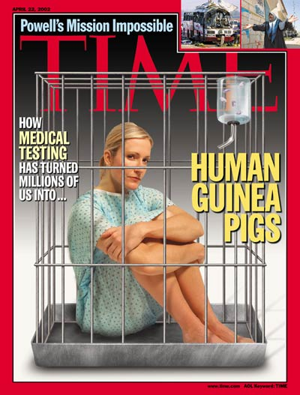
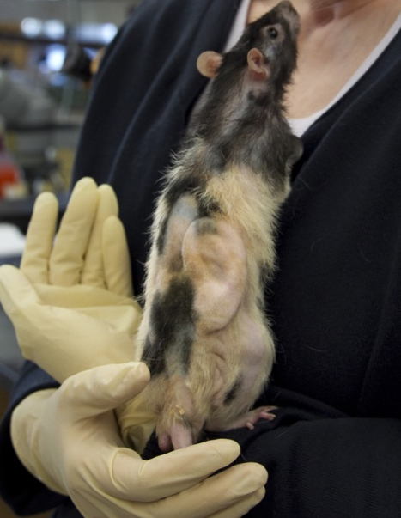
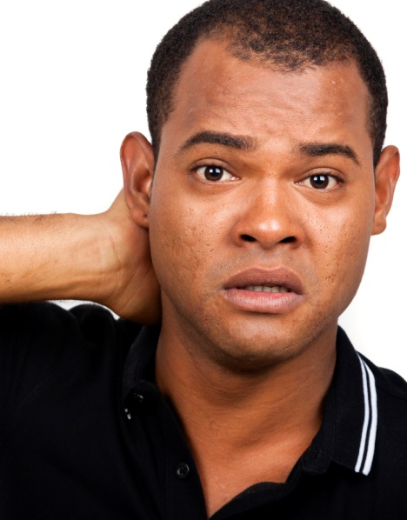
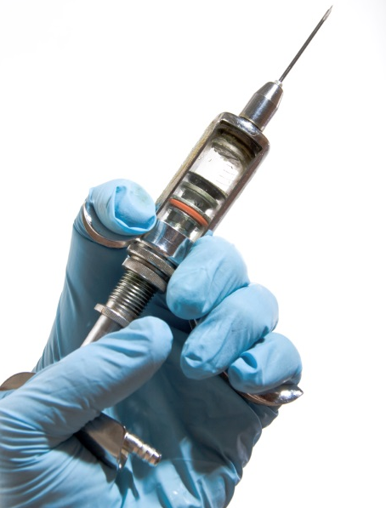
Common communities perceptions about research:
… “Eek this is terrifying!”
Notes:
For example, communities may think: Eek, scary! This may be an exaggeration, but to some people the idea of research is met with fear and confusion. And for good reason: not all research in the past was conducted ethically, and the idea of informed consent is not familiar to most people.
Obviously not all community members may share this view. Some community members may also have scientific backgrounds, and scientists are also part of various communities.
But generally speaking, when we talk about community members, we’re talking about those who are not directly involved in the implementation of the research and have no financial or professional stake in the outcomes. Yet they play a valuable role in helping researchers overcome some of the many challenges to that arise with HIV vaccine trials.

Slide 7
Challenges of HIV vaccine research
Community support and knowledge level generally low
Anti-Vaccine movement
Research raises complex issues
Distrust of government, medicine and research
Concern about HIV infections during the trial
Fear of getting AIDS from the vaccine
Recruitment strategies
CABs can serve as a bridge
Relationship of vaccine development to HIV prevention
Relationship of vaccine development to HIV treatment
Notes:
Some of the many challenges associated with conducting HIV vaccine trials may include. [read slide]
CAB members serve as an important bridge between the site and the community at large to help dispel myths and misconceptions and raise awareness about the value of the research overall.

Slide 8
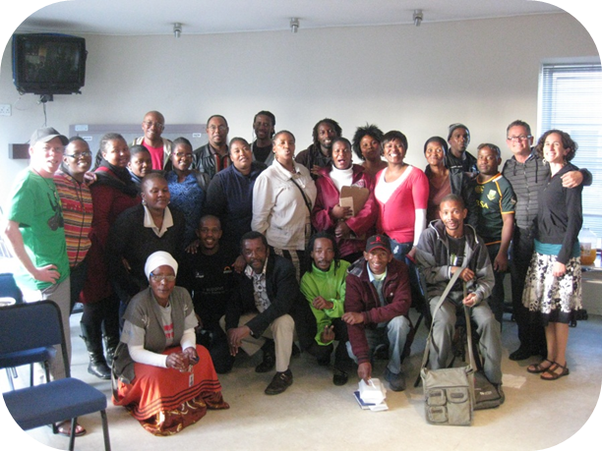
Who makes up a CAB?
Study participants, or individuals with similar characteristics
Prominent community members & key opinion leaders
Family members of study participants
Representatives of local community-based organizations and/or AIDS service organizations
Religious leaders
Individuals affected by or living with HIV
Notes:
So who makes up a CAB? CABs are as diverse as the cities and communities where trials are conducted. Members have various backgrounds and may include [read slide]

Slide 9
Role of CABs
Serve as a link between the research site and the community, providing a conduit for bi-directional communication.
Participate in CAB meetings and activities, including skill building and training opportunities.
Help dispel myths about HIV vaccine research and provide accurate information to peers.
Help educate the community about the site’s research activities.
Help recruit, train, and retain new CAB members.
Provide insight into the “real lives” of the populations prioritized for trial participation.
Notes:
And what are their main roles? [read slide]

Slide 10
Role of CABs - continued
Help ensure community concerns are adequately addressed in informed consent documents & the overall consent process, including language & cultural sensitivity
Represent the diversity of individuals that are living with HIV/affected and the concerns of those communities.
Help to identify emerging research needs and identify gaps
Advise on the site’s community education programs
Advise on site recruitment and retention activities
Advise on strategies for dissemination of research results to the community.
Ask questions! (and respond to questions asked of you)

Slide 11
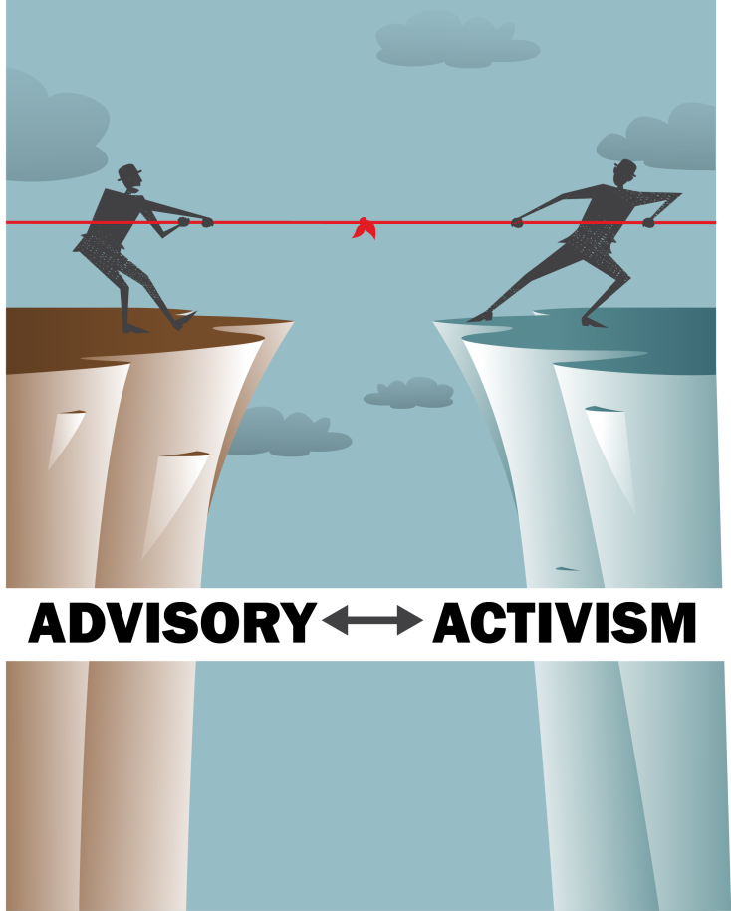
Advise/Advocate vs. Activism
The “A” in CAB stands for advisory.
CAB members may be advocates for their communities, their CAB, and study participants. However, the site PI is ultimately responsible for the conduct of the study and for the study participants’ wellbeing.
Activism, which can easily become confrontational, is not the goal.
Notes:
It’s also helpful to remember the broad goals of a CAB.
Remember that the A stands for Advisory. The CAB’s primary responsibility is to be in dialogue with the researchers, sharing information and providing feedback. As advisors, it’s important to remember that the final decision-making authority rests with the site’s PI; he or she may not be able to act on the CAB’s advice for a range of reasons.
CAB members may advocate on behalf of the needs of the communities from which trial participants will be recruited, or advocating for the needs of trial participants themselves.
It is important to remember that being activists, which can become more confrontational, is not really the goal. It is hoped that by building a transparent and open dialogue, confrontation can be avoided.
Groups which receive funding from the US government, such as the HVTN, CANNOT engage in political activism like lobbying members of Congress about legislation. Individuals may wish to do it on their own, but the CAB as a group cannot engage in this type of activity.

Slide 12
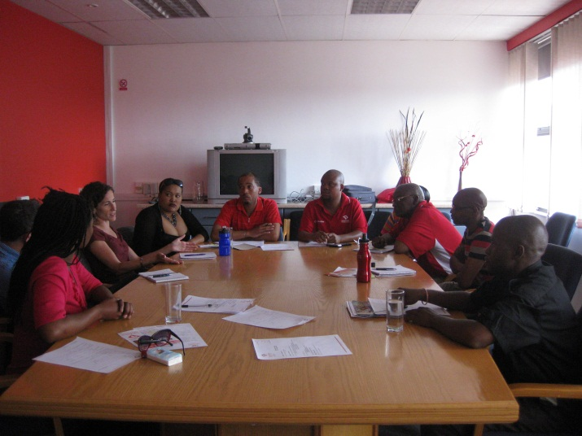
When are CAB members involved?
ALL stages of the research process
  Planning
  Development
  Implementation
  Dissemination of results
Providing input on
  Local relevance and acceptance
  Ethical and scientific quality of research
  Anticipated concerns by study volunteers
Klerksdorp CAB meeting, October 2012
Notes:
And so the HVTN involves CAB members in various stages of the research process; their advice providing the sites and the network valuable insight to help overcome some of the challenges to implementing vaccine research.

Slide 13
How is a CAB structured?
Some CABs:
  Have by-laws and constitutions. Some don’t.
  Have officers with term limits. Some don’t.
  Meet monthly, bi-monthly or quarterly.
  Have subcommittees. Some don’t.
  Provide input to multiple DAIDS networks. Some don’t.
All CABs:
  Have a Global CAB representative who participates on bi-monthly conference calls
  Send a member to the HVTN conferences
Notes:
Each CAB is structured a bit differently. It is up to the site and the CAB leadership to determine the exact structure. For example, [read first bullet list]. However, there are some universal expectations [read second bullet list]
The projects carried out by CABs are equally as diverse as the CAB members themselves. Here are a few examples of CAB developed projects at HVTN’s sites…

Slide 14
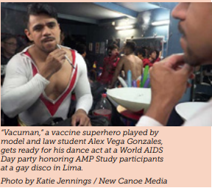
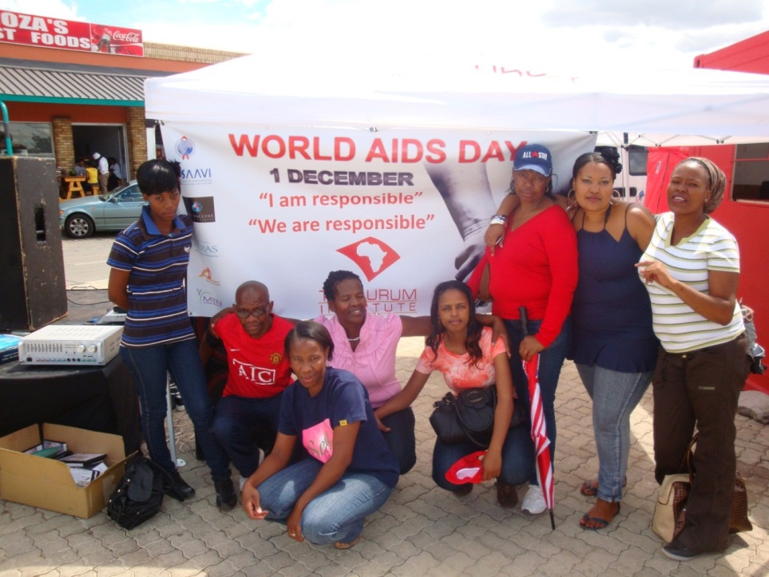
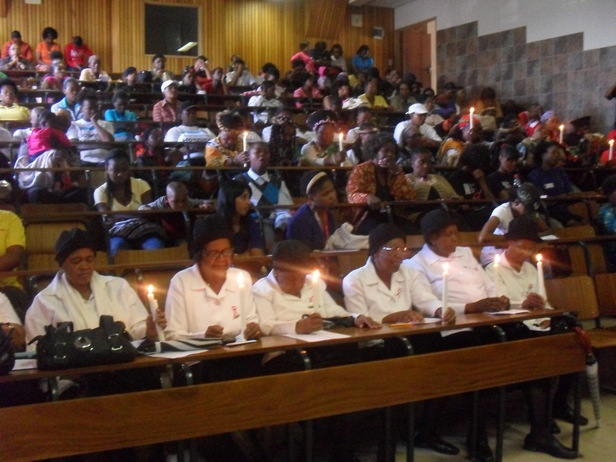
Examples of CAB projects
World AIDS Day- December 1st
Aurum Institute- Klerksdorp
PHRU- Soweto
Notes:
Left 2 photos- retired CAB member Gloria Malindi (on the right, wearing glasses) organized a candlelight vigil with the Anglican Church Mother’s Union in commemoration for those who have been affected by HIV.
On the right- Klerksdorp CAB members helped staff an information table at the site’s World AIDS Day event by engaging in conversations about HIV vaccines with those who passed by.

Slide 15
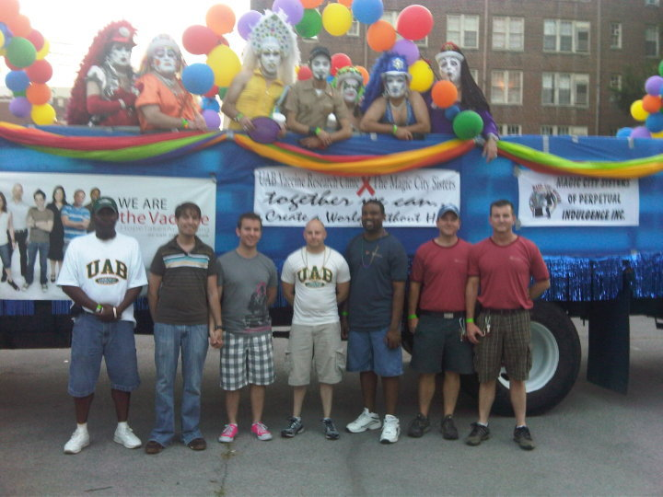
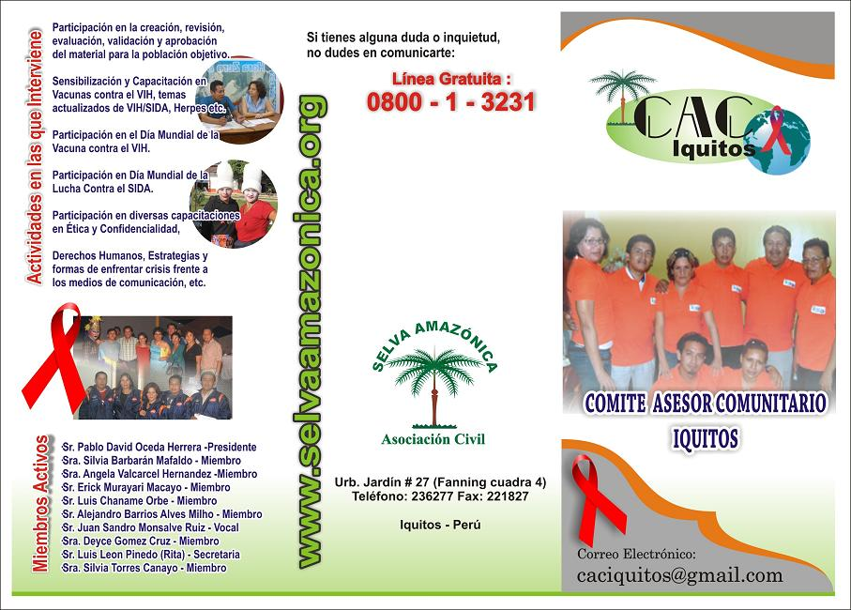
More projects!!
Iquitos, Peru.
This CAB developed its own brochure to share what the CAB does and invite other community members to join.
Birmingham, AL- Gay Pride.
CAB members (with a few site staff) came together to build this float for the Gay Pride Parade, which took first place!
Notes:
The Birmingham CAB helped design and run a parade float; the Iquitos CAB developed its own brochure to help recruit new members.

Slide 16
The Global CAB (GCAB)
2 co-chairs elected to 3-year term
Co-chairs are from 1 U.S. and 1 non-U.S. site
Each site has a representative and gets one vote
Holds bi-monthly conference calls
GCAB representatives have a bidirectional responsibility- liaising between site and network, sharing concerns and info both ways.
Notes:
Each local CAB is connected with the CABs across the network through participation in the Global CAB or GCAB.
The Global CAB is chaired by two CAB members who serve 3 year terms. One chair is selected from a US site, the other is selected from a non-US site. Each selects its GCAB representative through its own nomination or election process. Sites are also allowed to have an alternate GCAB member who participates in calls and on email lists. However, each site is only allowed 1 vote when it comes to GCAB-related elections.
Typically the GCAB holds calls approximately every every two month depending on the needs of the group. Additional regional CAB calls are also organized to address needs and languages.
Most importantly, GCAB members play an essential role as the CAB communication conduit between the HVTN and the local site CAB. The HVTN’s expectation is that information that is passed on to the GCAB is then shared with the rest of the local CAB. Conversely, the HVTN expects that the GCAB representatives are speaking on behalf of the interests and updates of their entire CAB during conference calls and meetings, and not just representing themselves.
Sites may also choose to have a staff person participate on calls to help support the GCAB representative(s).

Slide 17
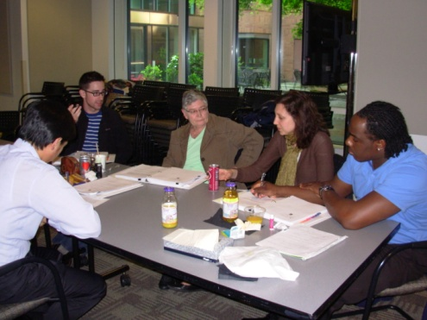
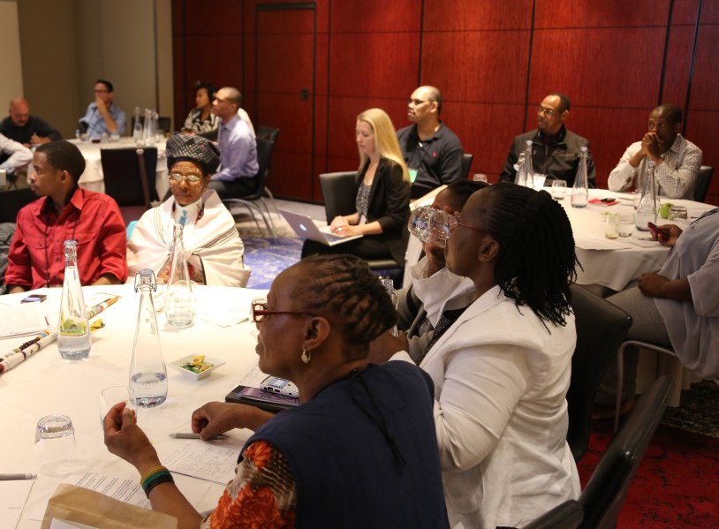
CAB connections to the Network & each other
HVTN Conference- Community Session, October 2013
Regional CAB Retreat,
April 2010
HVTN Conference- Community Session, October 2013
Regional CAB Retreat,
April 2010
LOCAL
COMMUNITIES
LOCAL
CABs
NETWORK
INVOLVEMENT
LOCAL
COMMUNITIES
LOCAL
CABs
NETWORK
INVOLVEMENT
Notes:
Another way CABs stay connected with other sites and the network is through network-organized conferences and workshops. Just as local CABs can serve as the eyes and ears of their local community to the site, they can also do this at a network level. At workshops and conferences CAB members learn and share new information that they are then able to share this information back with their communities.

Slide 18
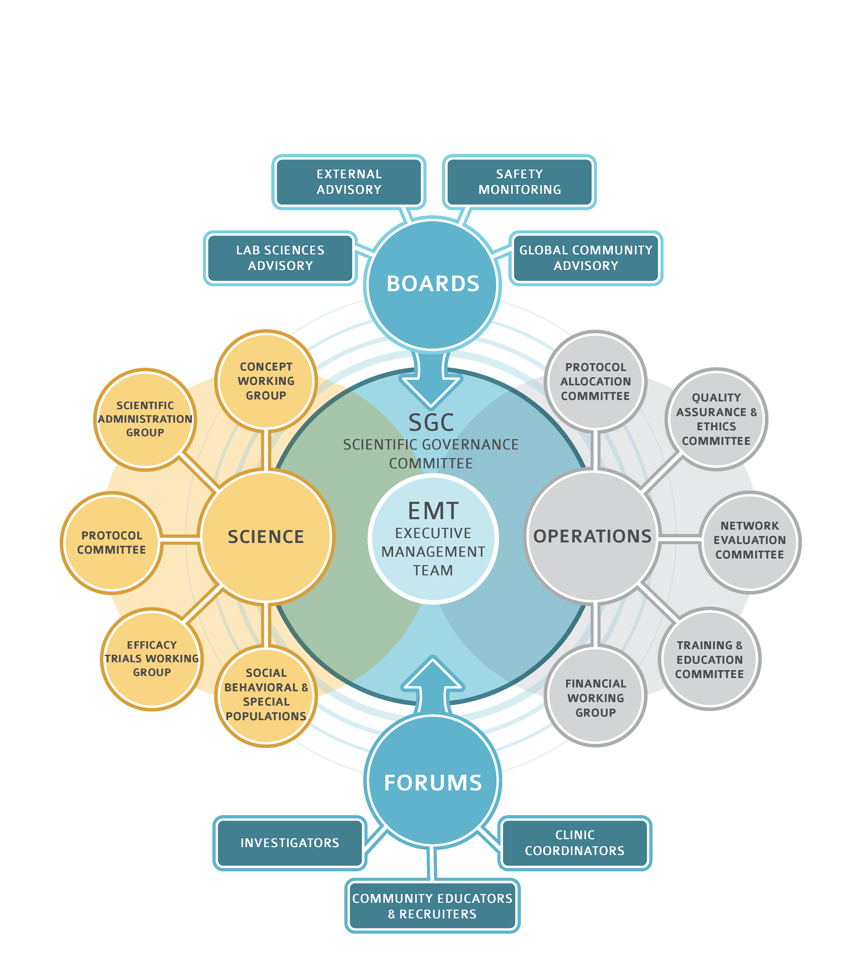

Indicates CAB involvement
HVTN organizational structure
Notes:
The HVTN takes community involvement very seriously. In fact, CAB members are involved throughout the governance of the HVTN. CAB members who serve on these groups have full voting privileges, and are truly expected to provide input and guidance on projects.
This chart shows the primary leadership bodies of the HVTN, the little faces represent all of the committees and working groups that have CAB representation.

Slide 19
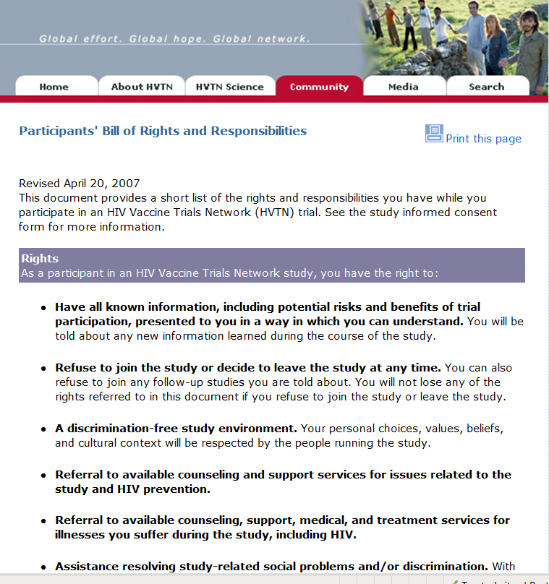
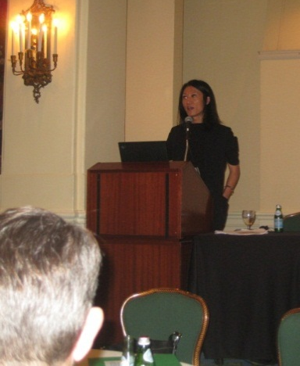
CAB input at a Network level
Participant’s Bill of Rights and Responsibilities (PBORR)
Transgender Working Group
One of several HVTN conference workshops focusing on better understanding how to better welcome and serve transgender participants in HVTN studies
Notes:
And this input makes a huge difference!
It is because of CABs that the HVTN is the only DAIDS Network to have a Participants’ Bill of Rights and Responsibilities.
It is because of CAB members that the HVTN formed the Transgender Working Group, and that transwomen were included as a distinct study population in HVTN 505, the most recent HIV vaccine efficacy trial in the world, making the network a leader in transgender inclusion for the DAIDS clinical trials networks.

Slide 20


CAB input (continued)
Ethical Considerations in Biomedical HIV Prevention Trials- network improvements based on guidance document
How/who to educate and inform about Vaccine-Induced Seropositivity (VISP).
Notes:
The Global CAB spent nearly 2 years assessing the Network’s practices in accordance with the UNAIDS/WHO ethical guidelines for biomedical HIV prevention trials, and because of that the HVTN will begin assessing capacities of local IRBs and developing a training curriculum for obtaining informed consent.
And one area where we are constantly seeking CAB input is how to best inform and educate about VISP. Vaccine-Induced Seropositivity has to do with the vaccines creating antibodies to HIV, in the absence of HIV infection. Since most first-line HIV tests only look for antibodies (and not the actual virus) this can cause some confusion and stress for study participants needing testing. From a research perspective, getting the wrong testing can lead to study unblinding, which can compromise study participation and data. Having CAB members understand this concept, and helping to develop strategizes to inform key stakeholders and develop site-specific materials, is essential.

Slide 21
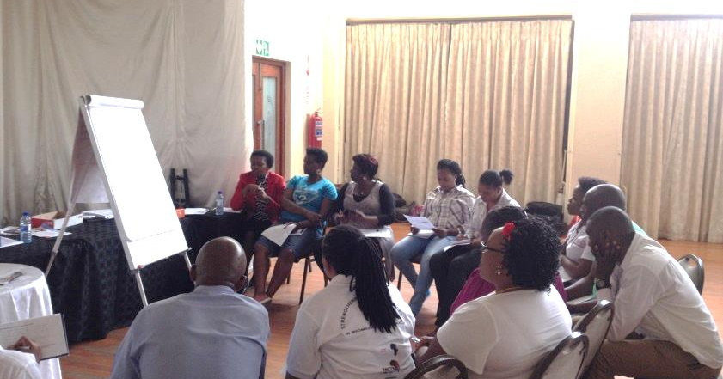
Staff support for CABs

Slide 22
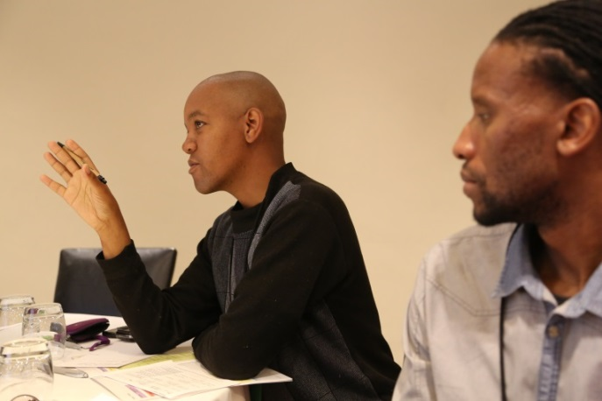
Role of the CAB liaison
Provide direct support to CAB members
Be a resource so CAB members can access technical expertise
Coordinate orientations and trainings for CAB members
Serve as a point of contact for both CAB and staff, channeling communications and questions as appropriate
Seek CAB input regarding materials and work plans and any planned events
Community liaison staff from the Aurum site in Klerksdorp (left), and the University of Cape Town site in Nyanga/Crossroads (right). Both work to facilitate CAB participation at their sites.
Notes:
Each site is expected to designate a staff member who is the liaison to the CAB, but the title for this person varies. Most sites use a member of the Community Education/Outreach staff, but this is not required. This staff liaison helps coordinate the details for CAB meetings such as scheduling the meeting, finding the meeting space, preparing any materials that will be used, and arranging for any refreshments that will be served. The liaison does not have to be a person who knows the answer to every question that is asked, but they are responsible for taking the questions back to the site staff to find the answers, and communicating them back to the CAB members, as well as keeping the HVTN informed about CAB activities and network-related concerns.

Slide 23
Role of the clinic staff
Serve as a resource for information regarding ongoing and planned studies, including new procedures
Translate science into lay language
Seek community input on clinic activities, such as the informed consent process
Seek community input regarding understandable language, local dialects/slang, and cultural sensitivity

Slide 24
Role of the Investigator of Principal Investigator
Build trust and share information with communities
Be willing to LISTEN
Hire staff from key communities
Translate science into lay language
Work with community media
Trust that community can contribute and add value
See community input on proposed research or grant applications, plans for results dissemination and sharing of new information
Provide meeting space and appropriate resources so that CAB members convene comfortably
Notes:
Ultimately, the PI is responsible for the research conducted at his/her site, and the PI will be held accountable for that research. The PI may not be able to act on the CAB’s advice all the time, or may only be able to act on part of what has been suggested. In the interest of building a respectful, transparent relationship, it is advisable for the PI to have an honest discussion about the reason(s) why any of the CAB’s advice could not be implemented. This helps the CAB learn about any boundaries/barriers that might exist and any limitations of funding or scope of work.

Slide 25
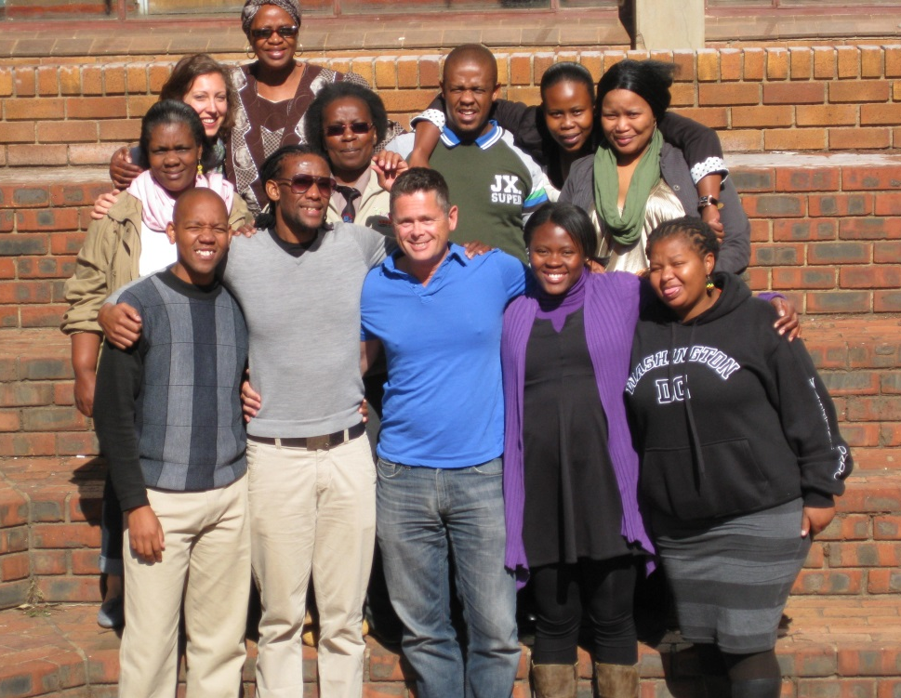
Conclusion
CABs play an important role in community engagement.
Without community engagement we would not have participants.
Without participants we will not be able to find a safe and effective vaccine
Notes:
Community involvement has had a direct impact on how we conduct trials, how we inform, engage and retain participants. It ensures that our research questions are of value to the public, and it helps build community buy-in for a future licensed vaccine.
At the end of the day, research is about people and communities. Research doesn’t just happen in a community, it happens with a community. And with the help of our sites and dedicated CAB members, we will find an effective HIV vaccine.

Slide 26


Science + Community = better research

Slide 27
THANK YOU

