Slide 1
Media Matters: Media and Interviewing Tips

Slide 2
Overview
Today we will learn about:
The role of the site in working with the media
The role of the CAB in working with the media
The role and needs of the media
How to prepare for and ace an interview
Notes:
Today we are going to focus on these key topics.
First we will discuss the role that the staff at the clinical research site perform with relation to the media.
Next, we’ll talk about the role a CAB member can play in media relations.
The next task will be to discuss the media—who they are, what myths we often have about them, and what they need in order to do their best work.
Finally, we’ll offer some tips on how to handle an interview so that can help you generate accurate, favorable coverage on the topic of HIV vaccine research.

Slide 3
Media - Who? What?
Global Social Networks ranked by number of monthly active users (January 2022)
Facebook | 2,910,000,000
YouTube | 2,562,000,000
Instagram | 1,478,000,000
TikTok | 1,000,000,000
Twitter | 436,000,000
Print
TV
Radio
Online
Social Media
https://www.statista.com/statistics/272014/global-social-networks-ranked-by-number-of-users/
Notes:
Before we talk more about working with the media, let’s spend a minute talking about all the different types of media that exist today.
In its basic sense, media, according to the Google definition, refers to “the main means of mass communication (esp. television, radio, newspapers, and the Internet) regarded collectively. Synonyms [include]: the press, the fourth estate, the news, the papers.”
For our purposes today, we are talking about anyone who writes or takes photographs for newspapers, magazines, or blogs and other websites and social media, plus reporters for radio or television, and the producers and editors who work back at the offices of these stations or papers or websites. This means that there are more places than ever where information about HIV vaccine research can appear—and more and more places we need to monitor.

Slide 4
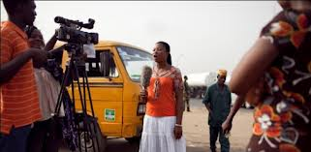
Why work with your local media?
They can help you get the message out about the need for an HIV vaccine.
They can address myths and concerns.
They can make your job more difficult if they get the story wrong and spread myths or misinformation.
Notes:
[read slide]

Slide 5
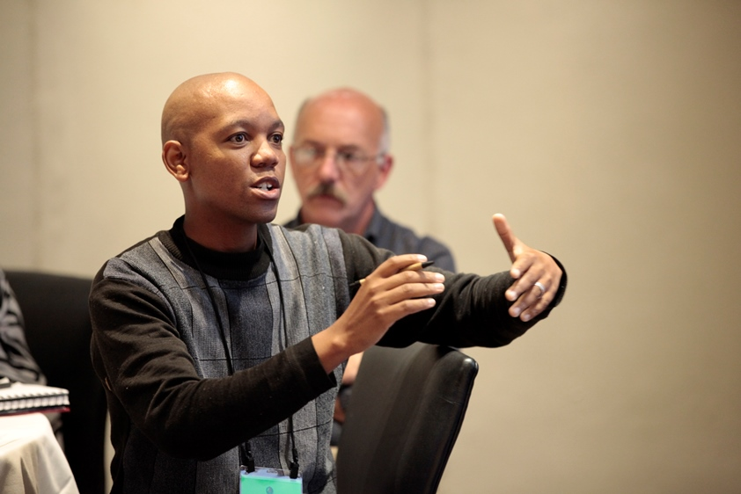
The site’s role with media
Seek opportunities to broaden awareness through media outreach
Maintain relationships with local press
Photo: Robert Hood
Deliver news to the media
New studies
Community events
Ask CAB for input on messages
Notes:
[Begin by asking for input on how the group defines the site’s role] After discussion, continue with this text:
One important job that the site staff has is to maintain good relationships with the local press. This means that they need to know the names of the reporters at each of the local newspapers, radio stations and television stations. They need to know who the editors or producers are at those places. Reporters change jobs, so it is important to keep track of who has moved where. Developing relationships takes time—it means helping reporters learn about vaccine science, understand the research process, and educating them about common myths and misperceptions. By taking the time to give reporters this background, it means that when there is a real “news” story, the journalists are knowledgeable to prepare a good story—one that is accurate, factual, and avoids sensationalism.
The site delivers news to the media. This involves writing and distributing press releases and then following up with reporters to see if they will write a story. This press release could be announcing a new trial that is starting at your site, announcing a community event, or encouraging reporters to cover an event. It could also be announcing some study results.
Another way that the site prepares for media interaction is to be prepared to answer questions on a topic that we would prefer not be in the news. By this, I mean that when there is a possibility of negative news, the site must be ready to answer hard questions—even though they will not be seeking out press coverage. This could happen if a study is stopped after a severe adverse event, or if a site is being closed. In cases like that, the site would not be actively encouraging the press to cover the story, but the site must be ready to talk to the press if they call.
Finally, one very important role of the site with regard to media relations is to seek input from their Community Advisory Board on the messages that they will deliver through the media. It’s very helpful to have the CAB review messages before they are used and to provide the community’s perspective on those messages.

Slide 6
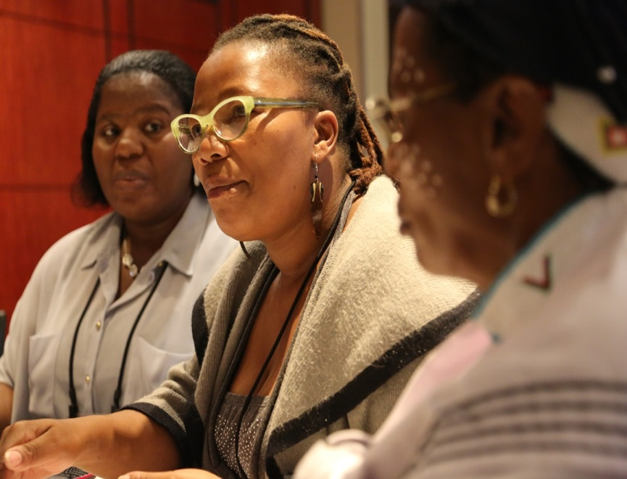
CAB roles with the media
Photo: Robert Hood
Represent the community's interests concerning possible issues that could get media attention so that the site spokesperson can be prepared to address them.
Share with the community what is being said in the news
Notes:
Okay, if those are the areas where the site is responsible, where is the CAB responsible? What is their role?
Most importantly, the CAB serves as eyes and ears in the community. If a CAB members hears myths being perpetuated within a particular community group, that information should be shared with the site staff. This allows the site to plan a way to address those myths in the community, and to be prepared to answer questions from any journalists who start to work on a story as a result of the myths that are circulating in the community.
Also, the site just isn’t able to review every paper or hear every radio story that airs. If CAB members hear a story about HIV vaccines, or vaccine research or research in general, let your site know. It’s important for the site to be aware of what’s being said in the media.
Finally, CAB members should not serve as spokespeople for the site. If a CAB member is ever asked to speak with the media regarding the site’s work, he or she should reply that they are not a spokesperson for the site, and redirect the reporter to the Principal Investigator at the site.

Slide 7
The site’s role with media
Seek opportunities to broaden awareness through media outreach
Maintain relationships with local press
Photo: Robert Hood
Deliver news to the media
New studies
Community events
Ask CAB for input on messages
Notes:
[Begin by asking for input on how the group defines the site’s role] After discussion, continue with this text:
One important job that the site staff has is to maintain good relationships with the local press. This means that they need to know the names of the reporters at each of the local newspapers, radio stations and television stations. They need to know who the editors or producers are at those places. Reporters change jobs, so it is important to keep track of who has moved where. Developing relationships takes time—it means helping reporters learn about vaccine science, understand the research process, and educating them about common myths and misperceptions. By taking the time to give reporters this background, it means that when there is a real “news” story, the journalists are knowledgeable to prepare a good story—one that is accurate, factual, and avoids sensationalism.
The site delivers news to the media. This involves writing and distributing press releases and then following up with reporters to see if they will write a story. This press release could be announcing a new trial that is starting at your site, announcing a community event, or encouraging reporters to cover an event. It could also be announcing some study results.
Another way that the site prepares for media interaction is to be prepared to answer questions on a topic that we would prefer not be in the news. By this, I mean that when there is a possibility of negative news, the site must be ready to answer hard questions—even though they will not be seeking out press coverage. This could happen if a study is stopped after a severe adverse event, or if a site is being closed. In cases like that, the site would not be actively encouraging the press to cover the story, but the site must be ready to talk to the press if they call.
Finally, one very important role of the site with regard to media relations is to seek input from their Community Advisory Board on the messages that they will deliver through the media. It’s very helpful to have the CAB review messages before they are used and to provide the community’s perspective on those messages.

Slide 8
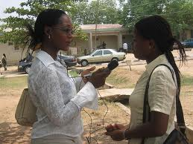
Common media myths
All media are the same
They will write what you tell them, whenever you want
They will misquote you and look for a negative story
They know and understand the topic
They will take your word on a subject
Notes:
Let’s shift our focus now and talk a little about the media. Here are some of the things that people often think are true about the media.
All of these statements listed here are myths. Maybe a better way to describe them is to say that none of these statements is true for all people in the media at all times. If you have a lot of press interaction, you will likely be misquoted at some point. But, you’ll also be quoted accurately most of the time. You’ll talk to some journalists who are well-prepared and knowledgeable, and you’ll talk to some who have never written a story on a scientific or health topic before. Many people believe that your ability to get coverage is tied to how much you spend on advertising. This is rarely the case. When it is the case, the publication is really more of an advertising vehicle than a true news source.

Slide 9
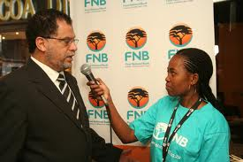
Remember that reporters are…
Competitive
Print, broadcast, online
Looking for something “new and newsworthy”
Time-Oriented
On multiple assignments
On deadlines
Transitory
Frequent staff turnover
Change posts/beats
People
Always remember “reporters are people too!”
Notes:
But there are some things that can be said that describe most reporters.
They are competitive. They compete with other reporters at their publication, and reporters at other publications. If they work for newspapers, they compete with television and radio journalists. They want to write something that is different, better than anything that anyone else is writing about the topic.
They are often in a rush. It’s very rare for a journalist to have just one assignment, and whenever you hear from them, they always seems to be getting one last quote before the story is turned in. You will talk to journalists who are early in the development of a story, but while they are working on your story, they are approaching deadline on some other story, and that means they may be distracted and pressured.
Reporters move around a lot. They move from small papers to bigger papers, from papers to magazines, from media journalist to corporate public relations positions. They are reporting on health topics today and politics tomorrow. The result of all of this movement is that you need to be aware of how knowledgeable the reporter is about the topic when you are talking to them.
Finally, always keep in mind that every reporter is human. Treat them with respect, and over time, you’ll reap the benefits. And remember, they are doing their job, even if they don’t write exactly what you wanted.

Slide 10
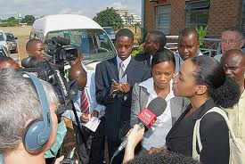
Reporters need ...
The scoop
Direct, honest answers to questions
The broader context
Statistics
Quotable sound bites
New information
Human examples
Notes:
You can help reporters do a better job of covering your story if you keep in mind what they need to do a good job.
Remember how competitive I said reporters were? That means they want a scoop. You will be asked if they can have an exclusive—a scoop. You really can’t give them a scoop, but they may find a scoop.
You can help improve their stories by providing many of the items listed here. Part of your work in preparing for a press interview is to develop some of these items in advance to give to the reporter.

Slide 11
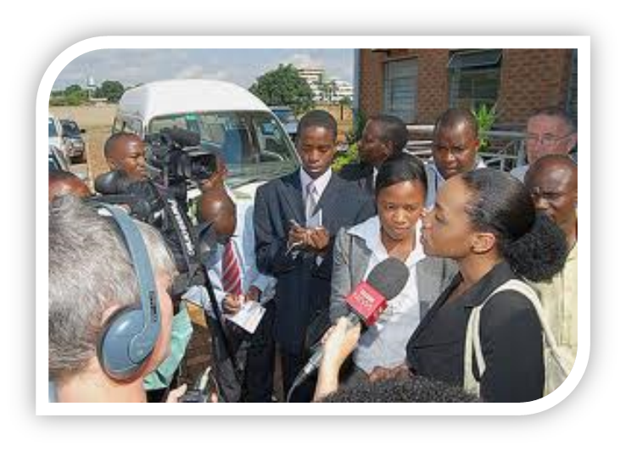
Working with local media
Remember:
Reporters are real people too and may be members of your community.
They can be great allies and help get the word out, but they need your help to provide the background and good education on the topic.
We are on their deadlines, they are not on ours!
Notes:
Now, if you go through media training, this won’t guarantee that you will always get great coverage in every publication whenever you want it. But you do increase the chances. And remember [read slide]

Slide 12
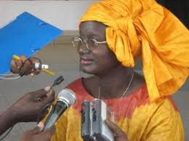
Know your “pitch”
Short and to the point: could be delivered within a brief elevator ride, or while waiting for a bus that’s up the road
Snappy, clear answer to: “Why is HIV vaccine research important?”
gives a sense of mission, says why this is newsworthy
Notes:
It’s important to get your key message down to a brief, focused answer. This is a one or two sentence statement that you use to open a discussion with a journalist, or to explain the role of CAB members when you are talking to a group, or even explaining to a family member or friend.
This is a statement that frames the importance of the topic—the sense of mission.
For example:
We need an HIV vaccine because every year nearly 2.5 million people become infected, with sub- Saharan Africa accounting for nearly 70% of all people living with HIV [source: UNAIDS website].
Vaccines have been key to ending all previous infectious disease epidemics, and HIV is no different.

Slide 13
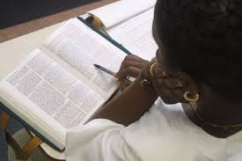
Before the interview: PREPARE!
Understand the audience
Review recent stories by the reporter
Make sure you know the content inside and out – prepare and share briefing materials
Make sure your messages support your goals
Prepare/rehearse in front of a video camera or with other people
Control the set-up and dynamics of the room
Be prepared for surprises
Notes:
If you are going to be a spokesperson, take the time to prepare for the interaction.
Get a copy of the newspaper and look at other stories this reporter has done. If you have internet access, use Google and enter the writer’s name—and read what you find. How does the reporter present issues—do they try to find controversy in every topic they cover? Is the reporting fair and balanced? Know what to expect.
Spend time reviewing your key messages. If you need to have a couple of index cards with key statistics or data, that’s fine. Practice, practice, practice. If you will be on camera for the interview, practice in front of a video camera. Practice with a friend or colleague. Ask the CAB to practice with you and give you some unexpected questions, so that you practice thinking quickly and giving a clear answer.
You don’t have to just accept the situation as it is presented. If it’s an on-camera interview and the lights are too bright, ask them to change them. If they give you a swivel chair, ask for a different one. Ask for a glass of water if you want one. You can ask for changes.

Slide 14
Preparing a CAB member or study participant
Remind CAB members and participants about maintaining confidentiality and that they can decline to answer questions that make them uncomfortable.
Help the person think through potential risks of being interviewed. What might happen if they announce that they are in a study?
Notes:
For CAB members, remind them:
They are presenting their own perspective, and not that of paid staff
They must maintain participant confidentiality (don’t refer by name to other study participants)
They have signed a confidentiality agreement, so even if the site has shared unpublished study data with the CAB, that the information is not to be shared publically.
They don’t have to answer any questions they don’t feel comfortable answering.
For current or former study participants, it is important to go through a miniature “informed consent” process before the participant agrees to be interviewed. In the HVTN’s experience, the greatest number of social impact concerns occur when people find out about someone’s trial participation. The participant should carefully consider what the impact would be if they “announce” their trial participation to others. For example:
Are there family members or others who would be upset by this news?
Might it cause a problem if their employer found out they are participating in a trial?
What might happen if someone who sees the interview mistakenly thinks they are HIV-infected?
After considering these potential risks, if the participant decides to give the interview, it can be helpful to review with them some of the key messages that we always try to convey about vaccine studies. If they have the opportunity to include these messages in their answers during the interview, it can help to reinforce the information and break down common myths. These key messages could include:
Safety of study participants is of the utmost importance.
Only people who are HIV-negative participate in preventive HIV vaccine studies, because we hope that one day a vaccine will keep people from becoming infected.
There is no vaccine against HIV yet, and it is only through these research studies that one can be found.
Some sites feel that the potential risks of being interviewed are too great for current participants, and will only agree to having a former participant be interviewed. This can help to underscore that the participant continues to be healthy and did not experience serious safety concerns because of being in a study.

Slide 15
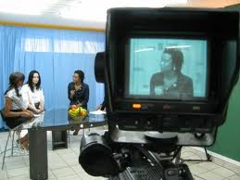
Controlling the interview
Ask the reporter to provide the questions in advance so you can prepare
Set the interview agenda
Pause and think
Request clarification
Focus on key messages
Notes:
You have a lot of power in an interview, if you choose to use it.
If there are topics that you won’t answer, let the reporter know upfront. Be polite about it, but be firm. “If you are planning to talk about XXX, I’m not knowledgeable on that, so I won’t be able to answer your questions.” And if the reporter still asks questions on that topic, just sit quietly, or repeat “That’s a topic I really don’t know enough about to comment, sorry.”
If you are asked a complicated or difficult question, feel free to pause and think about your response before you start talking. If this is for radio or TV, they will edit out the quiet (they call it “dead space”).
If the question is confusing, ask the reporter to repeat it. Tell her/him you don’t understand. Ask for clarification.
And through it all, remember the key messages that you want to deliver, and be sure you repeat them often.

Slide 16
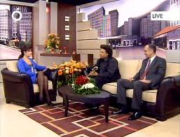
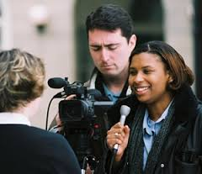
Use every opportunity to tell a story
Reporter:
“Do you have anything else you’d like to add?”
Answer:
“The three most important things I’d like to emphasize are…”
Close out the interview with what you would like the reporter to remember.
Notes:
Remember to use every opportunity that a journalist gives you to repeat your key messages. Lots of time the last thing a journalist will say is “Is there anything else you’d like to add?”
All too often, people respond: “No, I think that’s it.” Don’t miss your last opportunity to focus the reporter on your three key points!

Slide 17
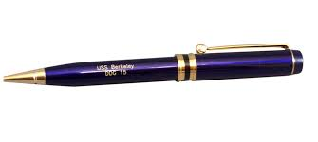
Follow up
Make notes during the interview and make sure you follow up on any promises
“I’ll get you those statistics…”
“You should talk to…”
Send a thank you to the reporter after the story appears
Notes:
During an interview, there are likely to be things that have been talked about that need some follow up, whether it’s a statistic that you couldn’t recall exactly, or materials you said you would provide. While you are being interviewed, make notes of these promises, and then be sure that you fulfill them. One great idea is to have someone else with you off-camera or in the background to take notes and help you follow up to evaluate the interview, helping you consider what you answered well and where you could improve the next time.
Finally, it can be really useful to follow any story or interview with a thank you. This can be written, an email or a phone call. But let the journalist know that you appreciate his or her work in raising awareness of vaccine research in the community.

Slide 18
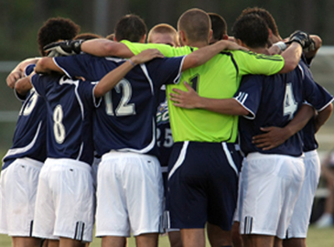
Rules to remember
Plan ahead
Know the media
You are the authority
You are in control
Always stay on message
Listen actively
Deliver all key messages
Follow up on commitments
Notes:
So, in summary, here are the key things I hope you will remember if you are going to be a spokesperson about HIV vaccine research. You will be most effective if you take the time to prepare for this press interaction, if you maintain control during the interview, remember and use your key messages, and finally, follow up on your commitments.

Slide 19
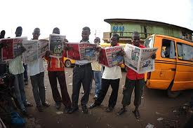
Questions?

Slide 20
THANK YOU

