Slide 1
An Introduction to HIV Vaccines

Slide 2
The impact of HIV
1.5 million people became newly infected with HIV in 2020
Over 79.3 million have become infected since the start of the epidemic
Over 37.7 million people are living with HIV around the world
About 36.3 million people died from AIDS-related causes (worldwide) since the start of the epidemic
Notes:
The ever-growing statistics on HIV infection and AIDS point to the need for a preventive HIV vaccine to be a part of a comprehensive strategy to control the spread of AIDS. In addition to known methods of prevention, HIV vaccine research is crucial in the fight against HIV/AIDS. Consider these alarming infection rates… (READ stats on slide).
Advances in treating HIV and AIDS have resulted in the number of infections and deaths going down over the years, but this can also create a false impression that “AIDS is over” and that prevention is no longer critical. This false impression is partly to blame for the continued rates of infection around the world.
In fact, the top health and science experts agree that safe and effective vaccines are the best hope for controlling the AIDS pandemic.

Slide 3
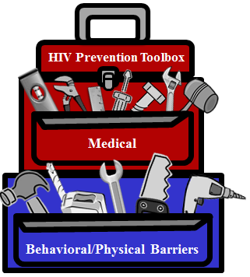
Approaches to HIV prevention
Vaccines**
Medical Male Circumcision
Post-Exposure Prophylaxis (PEP)
Pre-Exposure Prophylaxis (PrEP)
[delivered as pills, long-acting shots, vaginal rings]
Treatment as Prevention (TasP)
HIV Prevention Toolbox
Microbicides**
Diagnosis and Treatment of
Sexually Transmitted Infections (STIs)**
Interruption of
Perinatal Transmission
Medical
Harm Reduction
Education and Negotiation of Safer Behaviors
Clean Syringes (Needle Exchange Programs)
Treatment and Prevention of Drug/Alcohol Abuse
Condoms and Other Barrier Methods
**These methods are still being researched
Notes:
So what prevention options do we have? It is important to think of a vaccine as another tool in the prevention toolbox. Even when a HIV vaccine is found, these other prevention strategies will continue to be important. For example, even if you get a vaccine against HIV, condoms will still help you to avoid syphilis, gonorrhea, and chlamydia!

Slide 4
The HIV prevention spectrum
PRIOR TO EXPOSURE
POINT OF TRANSMISSION
TREATMENT
Education & behavior change
Needle exchange
Adult male circumcision
Syringe services programs
Treat other STIs
Preventive HIV/AIDS vaccines
Pre-exposure prophylaxis (PrEP)
Internal and external condoms
Use of clean needles
Anti-retroviral therapy (mother-to-child)
Microbicides (anal & vaginal)
Post-exposure prophylaxis (PEP)
Anti-retroviral therapy
Care
Education & behavioral change
Treatment as prevention
Therapeutic HIV/AIDS vaccines
Items in red still being researched
Notes:
[Items in black are available; items in red are being researched. The timeline shows the point at which each strategy can be employed.
***Note – Truvada approved for use as PrEP July 2012.]

Slide 5
Preventive vaccines
Used for decades around the world, most commonly in children
Very safe when manufactured and used properly
Very cost-effective compared to treatment
16 diseases prevented with childhood vaccinations in the US and developed world
Eliminated smallpox worldwide, soon polio
Notes:
[Read slide]
(It is important to stress the safety and cost-effectiveness of vaccines. One recent example that people may recall: in 2005, Chiron pulled its flu vaccine off the market because they detected a problem during manufacture and could not ensure the safety of the vaccine. This circumstance demonstrated that our systems for assessing safety are in place and working effectively.)

Slide 6
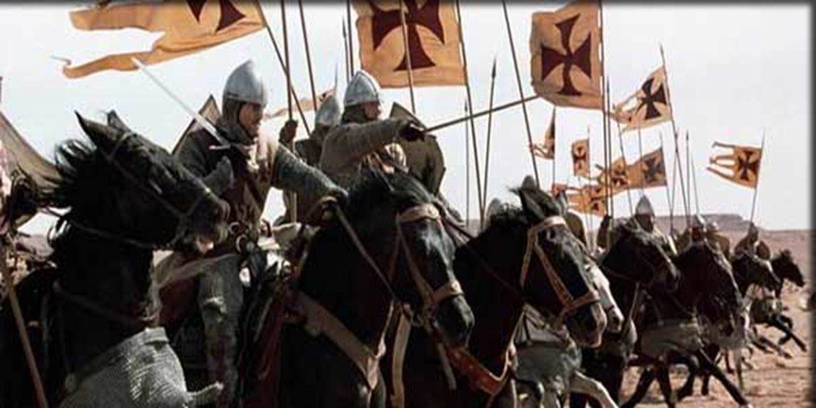
How does a vaccine work?
By teaching the body to recognize and fight invaders
Notes:
[This graphic is one example from Haiti to explain how vaccines work – they look like the real thing, just like someone wearing a mask. Other examples are a scarecrow – looks like a person but not really, or a photocopy – looks like the real thing, but not really.]

Slide 7
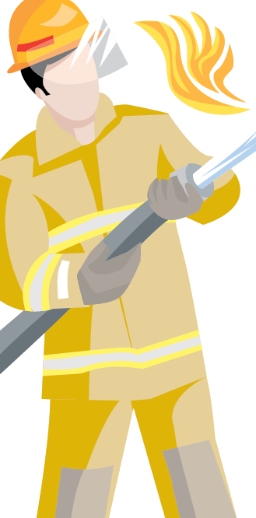
How does a vaccine work?
By teaching the body to recognize and fight invaders
Body Recognizes
HIV Virus
Body –
Sounds Alarm
Fighter Cells
Go Into Action
GOAL – HIV is
Controlled or killed
Notes:
[This example seems to work well with global audiences of any age.]
Vaccines work by teaching the body to recognize any invaders, including HIV, which sounds an “alarm” in the body calling the fighter cells into action, and ultimately helps the body to prevent or control an infection.

Slide 8
VACCINES EXPLAINED

Slide 9
Vaccines explained
A vaccine can be preventive, therapeutic, or both
Preventive HIV vaccines for HIV-negative populations are being developed to control the spread of HIV (they are not a cure for AIDS)
Researchers are also evaluating therapeutic vaccines to treat people who are living with HIV/AIDS
Notes:
An HIV vaccine can be:
Preventive, therapeutic, or a combination of preventive and therapeutic.
While the same vaccine may be tested for both preventive and therapeutic effects, what works to prevent HIV infection may not necessarily work to treat people who are already infected with HIV. The reverse is also true: therapeutic HIV vaccines are also in development, and may not block HIV in uninfected people.
[An example of a therapeutic vaccine is a new one for men who have prostate cancer called “Provenge.” If a man with prostate cancer takes this vaccine, it can extend his life by about 4 months (compared to men who don’t take it).
There are other vaccines that are used after someone gets exposed like the rabies or tetanus vaccine, but these are still preventive because they work by stopping (or preventing) your body from becoming infected.

Slide 10
Vaccine research in perspective
VACCINE | DISCOVERY OF CAUSE | VACCINE DEVELOPED FOR HUMAN USE | YEARS TO VACCINE
H. Influenzae-B | 1892 | 1985 | 93
Herpes (HSV-1) | 1919 | Not available | >100
Pertussis | 1906 | 1926 | 20
Polio | 1909 | 1954 | 45
Yellow fever | 1900 | 1935 | 35
Influenza | 1933 | 1945 | 12
Measles | 1911 | 1957 | 46
Hepatitis A | 1973 | 1995 | 22
Hepatitis B | 1967 | 1984 | 17
HPV | 1974 | 2007 | 33
HIV | 1983 | Not available | >40
Notes:
[The idea behind this slide is to point out just how long it can take to develop a vaccine, even after we know what the cause of a disease is. While the time is especially frustrating with HIV, the time frame is not too far off compared with other diseases. There are no vaccines for any other retroviruses like HIV which are especially complicated even though the science of vaccines gets better and better.]

Slide 11
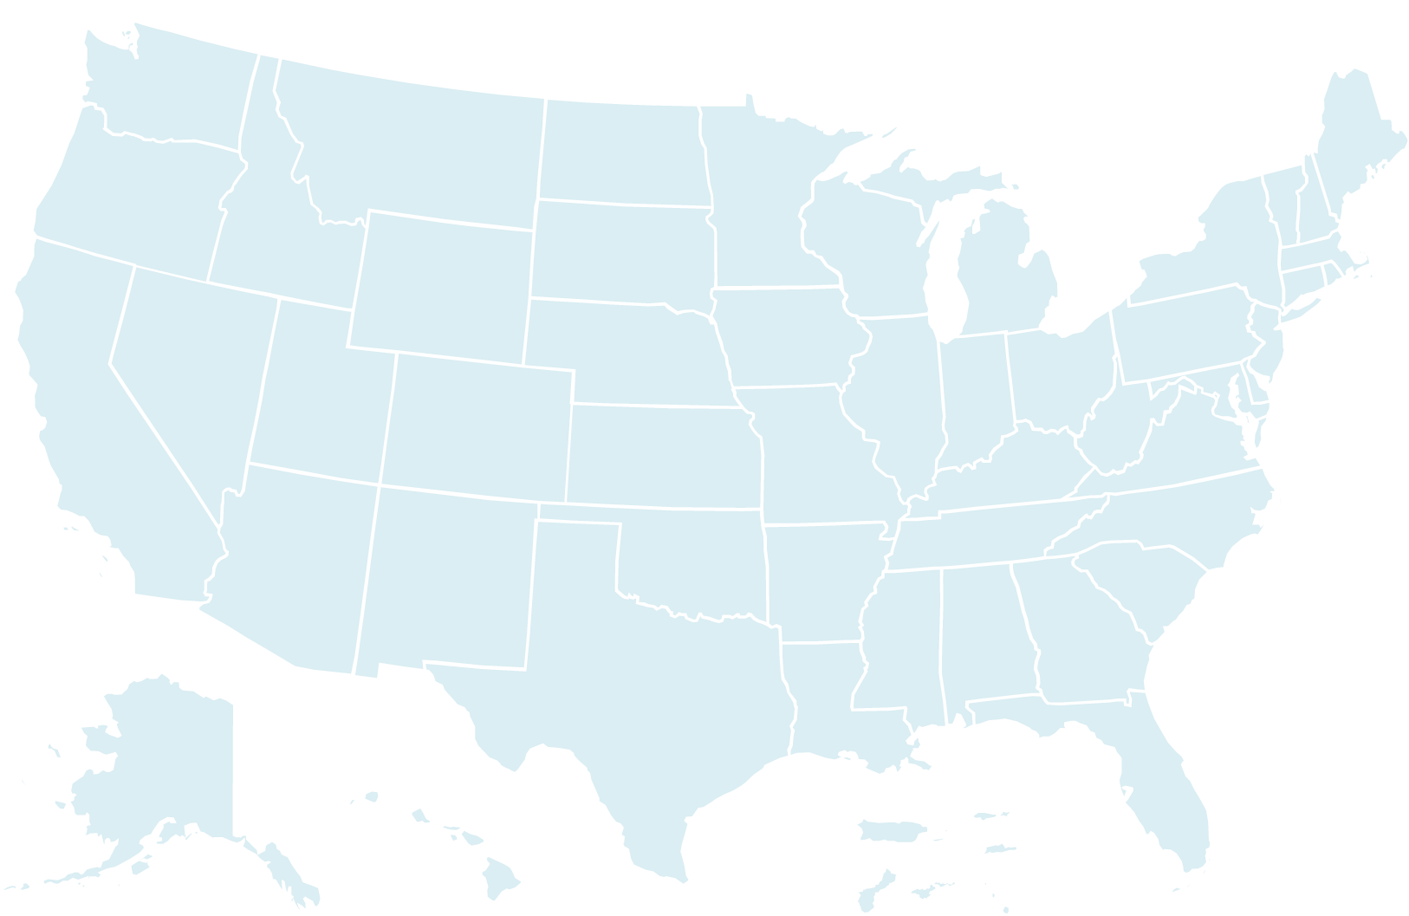
The impact of vaccines in the United States
DISEASE | BASELINE 20TH CENTURY PRE-VACCINE ANNUAL CASES | 2008 CASES* | PERCENT DECREASE
Measles | 503,282 | 140 | 99.9%
Diphtheria | 175,885 | 0 | 100.0%
Mumps | 152,209 | 454 | 99.7%
Pertussis | 147,271 | 10,735 | 92.7%
Smallpox | 48,164 | 0 | 100.0%
Rubella | 47,745 | 16 | 99.9%
Haemophilus influenzae type b, invasive <5 yrs.) | 20,000 | 30 | 99.9%
Polio, paralytic | 16,316 | 0 | 100%
Tetanus | 1,314 | 19 | 98.6%
*Provisional
Source: MMWR 4/2/99, 12/25/09, 3/12/2010
Notes:
And while it may take time, once we have them, vaccines have significantly reduced or eliminated a number of deadly infectious diseases. This data is just a snapshot in time from the US, and similar data exists for countries around the world. We hope one day to be able to add an HIV vaccine to this list.

Slide 12
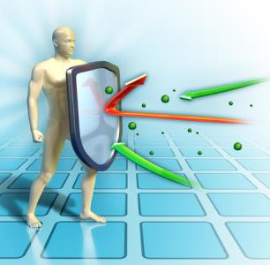
HIV vaccines are more challenging
Natural protective immunity to HIV is rare.
We must do better than Mother Nature to induce the immune system to create protective immunity.
This immunity needs to be a rapid response and in all the right locations, at all the right times.
Notes:
There are some people who can trace their ancestry from Western Europe (primarily England/Ireland/Wales) who have a mutation in their CCR5 receptors (a type of cell in your body). Mutations are part of human evolution over time, and this particular mutation offers a benefit. CCR5 is one of the pieces that HIV needs to attach onto a cell in order to infect it, and without this receptor, these individuals don’t become infected with strains of HIV that bind to this particular receptor.
There is no human example of someone clearing (or becoming cured of) an HIV infection naturally, the way we can with a cold or the flu. The closest example we have are the “long term non- progressors,” also known as “elite controllers.” They are still infected but are able to control their infection and maintain a low viral load naturally, without needing to take anti-retroviral treatment. Because Mother Nature didn’t give us a natural ability to fight back against HIV, we need a vaccine to help us build up immunity.
The immune response we need must work for mucosal exposures (in the vaginal tract, mouth, and rectum), infant exposures via breast feeding or through the birth process, and, ideally in the blood for those who are infected through IV drug use.

Slide 13
Does a licensed HIV vaccine exist?
NO!!!
Research is being conducted today to find a safe and effective vaccine!
Notes:
[The myth that a vaccine already exists but is being withheld is a fairly widespread myth. It is commonly encountered among groups that have a history of being mistreated in past research. When speaking about this, it is sometimes effective to point out that the scientist who develops a vaccine is likely to become a “science superhero”, win the Nobel prize, etc. – not many people would be willing to keep this discovery a secret!]

Slide 14
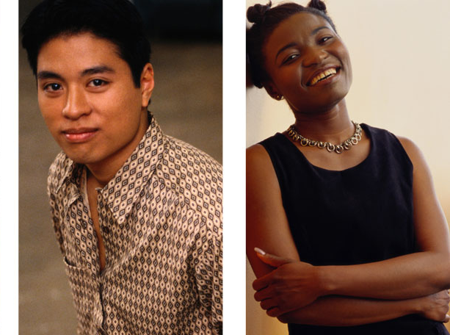
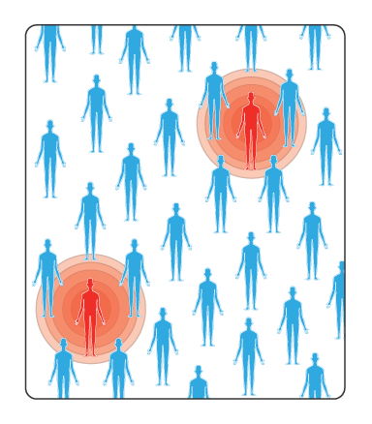
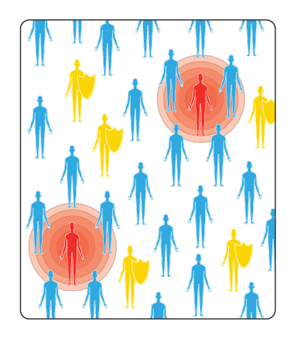
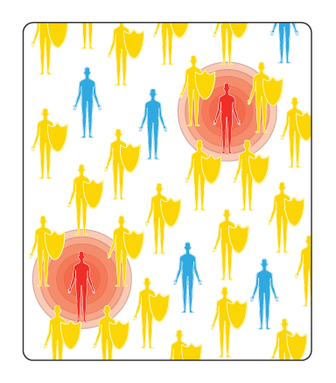
What might a preventive HIV Vaccine Do?
Benefits for the person who gets the vaccine:
Prevent infection
Prevent disease
Delay disease progression
Benefits for the entire community:
Prevent further transmission
Create “Population immunity”
None of the Population is Vaccinated
Some of the Population
is Vaccinated
Most of the Population
is Vaccinated
Notes:
What might a Preventive HIV Vaccine Do?
There are several possible ways that scientists believe a preventive vaccine could work. As we know, prevention is more cost effective than treatment, and any of these outcomes could help to reduce the number of infections, thereby reducing the costs of treatment.
We don’t know how an HIV vaccine will ultimately work, but we think these are the possible options: it might prevent you from ever getting infected; or, perhaps you could still get infected but you would be able to fight back and recover from that infection without it progressing to AIDS; or, perhaps you could still get infected, but the vaccine would help you control the infection and slow it down, so you could stay healthier longer; or perhaps it might not benefit the individual who gets vaccinated but instead could prevent that person from giving HIV to someone else.
Even when an HIV vaccine is developed, education and other prevention efforts will be needed so that people continue to practice safe behaviors.
The goal is to develop a vaccine that is highly effective and protects against infection. However, even if a vaccine protects only some people, it could have a major impact on controlling the epidemic. A partially effective vaccine could decrease the number of people who get infected with HIV; those people, in turn, would not pass the virus on to others.
Population immunity: this is the idea that if only some people get vaccinated, but those people are less likely to transmit HIV to others, then the wider community will have some protection as a result. It may not be necessary to vaccinate everyone, and the larger public might still benefit.

Slide 15
STAGES OF VACCINE DEVELOPMENT

Slide 16
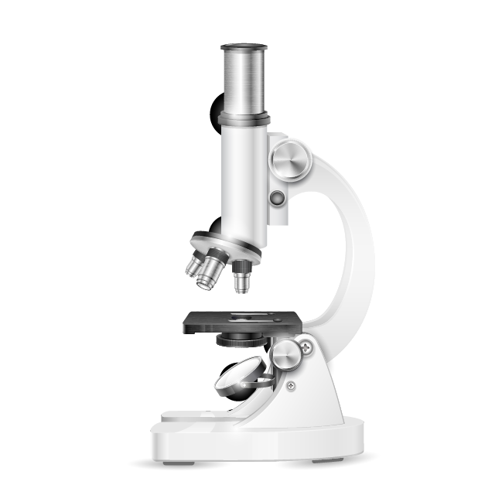
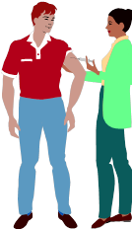
Stages of vaccine development
Notes:
The development process begins with ideas and advances to laboratory work, followed by studies in animals. Ultimately, since HIV is a human disease, research in people must be done to determine if a vaccine is safe and effective.

Slide 17
Ideas
Scientists at universities, research centers, and private companies create ideas for how an HIV vaccine COULD function.
Thousands of scientists worldwide contribute new ideas every year.
Very few ideas pan out, and even fewer progress to the next stage…
Notes:
Read slide.

Slide 18
Labs
The most promising ideas are examined in cell culture, in computer models, and with other tools.
This work takes place in universities, research institutes, and private companies.
Ideas are refined, and an experimental vaccine is developed from the best approaches for use in animals…
Notes:
Read slide.

Slide 19
Animals
A few experimental vaccines developed in labs are tested in animals.
Scientists examine if the vaccine works the way they think it should and if it is safe.
Vaccines are usually tested in mice, rabbits, and non-human primates.
Regional primate research centers, universities, and some private companies are involved in this step.
Notes:
Read slide.
These are the animals most often used – mice, rabbits, and non-human primates (like monkeys).

Slide 20
People
Only vaccines found safe and promising in animal studies move into human testing.
Very few vaccines reach this stage.
Regulated by strict ethical and scientific controls.
Human testing occurs at specialized research centers around the world.
Since animals do not have the same immune system as humans, the only way to prove vaccine effectiveness is to test in people.
Notes:
Read slide.

Slide 21
VACCINE TRIAL PROCESS

Slide 22
Vaccine trial process
GOALS
Does it work to prevent HIV?
Best dose?
Safe?
How much of an immune response?
Safe?
Immune response?
Produce an immune response?
Protect after viral challenge?
PRECLINICAL
PHASE I
PHASE II
PHASE III
ANIMALS
30-50 PEOPLE
200-400 PEOPLE
PARTICIPANTS
3000-5000 PEOPLE
Notes:
HIV vaccines are tested in various stages which take a number of years. Initial laboratory work is followed by animal studies (collectively known as pre-clinical research) and then clinical trials in humans. During clinical trials vaccines are tested in healthy volunteers to see whether they are safe and effective. Usually, there are 3 phases of these trials. Phase I involves approximately 30 to 50 healthy, uninfected participants at low risk of HIV infection, and tests the safety of the preventive vaccine. Phase II involves about 200-400 low and higher risk participants to see if the vaccine causes an immune response. After a successful Phase II trial, a Phase III trial can take place. This involves several thousand high-risk volunteers to assess if the vaccine works to prevent HIV infection.

Slide 23
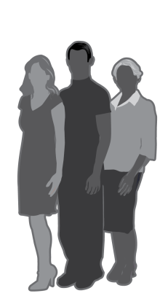
Clinical trials of preventive HIV vaccines will require more people!
PHASE I
PHASE II
PHASE III
12 to 18 months
Small group of healthy, HIV-negative participants to test safety
Up to 2 years
Hundreds of HIV-negative participants to test safety and immune responses
3 to 4 years
Thousands of
participants at higher risk, to test safety and efficacy
Notes:
[This slide is essentially the same as the previous – another way to illustrate the stages of trials. Some people like this one better because it tries to show the need for diversity among participants. It also shows the duration of each stage of human trials. You can use both slides, or choose one.]
Vaccine development requires several years of research in laboratories and animals before clinical testing in humans can begin. A potential vaccine goes through 3 phases of testing in humans before the Food and Drug Administration (FDA) can consider licensing it for public use. The 3 phases of clinical tests are:
• Phase I — involves a small number of healthy volunteers (HIV-negative and at low risk for HIV infection) to test the safety and various doses of the vaccine; usually lasts 12–18 months
• Phase II — involves hundreds of volunteers (HIV-negative and both low- and high-risk populations) to test the safety and immune responses of the vaccine; can last up to 2 years
• Phase III — involves thousands of volunteers (HIV-negative and high-risk populations) to test the safety and effectiveness of the vaccine; can last 3–4 years

Slide 24
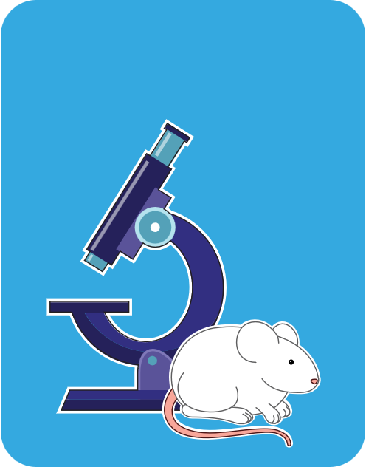
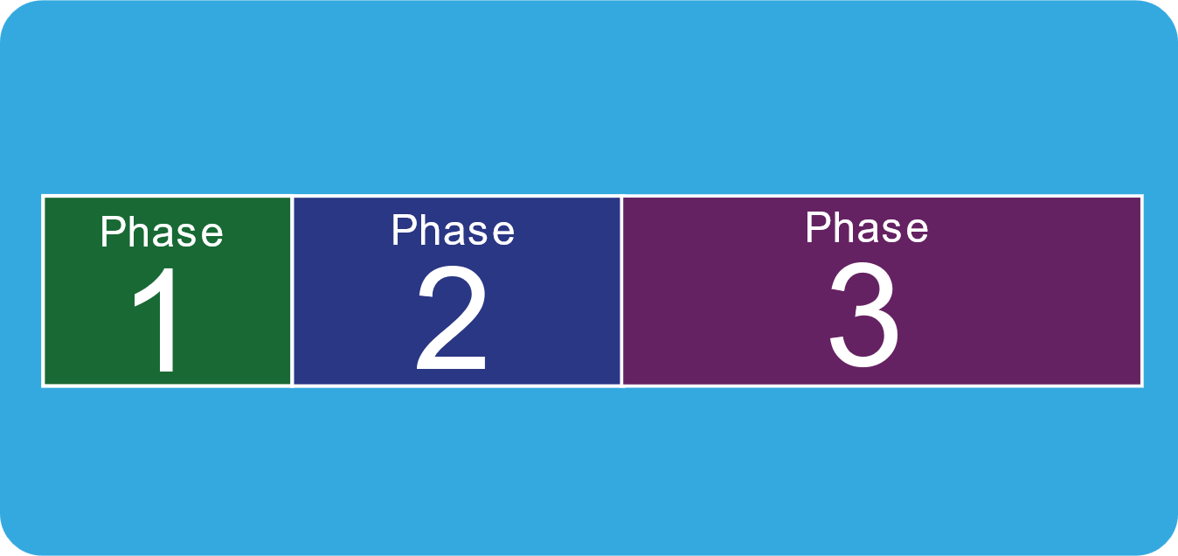
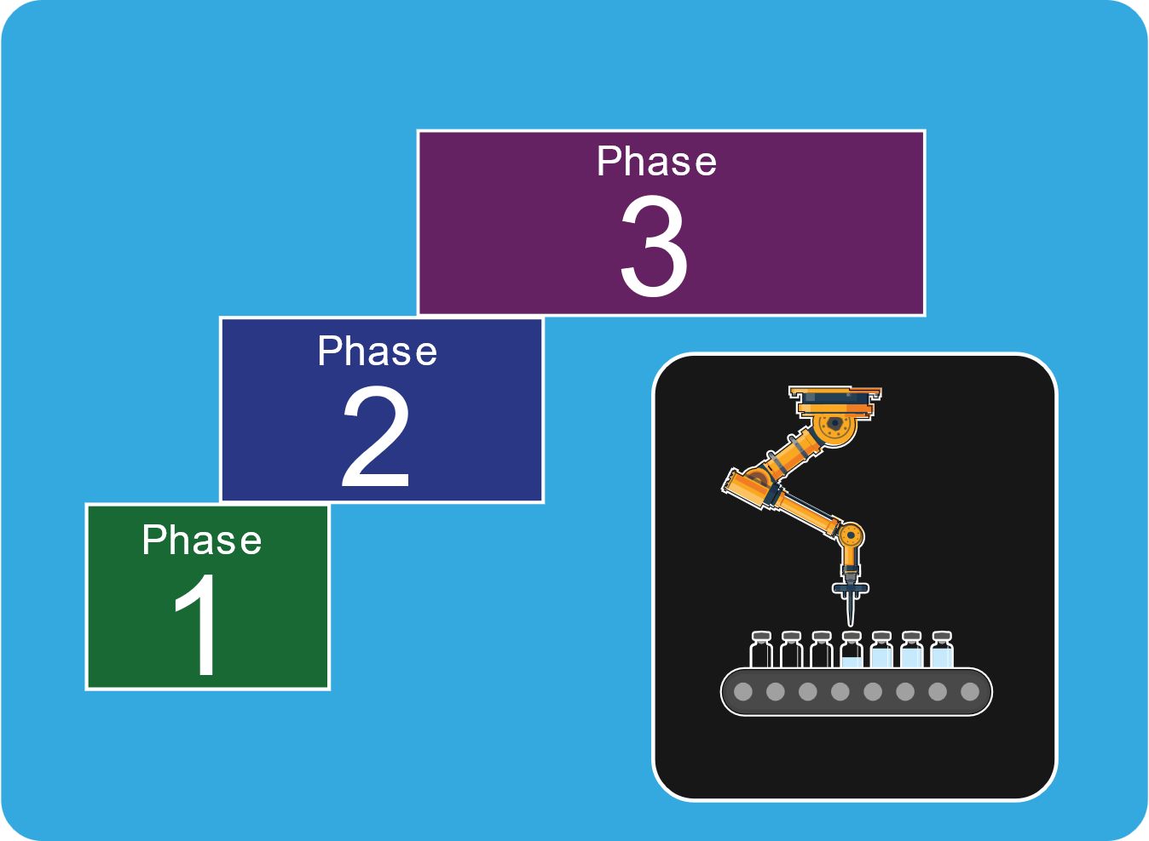
Comparing COVID-19 and Traditional Vaccine Timelines
Typical Vaccine Timeline
About 10 Years
PRECLINICAL
PHASE
HUMAN CLINICAL TRIALS
LICENSING
MANUFACTURING
DISTRIBUTION
COVID-19 Vaccine Timeline
Less Than a Year
HUMAN CLINICAL TRIALS
PRECLINICAL
PHASE
LICENSING
DISTRIBUTION
MANUFACTURING
Notes:
You’ve probably seen that the studies for a COVID-19 vaccine were done faster than usual, and found an effective vaccine faster. What we want you to know is that none of the steps were skipped. We just changed the structure of how the work was done, such as doing some steps in parallel instead of one after the other. We also overlapped the phases, starting the next phase just as soon as we had the safety data collected and analyzed from the previous phase. This required the cooperation of regulatory agencies around the world.
It is also important to know that throughout these studies, there were several groups overseeing the studies to make sure that participants were protected. There were independent safety monitoring groups that oversaw each study while it was in progress. In addition, the US Food and Drug Administration (FDA), the US National Institute of Allergy and Infectious Diseases (NIAID), and the US Biomedical Advanced Research and Development Authority (BARDA) were all involved in reviewing the study data and making sure it was appropriate to move from one phase to the next.
This rapid development just shows what can be accomplished when all of the world’s vaccine scientists are focused on the same issue, and all of the governments are devoting significant funding to solving the same problem. When the companies making the vaccines didn’t have to stop to do fundraising in between every study, and when regulators were willing to review data on accelerated timelines, things can be accomplished faster.

Slide 25
ALL participants receive the best risk reduction education available
HIV NEGATIVE VOLUNTEERS,
RANDOMLY ASSIGNED TO VACCINE OR PLACEBO
VACCINE + COUNSELING
& RISK REDUCTION TOOLS
PLACEBO + COUNSELING
& RISK REDUCTION TOOLS
FOLLOW FOR YEARS
MONITOR HIV STATUS
FOLLOW FOR YEARS
MONITOR HIV STATUS
END OF STUDY,
COUNT NUMBER WHO
BECAME INFECTED
END OF STUDY,
COUNT NUMBER WHO
BECAME INFECTED
Notes:
Most HIV vaccine trials are double blinded and placebo controlled. This means that participants are put into groups at random to receive either the experimental vaccine or a placebo, and neither the clinic staff nor the participant knows which product they are getting until the very end of the trial. ALL participants receive the same risk reduction counseling at every study visit about how to protect themselves from becoming infected with HIV, and they are reminded that since we do not know if the vaccine is effective, they should not assume that they are getting any protection from it. (If we knew that answer, we wouldn’t need to do the trial!)

Slide 26
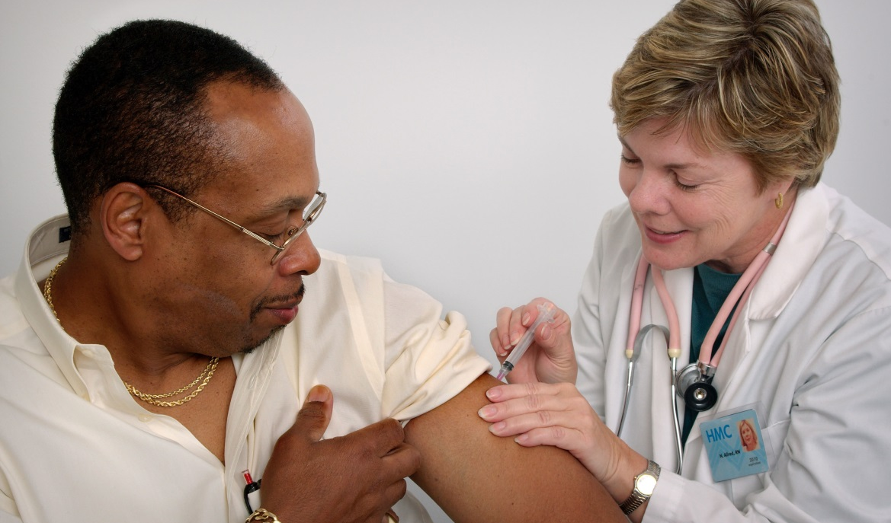
Who participates in a trial?
Healthy, HIV-negative adults between age 18 and about age 55, who can understand the potential risks and benefits of participation
Notes:
At this time, the FDA does not allow us to include teens in our studies. There are special considerations for testing products in children and teens. A vaccine will need to show efficacy in adults before we can move forward with trials in young people. In the meantime, we continue to enroll adults in our studies.

Slide 27
Diverse participants
Notes:
In order to know if an experimental vaccine will be safe and effective for all people, we must test it in all kinds of people. Trial participants should be diverse, representing a broad age range (typically 18-55); men, women, transgender and non-binary individuals; and people of many different ethnic backgrounds.
We know that ethnic heritage makes a difference in some diseases; for example, Jews of Eastern European heritage are at greater risk for Tay Sachs disease, and in the US, African Americans are at greater risk for Sickle Cell Anemia. We do not know yet if race or ethnic heritage will make a difference in whether an HIV vaccine will work for certain groups, therefore we must include as many groups as possible in our trials to answer this question.

Slide 28
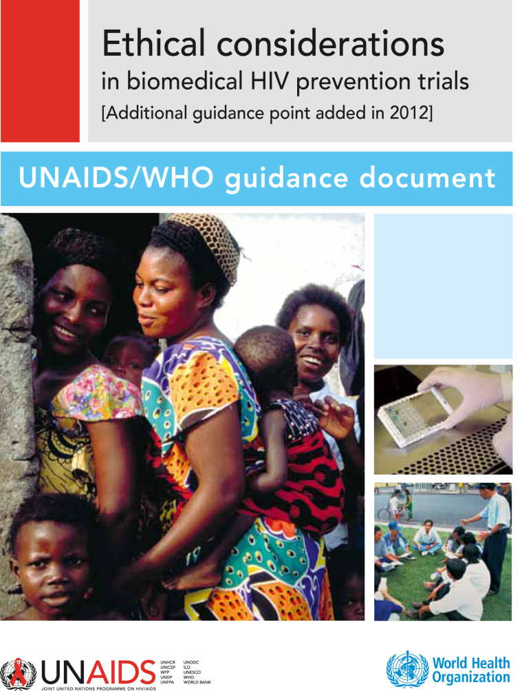
How are my rights protected, and who makes sure I am safe?
Community Advisory Boards
Participants Bill of Rights and Responsibilities (adopted by HVTN in 2001)
Institutional Review Boards
Data Safety and Monitoring Boards
Office of Human Research Protection
US Food & Drug Administration (FDA)
UNAIDS/WHO
LITERATURE COVER
Notes:
There are many documents, regulations and groups working to make sure that trials are ethical. Each HVTN site has a Community Advisory Board (CAB) which includes people from the local community who are representative of the populations being included in trials and the populations that are infected with and affected by HIV. CABs work in collaboration with research staff and provide advise about the conduct of trials.
There are also:
Institutional Review Boards (university and government), also known as Ethics Committees
Data Safety and Monitoring Boards who are independent of the researchers doing the trial
The Office of Human Research Protection (US government)
FDA (US Food & Drug Administration)
as well as groups similar to the FDA in other countries.
[People often ask, “How do I know I won’t be a guinea pig?” We try to dismiss this language as quickly as possible! Guinea pigs are entirely dependent on others for their food, water, clean cage, etc. People who are considering joining a trial are independent, capable of making their own informed decisions, and can come to their own conclusion about whether joining a study is the right decision for them.]

Slide 29
Research Safety
Preventive vaccines being used in human trials cannot cause HIV infection or AIDS
“Informed Consent,” which explains the risks and everything involved with trial participation, is obtained from all volunteers
Over 30,000 people have participated in HIV vaccine trials and there have been few serious safety concerns that could not be resolved quickly
Notes:
HIV vaccines being tested in the HVTN today do NOT contain HIV -- there is no real virus in the vaccine, and people receiving the vaccine cannot become infected by the vaccine. However, people enrolled in a trial may still become infected with HIV through their own behavior.
HIV vaccine clinical trials are completely voluntary. Researchers are required to obtain the informed consent of all volunteers. This is meant to ensure that volunteers fully understand the purpose of the study, how the HIV vaccine will be tested, the number of clinical visits required and the possible benefits and side effects caused by the vaccine. So far, few side effects have been associated with experimental HIV vaccines. Those that have occurred have been mild and similar to those of any other approved vaccines. The most common side effects are soreness at the site of the injection, a low-grade fever, and body aches, which quickly disappear. Throughout the study, volunteers are carefully examined to determine if there are any serious side effects associated with the vaccine.

Slide 30
Common misconceptions
A vaccine to prevent HIV infection already exists.
In order to find one, we need thousands of volunteers to participate in clinical trials.
The vaccine could make me infected with HIV.
The vaccines tested by HVTN use only man-made copies of pieces of the virus. They cannot cause HIV infection.
Participants in an HIV vaccine trial must be HIV+.
Preventive HIV vaccines are for uninfected people.
NO!
NO!
NO!
Notes:
[Read slide]

Slide 31
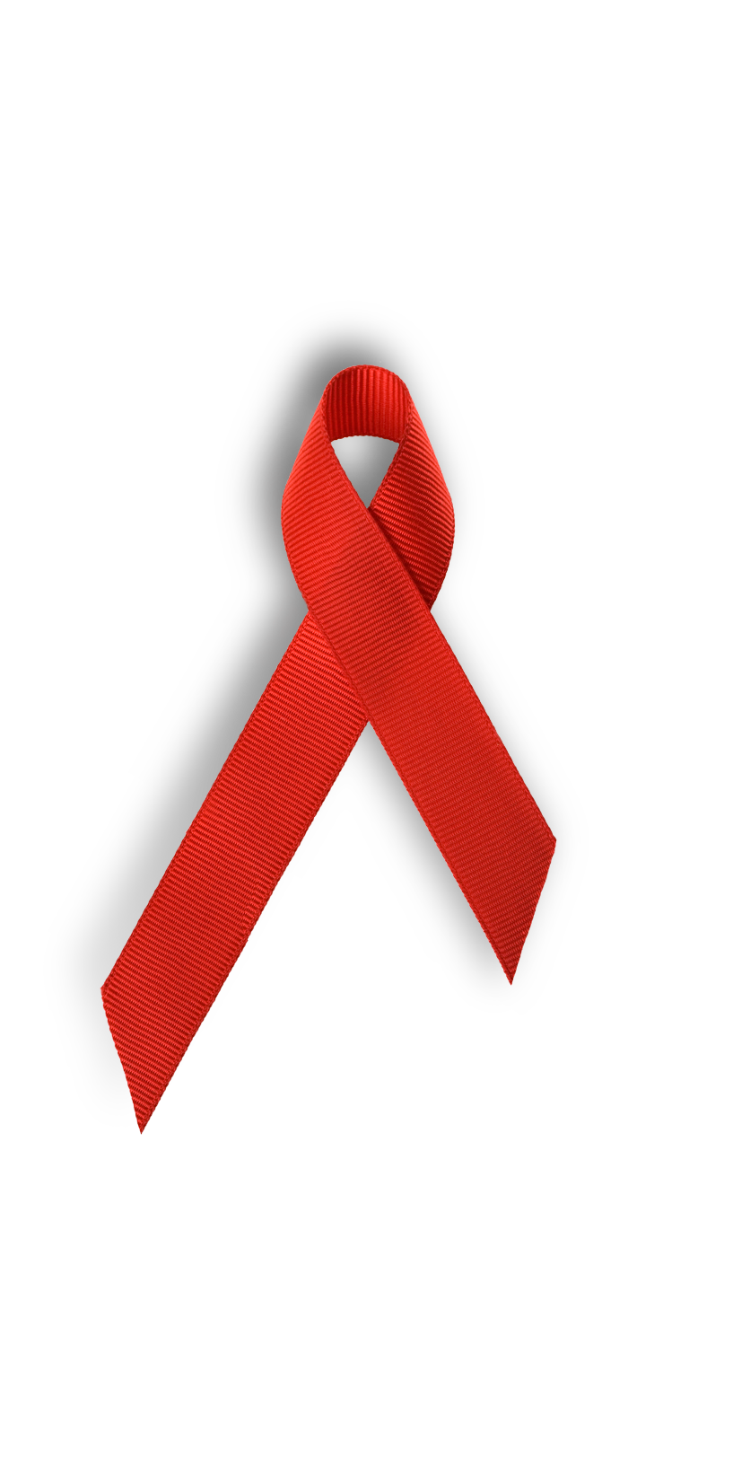
What can you do?
Share what you’ve learned
Keep up to date about what’s going on:
hvtn.org (HIV Vaccine Trials Network)
avac.org (AVAC: Global Advocacy for HIV Prevention)
iavi.org (International AIDS Vaccine Initiative)
Talk to people you know – can you help to address their concerns so that they become supporters of vaccine & other prevention research?
Notes:
We know that being a trial participant is not something everyone can do. However, everyone can help in the effort to create a supportive environment for vaccine research, and everyone can help to educate others about the need for an HIV vaccine.

Slide 32
Strategies: advocate for comprehensive programs
Abstinence, Be Faithful, Use Condoms – this is a great start, but not enough!
Condom Distribution, Needle Exchange/Syringe Services programs, Negotiation of Risk Reduction Behaviors
Microbicides, Treatment, Vaccines – Research in all areas is vital!
COMPREHENSIVE PROGRAMS REQUIRE ALL OF THESE COMPONENTS!!
Notes:
Another thing that we can all do is to encourage communities to advocate with legislators for comprehensive programs. We need to be vocal advocates for funding comprehensive programs that attack this epidemic from many angles. An easy way to remember this is “ABC + CNN + MTV.” (These are common TV stations in the US, but the logos are very helpful.) And while none of these TV stations includes the letter P, we want to be sure to remember PEP and PrEP as well!
Sometimes people get caught up in arguing about how money should be spent: do we need more for research, or more for prevention, or more for treatment and care? Instead of arguing about the size of the piece of the pie, we can advocate for a bigger pie! All of these areas are vitally important, and all are worthy of expanded funding.

Slide 33
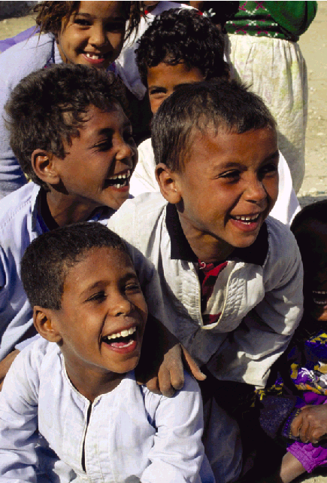
Working together for a future without HIV
A vaccine brings hope to future generations for a time when there will be zero new HIV infections!
Notes:
[END PRESENTATION by reading this slide.]

Slide 34
Thank You!

Slide 35
The following slides are not part of a basic introductory presentation on HIV vaccine research but may be useful to you in explaining key concepts. Use them as needed!

Slide 36
HIV viral structure
Proteins on the viral
Envelope (e.g. gp120)
Membrane or envelope
Matrix proteins
Nucleus (genes)
(e.g. Gag, Pol, nef, Tat)
Core proteins (e.g. p24, p17)
Experimental vaccines tested in the HVTN today do not include whole, killed or weakened HIV
Notes:
This diagram is useful to explain how scientists just use pieces of the virus when the synthetic copies are made for use in the vaccines. You can demonstrate how just the envelope proteins are used, or just a portion of the genes from the nucleus, etc.
an to explain this: if you have an eyelash, a tooth, and a fingernail, could you make a human being? No, these small parts do not have the capacity to combine themselves into a fully functional person. Similarly, using just small pieces from HIV, and then making synthetic copies of them to use in the study vaccines, does not have the possibility of creating real HIV that could cause infection.

Slide 37
HIV western blot
A
B
C
160
Can HIV testing distinguish vaccine recipients from infected persons?
120
60
55
51
Infection with HIV
Envelope vaccine recipient
Multivalent vaccine recipient
41
31
24
17
Notes:
This slide is useful when explaining that researchers are able to tell the difference between a true HIV infection and a vaccine-induced seropositive (VISP) response. People can see that the test results clearly look different. For more information about VISP and how the HVTN addresses it, you can direct people to the HVTN website:
Page for participants or those thinking about joining a study: http://www.hvtn.org/visp
Page for health care providers: http://www.hvtn.org/visp/vispcare

Slide 38
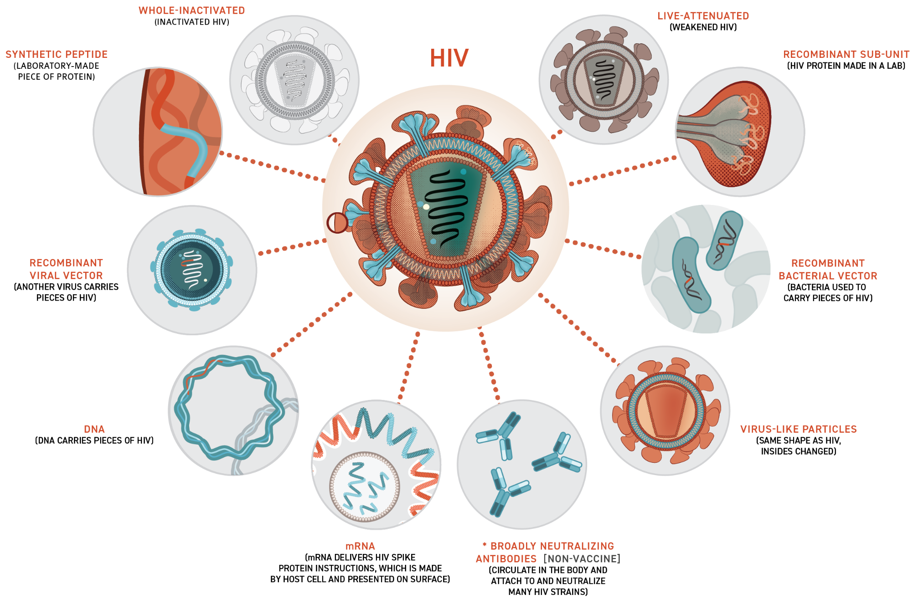
HIV vaccine designs and pieces
Notes:
This slide shows many of the possible designs for creating any vaccine. Live attenuated has not been used with HIV (red circle with slash), as there are safety concerns about using live HIV, even if it is weakened (attenuated).
There have been similar concerns about using whole inactivated HIV (dotted line circle with slash). The first trial using this strategy was launched in Canada in 2012 with a product made by a South Korean biotech company, but we have never seen or heard any data presented about this study, nor seen the results published. It is unknown whether work on that product continues. No NIAID-funded trials are pursuing this strategy.
Aside from these 2 designs, the HVTN has run clinical trials of most of these other designs. As a note, “virus like particles” shown on the bottom, is the design used for Gardasil, the new HPV vaccine made by Merck. And mRNA has been used successfully in vaccines by Moderna and Pfizer for vaccines against COVID-19.

