Slide 1
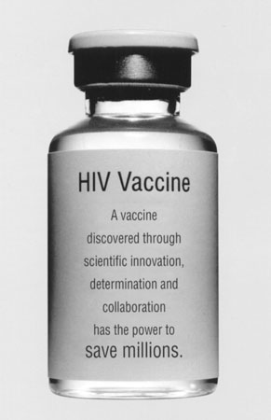
An Introduction to Biomedical HIV Prevention
The HIV Vaccine Trials Network is supported through a cooperative agreement with the National Institute of Allergy and Infectious Diseases

Slide 2
The facts
In 2020, there were 37.7 million people living with HIV.
36.0 million are adults.
1.7 million are children (0–14 years).
53% of all people living with HIV were women and girls.
84% of all people living with HIV knew their HIV status in 2020.
About 6.1 million people did not know that they were living with HIV in 2020.
Notes:
[note to presenter: use of introductory epidemiology slides are optional. The UNAIDS slides are updated every year for World AIDS Day on December 1st, and can be downloaded for free from http://www.unaids.org (use the search field and type in “epidemiology slides” to get the latest version).]
Advances in treating HIV and AIDS create a false impression that “AIDS is over” and that prevention is no longer critical. But as these slides show, the epidemic is far from over. And increasingly, the face of the epidemic is younger and more likely to be female.
In fact, the top health and science experts agree safe and effective vaccines are the best hope for controlling the AIDS pandemic in the long term. Other than clean water, vaccines have historically been the most effective method of stopping an infectious disease.
But until we have a safe and effective vaccine, it is also important to think about prevention tools that can be used now, in the short term.

Slide 3
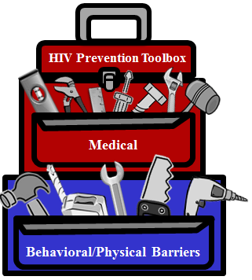
Approaches to HIV prevention
HIV Vaccines**
Medical Male Circumcision
Post-Exposure Prophylaxis (PEP)
Treatment as Prevention (TasP)**
Microbicides
(Ring)
Pre-Exposure Prophylaxis (PrEP)
Diagnosis and Treatment of
Sexually Transmitted Infections (STIs)**
Interruption of Vertical transmission
Harm Reduction
Clean Syringes (Needle Exchange Programs)
Education and Negotiation of Safer Behaviors
Condoms and Other Barrier Methods
Treatment and Prevention of Drug/Alcohol Abuse
**These methods are still being researched
Notes:
So what prevention options do we have? Many. A vaccine is only one tool in a large prevention toolbox. Even when a vaccine is found, these other prevention strategies will continue to be important. For example, even if you get a vaccine against HIV, condoms will still help you to avoid syphilis, gonorrhea, and chlamydia!

Slide 4
Approaches to HIV prevention (medical)
Vaccines**
Medical Male Circumcision
Post-Exposure Prophylaxis (PEP)
Treatment as Prevention (TasP)**
Pre-Exposure Prophylaxis (PrEP)
Microbicides (Ring)
Diagnosis and Treatment of
Sexually Transmitted Infections (STIs)**
Interruption of
Mother-to-Child Transmission (MTCT)
Harm Reduction
Education and Negotiation of Safer Behaviors
Clean Syringes (Needle Exchange Programs)
Treatment and Prevention of Drug/Alcohol Abuse
Condoms and Other Barrier Methods
**These methods are still being researched
Notes:
Let’s start with the medical HIV prevention tools. They are:
Post-exposure prophylaxis (PEP): Taking anti-HIV drugs as soon as possible after exposure to HIV.
Pre-exposure prophylaxis (PrEP): People who do not have HIV but are at risk take daily medication to reduce the risk of infection, if exposed. A pill called Truvada, made up of 2 ART medications (tenofovir and emtracitibine), was approved by the US FDA for use as PrEP in July, 2012.
Another PrEP intervention is CAB-LA an injectable, or long-acting injectable cabotegravir, is an antiretroviral drug developed by ViiV Healthcare and formulated to be administered once every two months as an injectable form of PrEP. Cabotegravir previously was approved in the US and Canada for treatment, in combination with another injectable ARV, rilpivirine. As of December 2021, CAB-LA was additionally approved by the US for use as a prevention option
Interruption of Vertical Transmission : Interventions to reduce infant exposure to HIV during pregnancy, labor, and breastfeeding.
Vaccines: A substance that teaches the body’s immune system to recognize and protect against a disease caused by an infectious agent or virus, often by stimulating the body to produce antibodies to that infection.
Treatment as Prevention: Use of antiretroviral treatments to decrease the chance of spreading HIV. Getting HIV-positive people into treatment and keeping them in care, also known as treatment as prevention (TasP), has proven successful in reducing a person’s viral load, therefore, making them less likely to pass the virus to their HIV-negative partner.
Microbicides: Interventions designed to reduce the risk of HIV transmission during vaginal and/or anal sex. Dapivirine Vaginal Ring, It is flexible vaginal ring made from silicone and women can insert the ring themselves every 28 days. It is about 56mm in diameter and 7.7mm in cross section (thickness). Over the course of 28 days it releases the ARV dapivirine. What is great about the ring is that it is discreet and does not interfere with sex. The ring can be stored without the need for cold chain and has a self life of about 60 months if stored below 30 degrees
Diagnosis and Treatment of Sexually Transmitted Infections (STIs) : The most common transmission of both HIV and STIs is sexual intercourse.
Medical Male Circumcision: An intervention that reduces the risk of female-to-males sexual transmission through vaginal sex by approximately 60%. Medical Male Circumcision can also be considered a medical prevention tool.

Slide 5
Approaches to HIV prevention (behavioral)
Vaccines**
Medical Male Circumcision
Post-Exposure Prophylaxis (PEP)
Treatment as Prevention (TasP)**
Pre-Exposure Prophylaxis (PrEP)**
Microbicides
(Ring)
Interruption of
Mother-to-Child Transmission (MTCT)
Diagnosis and Treatment of
Sexually Transmitted Infections (STIs)**
Harm Reduction
Education and Negotiation of Safer Behaviors
Clean Syringes (Needle Exchange Programs)
Condoms and Other Barrier Methods
Treatment and Prevention of Drug/Alcohol Abuse
**These methods are still being researched
Notes:
Behavioral and physical barrier prevention tools include:
Harm Reduction: A way of dealing with behavior that recognizes where a person is with their current prevention behaviors, and seeks to reduce damages to the health of a person and his/her community. For example, harm reduction can include education about the HIV-related risks of drug use, and might emphasize the importance of using clean needles rather than focusing on stopping drug use completely.
Clean Syringes (Needle Exchange Programs): Provides clean needles to reduce the risk of infection for injected drugs. Needle exchange programs provide a safe way for people to turn in their used syringes for appropriate disposal and received new sterile syringes in return; some programs also provide information on how to clean syringes using bleach and water.
Condoms and Other Barrier Methods: Any method that prevents passage of blood, semen, or vaginal fluids from passing from one person to another; for males. Condoms can be male AND female, used for vaginal, anal, and oral sex.
Treatment/Prevention of Drug/Alcohol Abuse: Includes injection drug use, poor judgment and risky behavior while under the influence, and effects of drug abuse and addition on a person’s overall health.
Education: Education includes knowing your status, encouraging regular HIV testing, and knowing how the disease is transmitted. Negotiation of safer behaviors helps the individual to think about the conversations they could have with their partners about using various prevention methods, and feeling empowered to protect themselves.

Slide 6
The HIV prevention spectrum
Prior to exposure
Point of transmission
Treatment
Education & Behavior change
Syringe Services Program
Adult male circumcision
Diagnose and Treat other STIs
Preventive HIV Vaccines
Pre-exposure prophylaxis (PrEP)
Treatment as Prevention (TasP)
Male and female condoms
Use of clean needles
Anti-retroviral therapy (mother-to-child)
Microbicides (vaginal)
Microbicides (rectal & vaginal)
Post exposure prophylaxis (PEP)
Anti-retroviral therapy
Care
Education & Behavioral change
Therapeutic HIV/AIDS vaccines
Treatment as Prevention (TasP)
Items in red still being researched
Notes:
With all the tools we have, it is important to give people as many choices as possible at as many time points as possible. Wouldn’t it be great if people had five or six options to choose from at each different time point? This slide shows when each of these tools could be used. Items in black are available; items in red are being researched
One of the lessons that has been learned about contraception is that the more options you give women for birth control, the greater the likelihood that she will find one method that suits her circumstances. That could be a matter of cost, ease of use, availability/access, the partner’s willingness to use that method, etc. The same is true for HIV prevention – the more tools that we have available, the greater the chances are that every individual will find one tool that meets their needs.

Slide 7
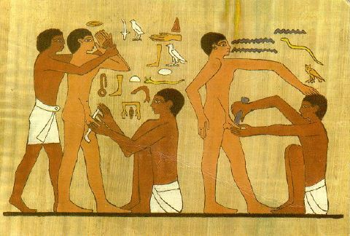
Medical Male Circumcision
Circumcision may be the oldest and most common surgery for humans (20-25% of men globally are circumcised)
A simple procedure that brings many benefits, but also some risk
Cultural considerations must be respected
3 trials in South Africa, Kenya and Uganda showed reduced risk of female to male transmission by 50-60%
A relief on the tomb of Ankh-Mahor
Notes:
Let’s begin by looking more in depth at some of the recent advances in HIV prevention research:
In 2007 three different clinical trials of medical male circumcision in South Africa, Kenya, and Uganda reported similar exciting results. All 3 trials were done in heterosexual men who were at risk of HIV infection because they had an HIV-infected female partner (i.e. vaginal sex as primary route of possible transmission). The studies were done among men from cultures that did not have any objections to circumcision, so their cultural norms were being respected. Following the circumcision procedure, the men were counseled to abstain from sex or to be sure to use condoms until their wounds had been checked by a doctor and determined to be fully healed (roughly 4 weeks). In all 3 trials, the researchers saw that men were 50-60% less likely to be infected with HIV by their female partner.
Why do we think circumcision has this effect? Scientists believe that the culprit is Langerhans cells, a particular type of cell that lines the foreskin of the penis. Langerhans cells are very susceptible to HIV infection providing a type of free lunch for HIV to dine on! When a man is circumcised and the foreskin is removed, the Langerhans cells are no longer present and the restaurant is closed! With time, the skin of the newly circumcised penis becomes keratinized making it tougher and more resistant to infection.
However, we do not yet know if male circumcision offers any HIV prevention benefits to female partners, or if there are benefits for men who have sex with men whose primary route of HIV transmission would be anal sex. One trial that was looking at the question of benefits to female partners was done with HIV-infected men and their HIV-negative female partners. The trial had to be stopped early because of harm, with too many women becoming infected with HIV [WHICH STUDY]. Researchers believe that the men were resuming sex before their wounds were fully healed (and not using condoms), so the open wound made it easy for the women to become infected. There have been no trials at all looking at circumcision among men who have sex with men. As a result, we don’t know the answer to these questions. We have to be very careful to be specific about the limits of our knowledge regarding male circumcision.
[ADD INFORMATION ABOUT PREPEX]
Interestingly, women also have Langerhans cells lining the cervix. This has prompted researchers to look at whether using a diaphragm or cervical cap, which cover up the cervix and therefore block access to the Langerhans cells, could also be used to prevent HIV. There have been a few small trials looking into this, but more research into this idea is still needed.

Slide 8
Preventive HIV vaccine trial: RV144 (The Thai Trial)
Study Details
Run by USMHRP working with Thai Military
16,402 participants:
60% men,
40% women
18-30 years old
“Average” risk of HIV infection
Study began October 2004
Vaccinations completed July 2006
Trial concluded June 2009
The 2-Vaccine Regimen
Prime: ALVAC-HIV
Made of canarypox with the HIV gag protein
Given at 0, 1, 3 and 6 months
Boost: AIDSVAX B/E. Made of the envelope protein called gp120
Given at 3 and 6 months
Notes:
In 2009, came the results of RV144 also called “the Thai Trial.” It was the first vaccine study to every show any efficacy in that it offered some protection against HIV. The study enrolled 16,000 participants in Thailand and was conducted by the US Military Research Program and the Thai Ministry of Health and military.
The participants enrolled were considered “average citizens” in that they were not at particularly high risk of becoming HIV infected. The study sponsors felt it was important to know if the vaccine worked in “average” people and not just high risk groups.
Half of the participants received the 2 vaccine regimen and half received a placebo. The vaccines also used pieces of man-made HIV proteins from clades B and E types of HIV. This is because these are the main types of HIV found in Thailand.

Slide 9
The Thai Trial: results
125 HIV infections:
51 in the vaccine group; 74 in the placebo group
Vaccine efficacy in females: 39% (50 cases total)
Vaccine efficacy in males: 26% (75 cases total)
p = 0.61, meaning that gender differences were not significant
No effect on lowering viral load or on CD4 T-cell counts.
Vaccine efficacy overall = 31.2%
Notes:
So here are the results – the first ever vaccine study to find any efficacy at all!! Now a 31% efficacious vaccine isn’t good enough to take forward to licensure but it is a great start! (By comparison, the annual influenza vaccine is about 60% effective.)
These results also raise some questions that will need to be explored in future studies. One question is whether this vaccine regimen would work in other areas where the type of HIV is different. The HVTN has several studies in development to explore this question. Other questions are whether the vaccine regimen would work with people of other risk factors, like men who have sex with men or injecting drug users.

Slide 10
Vaccines work!
“How Vaccines Have Changed Our World in One Graphic” www.forbes.com
Feb. 19, 2013
(using data from 2010, published in JAMA)
Notes:
One thing we know from other diseases is that vaccines work!! However, we don’t yet have a vaccine against any other retrovirus, which is what HIV is. [A retrovirus is type of virus that that reproduces by becoming part of the structure of the cells they take over. Many retroviruses are known to cause cancer in animals]. And although the data in this graphic is only showing the numbers for the US, the results are similar all around the world. It is really exciting to know that a preventive HIV vaccine is possible!! Now we must continue to explore so that we can understand WHY this vaccine regimen in the Thai trial worked to prevent infections, and how to improve the results to make a vaccine that could be licensed which is exactly what the HVTN is working on!

Slide 11
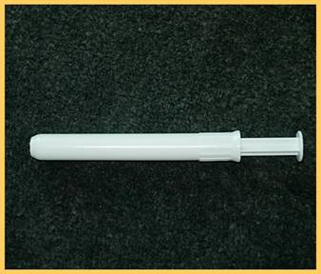
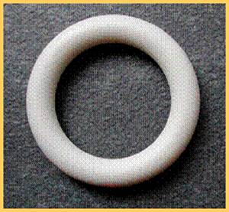
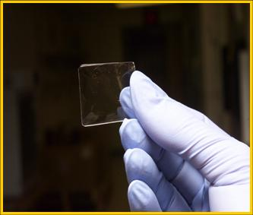
Microbicides
Vaginal/rectal gel applicator
Film
Vaginal ring
A microbicide is a product that can be applied to the vagina or rectum with the intention of preventing the transmission of sexually transmitted infections including HIV. Products may include gels, vaginal rings, or vaginal films.
Products are user-initiated, can be used without partner consent
May or may not be contraceptive as well as protecting against STIs
Notes:
Microbicides are products typically made with the same drugs that are used for HIV treatment. The products are designed to be used in the vagina or in the rectum, making them a prevention method that could be used by both men and women. One big advantages to a microbicide is that they are invisible to your sexual partner, meaning that an individual can decide if they want to use the product without needing to inform their sexual partner.
Different formulations are being studied. Most trials to date have used an applicator like the photo on the left, which works similarly to inserting a tampon or suppository. Once a product is found to be effective, there will likely be follow-up studies to look at other delivery methods such as vaginal rings (like the ones used for birth control – insert once a month, product dispenses over time) or films, much like the dissolving breath freshener strips, that melt in a warm, moist environment. These other delivery methods could make the microbicide easier to use, and even more invisible to others.
Recently in an initial announcement in January 2021 where the World Health Organization (WHO) recommended the dapivirine vaginal ring as an additional HIV prevention option for women at substantial risk for acquiring HIV. The Dapivirine Vaginal Ring has been approved in some African Countries and is currently under review by several others.
[Note for the presenter: if you are able to bring some Listerine breath strips with you as a demonstration, it really helps!
Microbicides could be designed in a number of ways. One way is to use a cream or gel that creates a barrier, so that HIV can not reach your mucosal tissue to be able to infect it. Another strategy is to include anti-retroviral therapy medications in the formulation, which could help to kill or disable HIV, making infection less likely to happen. It is also possible that a vaginal microbicide could be made with or without a contraceptive, making it possible to prevent pregnancy as well as HIV, or enabling a woman to become pregnant even if she has an HIV-positive partner. A variety of strategies are being studied.

Slide 12
Microbicides: Dapivirine Ring Trials
Notes:
Phase 3 clinical trials on the ring were conducted in Malawi, SA, Uganda and Zimbabwe – which is the ASPIRE and Ring Study conducted in parallel, randomized a total of 4500 HIV negative women (ages 18-49) to a placebo ring or the dapivirine ring. These studies found a 27% risk reduction in ASPIRE and 35% in the Ring Study. Adherence to the product was about 80% in these studies and no safety concerns were seen with risk use. Following the Phase III studies, the Open Label Studies, DREAM and HOPE enrolled a total of 2400 HIV negative former phase III trial participants and all were offered the dapivirine ring. These studies showed an increase in risk reduced with the Hope Study reporting 39% risk reduction and DREAM study, a 62% risk reduction. These studies had a similar safety profile as phase III studies. Adherence to the product was over 90% in these studies suggesting that women who knew they were using an active product were more likely to use it. This shows that with increased adherence in the OLE studies there is a potential for higher risk reduction.

Slide 13
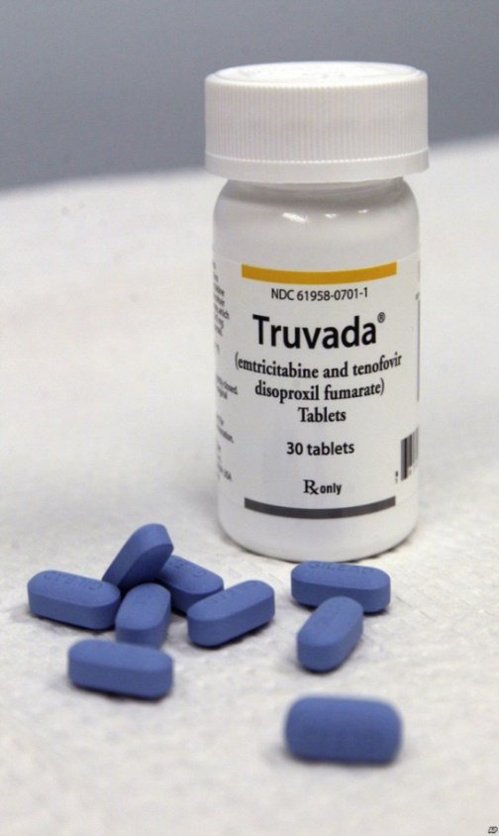
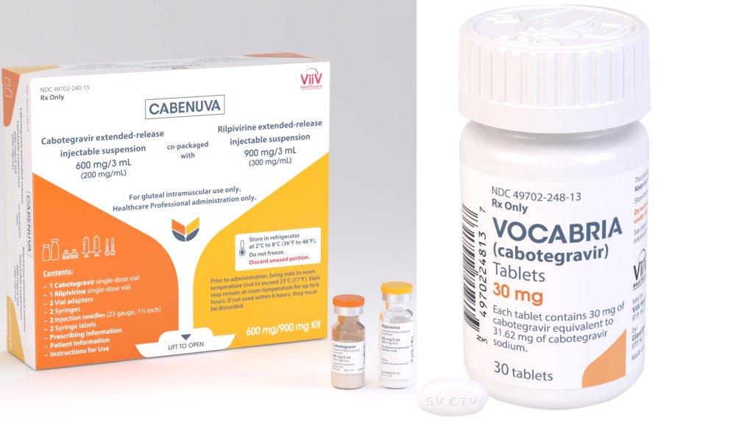
PrEP (Pre-Exposure Prophylaxis)
What it is: the use of anti-HIV medication or injection by people who are NOT infected with HIV as a method of HIV prevention
(July 2012) The US Food and Drug Administration approved the daily use of Truvada as PrEP by people at increased risk for HIV infection
Cabotegravir is another ARV approved for use as prevention by the US FDA, as of December 2021. It was found to be safe and efficacious in two studies administering the drug, every two months, as a long-acting injection.
picture of cabotegravir - Bing images
Notes:
The next new biomedical prevention method is known as PrEP, which stands for Pre-Exposure Prophylaxis. This idea is already in use with malaria- the same drugs that are used to treat malaria can be taken preventively.
Similarly, the idea of PrEP for HIV is for a healthy person to take anti-retroviral medication every day as a way to prevent HIV infection. So far, the US Food and Drug Administration has approved one pill, sold by the name Truvada and the injectable named Cabotegravir for this purpose. Truvada contains 2 anti-retroviral medicines in one tablet [tenofovir (TDF) and emtracitibine (FTC)]. Cabotegravir is given first as two initiation injections administered one month apart, and then every two months thereafter. Patients can either start their treatment with Apretude or take oral cabotegravir (Vocabria) for four weeks to assess how well they tolerate the drug.
It is important to note that use of PrEP requires that a person be seeing their doctor regularly, about once every 3 months. People must have regular HIV testing to confirm that they remain uninfected, because if they did become infected, taking Truvada (which only contains 2 drugs) or Cabotegravir would not be sufficient for treating their HIV infection (treatment regimens include 3 drugs). There are also some side effects associated with taking Truvada and Cabotegravir, and it is important that people get the additional kinds of tests and follow-up with their doctor.
picture of cabotegravir - Bing images

Slide 14
Treatment as Prevention (TasP)
Notes:
Treatment as Prevention (TasP) refers to taking HIV medicine to prevent the sexual transmission of HIV. It is one of the most highly effective options for preventing HIV transmission.
People with HIV who take HIV medicine (called antiretroviral therapy or ART) as prescribed and get and keep an undetectable viral load—a very low level of HIV in the blood—can stay healthy and have effectively no risk of sexually transmitting HIV to their HIV-negative partners. This is sometimes called undetectable = untransmittable (U=U).
TasP works when a person with HIV takes HIV medicine exactly as prescribed and has regular follow-up care, including routine viral load tests to ensure their viral load stays undetectable.

Slide 15
Strategies for all: spread the word, advocate for comprehensive programs
Abstinence, Be Faithful, Use Condoms – this is a great start, but not enough!
Condom Distribution, Needle Exchange, Negotiation of Risk Reduction Behaviors
Microbicides, Treatment, Vaccines – Research in all areas is vital!
Comprehensive programs require ALL of these components!!
Notes:
With all of these new biomedical HIV prevention options to consider and so many studies being done to follow-up on these early results, many people wonder how they can get involved, since joining a clinical trial might not be the right choice for everyone. We can all support these efforts by helping to share information with people we know. That could mean conversations with our friends and family, with our religious communities, with our book club, or our neighbors!
We can also be active citizens of our communities, advocating with our elected officials at the local, state, and country levels. We need to help educate our elected officials and make them aware that HIV prevention is an issue we feel strongly about. We can ask them to voice their support for comprehensive programs that include all of these components, and to ensure that budgets fund all of these components appropriately.

Slide 16
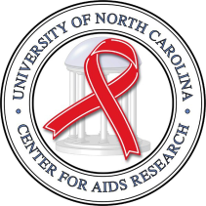
HIV prevention: putting the pieces together
Counseling
Microbicides
Male Circumcision
PrEP
Behavior Change
Vaccines
Mother to Child
Transmission
Treatment as Prevention
Notes:
Ultimately, we know that it is important to having as many tools in our toolbox for preventing HIV as possible. We don’t necessarily know what the complete picture will look like, but until we do, we must continue to explore every new piece to see how it fits into the puzzle. It is possible that we will need to use some tools together in different combinations.

Slide 17
Notes:
The road to ending the HIV/AIDS epidemic is still long, and there are some steep hills we have to climb. But the advances of the past few years have been numerous, and exciting! We have had proof of concept of a protective vaccine, proof of concept of a protective vaginal microbicide, and the approval of the first anti-retroviral pill that can be used by healthy people to prevent HIV, and all the other exciting advances mentioned here today. We need to stay focused and support each other as we continue to move forward on this journey!

