Slide 1
An Introduction to Broadly
Neutralizing Antibodies (bnAbs)

Slide 2

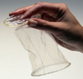




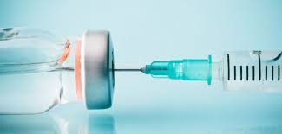


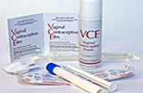
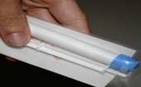

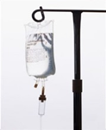

An analogy for prevention
PREGNANCY PREVENTION | HIV PREVENTION
Education & behavior modification | Education & behavior modification
Condoms | Condoms
Birth control pill | Oral & Injectable PrEP
“Morning-after pill” | PEP
Spermicide | Topical microbicides
Implantable birth control | Antibody-mediated Prevention (bnAbs)
Vasectomy/Tubal Ligation | Vaccination
Notes:
When we think about HIV prevention, one of the things we want is to have as many different prevention options as possible. We have learned from the family planning field that when you give a person more options, they are more likely to find a prevention method that will work for them, for whatever their particular circumstances might be.
The same is true for HIV – we want to give people as many different ways to protect themselves as possible. This table compares the different methods for both types of prevention. Some of these methods are still in the research stage and are not yet available (microbicides, bnAbs, vaccines). There are additional HIV prevention measures not shown here, such as vaginal rings. But the point remains the same: together, we hope to offer people more choices to cover a wider range of the different time periods in their lives, when people might find that they have different needs. For HIV, the one time period that we really need to focus on is the time when an exposure might happen. That is where using antibodies could be helpful.

Slide 3
A long history of using antibodies to prevent other viral infections
VIRUS | PRODUCT DESCRIPTION | INDICATION
Measles | Concentrated human gamma globulin | Prevention
Polio | Concentrated human gamma globulin | Prevention
CMV | Cytomegalovirus Immune Globulin | Prevention
Hepatitis A | Immune serum globulin (ISG) | Prevention (travel)
Hepatitis B | Hepatitis B Immune Globulin | Post Exposure
Rabies | Rabies Immune Globulin | Post Exposure
RSV | mAb (palivizumab) for prophylaxis of high risk infants | Prevention in High Risk Infants
VZ | Varicella Zoster Immune Globulin | Post Exposure
Most effective vaccines induce antibodies that neutralize the pathogen.
Slide credit: John Mascola
Notes:
Antibodies given by infusion have been used for decades to prevent a number of different infections caused by viruses. One of the most common methods is using Immunoglobulin G (abbreviated IgG) to prevent Hepatitis A and B, and varicella zoster which causes chickenpox and shingles.

Slide 4
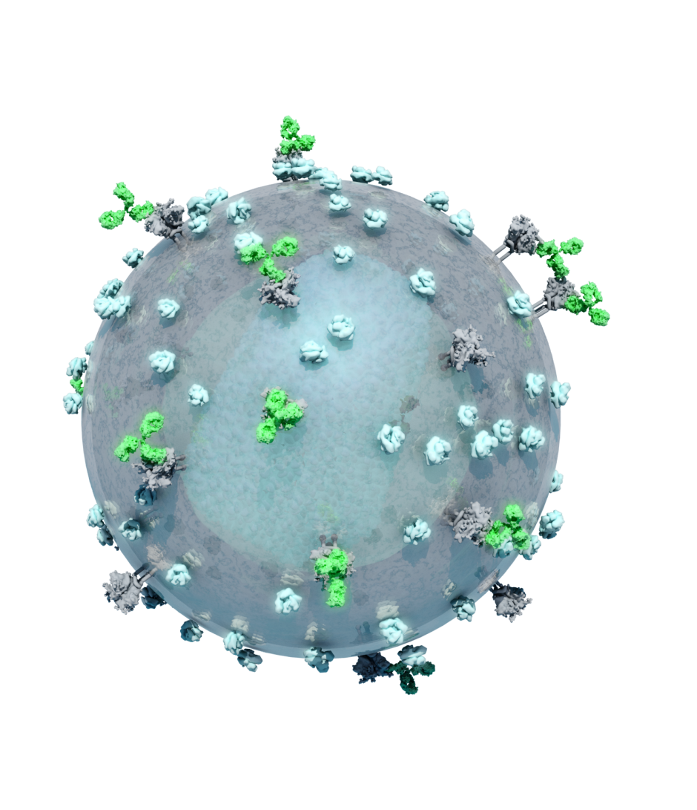
How do people fight infections?
One of the ways is by using antibodies.
Antibodies are proteins produced naturally by the human body.
They are part of the immune system, which protects us against illness and disease.
They are specific for every different kind of germ or illness people get exposed to.
They can also be made in a lab, to be used like a medication, known as “monoclonal antibodies”.
Image of HIV with antibodies (green) attached to surface proteins
Notes:
As a reminder, a vaccine teaches the body how to recognize the invading virus and to “become the factory” that can produce lots and lots of antibodies to prevent infection or fight disease if a person is ever exposed to that virus in the future. Using infusion of antibodies is different: it skips the step of teaching your body to be the antibody-making factory. Instead, people are given infusions of large doses of laboratory-made antibodies that can also prevent infection and fight disease. Since the body didn’t learn how to make these antibodies, people may need to receive ongoing doses of antibodies on a schedule.
These laboratory-made antibodies are known as “monoclonal.” Let’s break that term down: “mono” means one, and “clonal” might sound familiar, like the word “clone.” When you clone something, you make a copy of it. And that’s exactly what happens in the lab: researchers take one antibody and make many millions of copies of it.

Slide 5
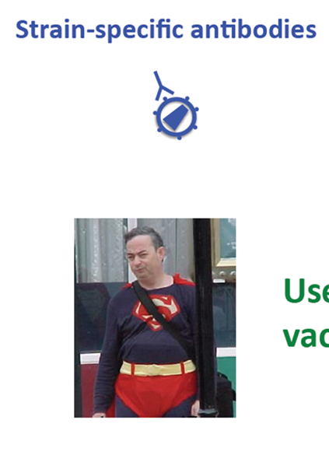
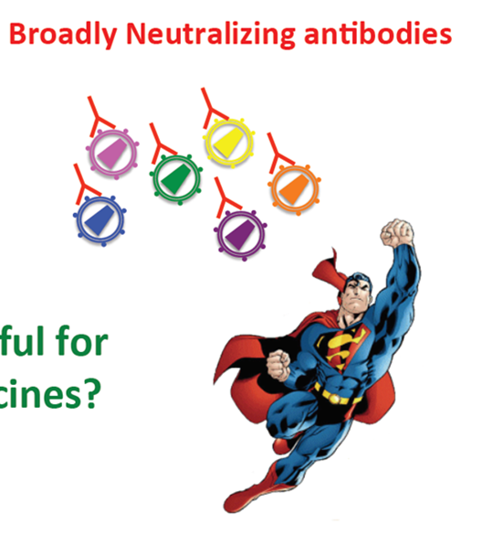
Another new idea
All people with an infection make neutralizing antibodies,
but not all antibodies are created equal…
Slide credit: Penny Moore
Notes:
Everyone who gets infected with any kind of bacteria or virus will make neutralizing antibodies to fight the infection, but they are not all equal! Some are weaker, like the man wearing a costume on the left. These antibodies only recognize and fight back against one particular strain. The exciting ones, like the real Superman on the right, are broadly neutralizing, and they are able to recognize and fight back against many strains. BnAbs [pronounced bee-nabs] stop HIV from binding to human T-cells by attaching to the virus and preventing the virus from infecting T-cells. This is especially important for HIV, which has many global strains that circulate in different parts of the world.

Slide 6
bnAbs
BnAbs are monoclonal antibodies that were made in a lab.
They were copied from natural antibodies discovered in people who have been living with HIV for many years.
The antibodies can be given to people by IV infusions or subcutaneous infusions. This is known as “passive immunization.”
Notes:
BnAbs were first identified in people who had been living with HIV for many years known as long term non-progressors or elite controllers . The antibodies appear to be part of the way that these people are able to control HIV without having health problems, and without using ART medication.
You will see the name bnAbs spelled different ways, with different capitalization. There is no standard way of writing this term. In the HVTN, we only capitalize Antibodies (Ab), and the other letters are written in lower-case, unless it is the beginning of a sentence.
Vaccines are known as active immunization, because the vaccine teaches the body how to make the antibodies and fight off the infection or disease. By comparison, bnAbs are considered “passive immunization”, because the body is not doing the work. A person just receives the antibodies directly through an infusion.

Slide 7
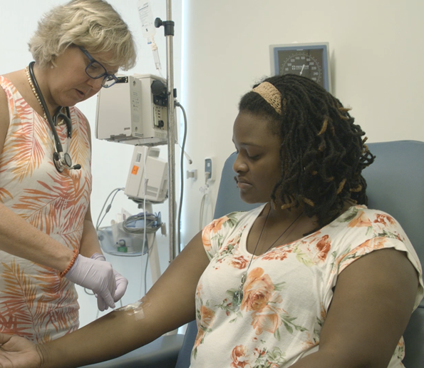
Giving the antibodies: IV infusion
Notes:
Intravenous infusions, which are abbreviated IV, are given into a vein on your arm. We use a sterile needle to place a small plastic tube into a vein, usually in your arm. The small plastic tube is connected to a small bag of fluid that contains the study antibody. A pump controls how fast the fluid drips from the bag, through the tube, and into your vein.

Slide 8
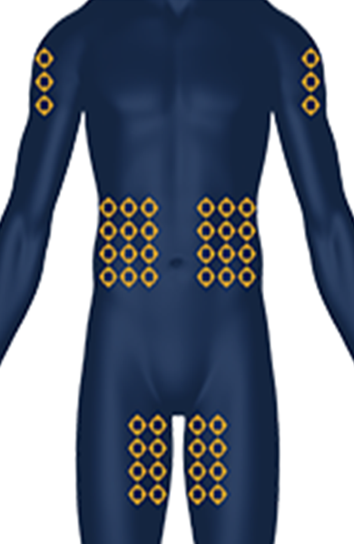
Giving the antibodies: SC infusion
Notes:
Subcutaneous infusions, abbreviated SC, are given using a very thin needle placed under your skin in fatty areas of your body like your belly, upper arm, or thigh. The dose of the antibody can be divided into smaller amounts to make the administration more comfortable. A person might be given infusions in 2 or 3 locations at the same time, as suggested by the circles shown on each area of the body in the drawing on the right. A pump is used to control how fast the study antibody is injected through the needles.

Slide 9
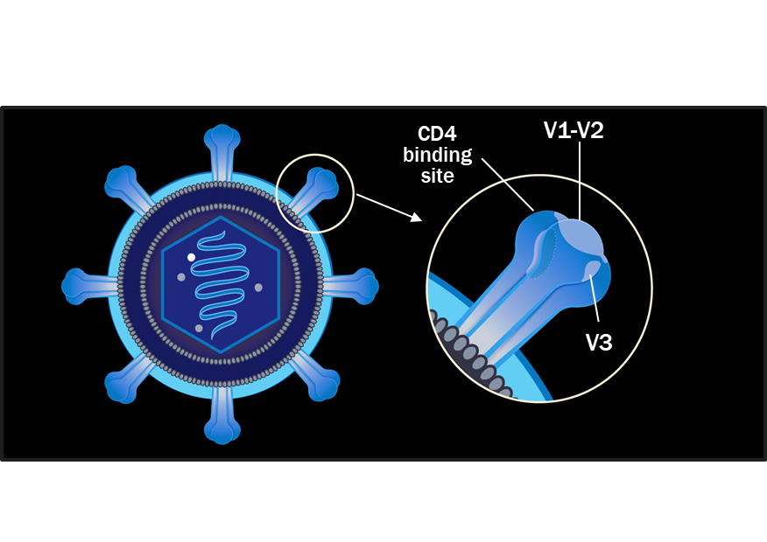
What do the antibodies do?
Each bnAb binds to different places on the spikes found on the surface of HIV, blocking HIV from attaching to human T-cells and causing infection.
Notes:
One of the things antibodies can do is called neutralization. Neutralization means that when the antibodies attach to the outside of the virus, they block the parts where the virus would normally attach to human T-cells to cause infection. With these key parts on the virus blocked, HIV can not attach and cannot infect the cells, and it is therefore neutralized.
None of the individual bnAbs that have been discovered are able to successfully neutralize ALL of the different strains of HIV found around the world. Scientists think that using combinations of bnAbs will mean that more HIV gets blocked, maybe even getting closer to 100%. Using a combination of antibodies that bind to different locations increases the chances that at least one of the antibodies would be able to recognize whatever strain of HIV a person is exposed to, bind to it, and neutralize it.

Slide 10
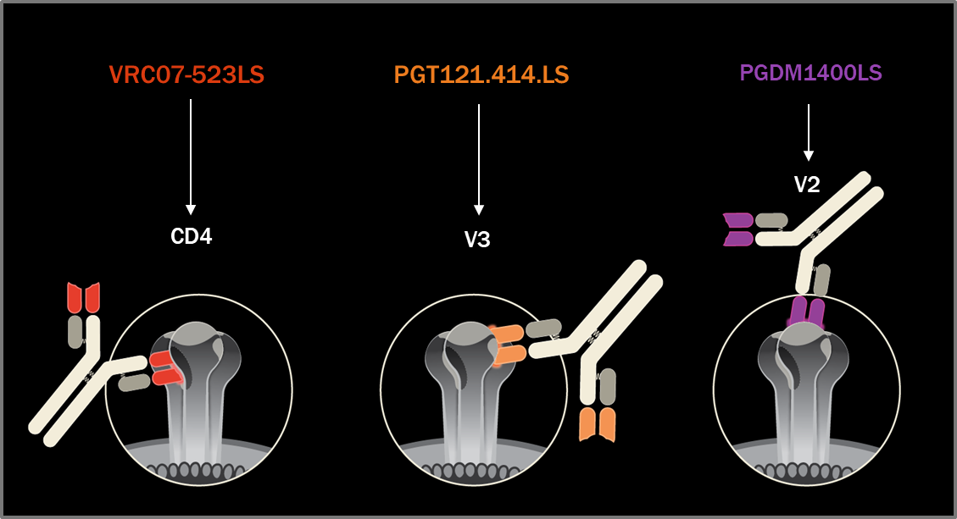
Where do they attach – some examples
CD4 Binding Site
Notes:
Here are a few examples of some of the bnAbs that are currently being used in HVTN studies. The letters and numbers above each one are the scientific names of the antibody, and in white is the specific part of HIV that the antibody binds onto.
VRC07-523LS attaches to a spot called the CD4 binding site. This is the spot that HIV uses to attach to human T-cells.
PGT121.414.LS attaches to a spot called the V3 Loop. This loop is part of the process that HIV uses inside a T-cell to begin to make copies of itself and cause infection.
PGDM1400LS attaches to a spot called the V2 Loop. This loop interacts with the receptors on human cells, and being able to block it is thought to be important for preventing infections.

Slide 11
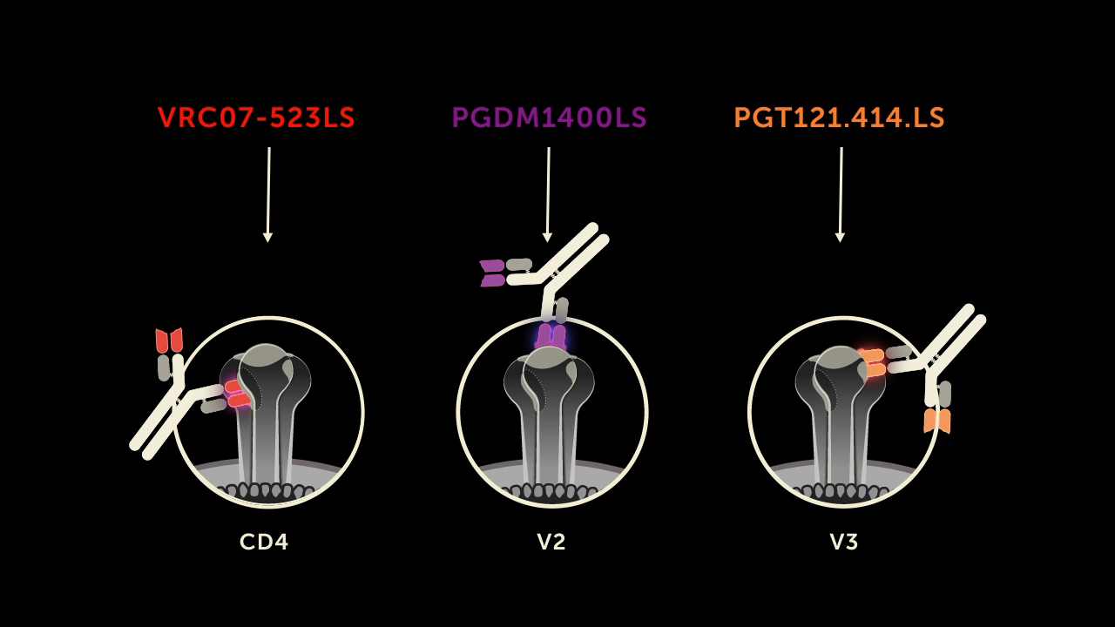
Why combinations are used
Notes:
[Note for sites: the animation will continue to play on a loop until you advance to the next slide.]
This animation helps to show what has been described so far. Antibodies are able to circulate in the body, attach to HIV, and neutralize it. Once HIV is neutralized, it is blocked from being able to attach to human T-cells to cause an infection. These 3 example bnAbs attach to different spots on HIV, and we hope that giving combinations of bnAbs will increase the chances that more HIV is blocked. You can see that there are many different strains of HIV shown in shades of blue and green, and the special bnAbs are able to recognize them all when used altogether.

Slide 12
General risks of getting antibodies
Different antibodies have been given to people for other diseases. With those antibodies, most side effects happen within the first 24 hours.
Other antibodies have caused a variety of side effects in some participants:
So far, bnAbs against HIV have been associated with very few side effects.
Notes:
The side effects listed here are for other antibodies against other diseases. So far, the experimental antibodies against HIV have been associated with very few side effects. In over 40,000 administrations of antibodies against HIV given in other studies, most side effects happened within the first 24 hours.
Rarely, some other antibodies for other diseases have caused serious reactions that may be life-threatening. Two such serious reactions are:
Anaphylaxis – a physical reaction that includes difficulty breathing, possibly leading to low blood oxygen, low blood pressure, hives or rash, and swelling in the mouth and face. This may occur soon after getting an antibody.
Serum Sickness – a physical reaction that includes developing hives or a rash, fever, big lymph nodes, muscle and joint pains, chest discomfort and shortness of breath. This may occur several days to a few weeks after getting an antibody.
Rarely, antibodies licensed for treatment of other diseases have been linked to a blood disorder that interferes with blood clotting, to cancer, to damage to the heart muscle, and to the body’s immune system attacking healthy cells.
These rare side effects and reactions have not been seen in HVTN studies using bnAbs against HIV, or with similar experimental antibodies against HIV used in other research programs.

Slide 13
bnAbs can work! Lessons from the AMP studies
1. VRC01 given every 2 months over 20 months reduced acquisition of HIV strains that were sensitive to VRC01 (IC80 <1 µg/mL)
  The high dose of VRC01 (30 mg/kg) achieved 85% protection against Clade B and Clade C viruses that were sensitive to VRC01.
  This suggests that the main factor in determining efficacy is the virus itself, and whether it is sensitive to VRC01.
2. We found a relationship between VRC01 in the blood (serum titer) and neutralization (IC80)
  We can predict how much antibody is needed to be effective against strains of HIV in various regions of the world.
  This allows selection of better antibodies for future studies.
Notes:
Time for a bit of science!
When the AMP studies were designed, HVTN researchers used the assumption that 70% of the HIV strains would be susceptible to VRC 01 at an IC80 concentration of <10 micrograms per milliliter. “IC80” tells you how much antibody is needed to neutralize 80% of the viruses. But what we found in the AMP studies was that among the people in the studies who acquired HIV during the time they were in the study, only about 25% of the viruses they acquired were susceptible at an IC80 concentration of <1 microgram per milliliter. The antibody worked to neutralize the virus, but only if it was a virus that was sensitive to the particular antibody tested in the study. You can think of this in the same way that you need to use certain antibiotics for infections. You may have heard the expression that someone has “multiple drug resistant tuberculosis”, meaning that several different drugs will not work for that particular infection. It’s the same idea here – some HIV viruses may be resistant to a particular antibody, so the antibody will not be successful at neutralizing.
The second thing that was a major advance is that there is a relationship between the level of VRC01 needed in the blood (called a serum titer) and the neutralization sensitivity of the virus. Using this relationship, we can predict how much antibody is needed to prevent HIV in various geographic regions of the world where the various strains of the viruses circulate, such as clades B and C in the Americas and Africa, respectively. This allows us to choose better antibodies for future studies and make more efficient progress advancing them in clinical trials.
Because of the AMP studies, we now have a better understanding that it isn’t just the bnAb that matters, but also the virus itself. Whether the bnAb protects against infection depends on the strain of HIV a person is exposed to, and whether it is sensitive to the specific bnAb they receive.

Slide 14
How could bnAbs be a prevention tool?
Some possible uses of bnAbs for prevention include:
Cover a period of risk for newborns (during & right after birth, during breastfeeding)
Cover the “tail” of long-acting PrEP injection, when the dose of the PrEP medication is waning
Cover the ramp-up period of an HIV vaccine regimen given in multiple doses over several months to a year
Combine with other bnAbs as a prevention “cocktail,” similar to how we use multiple drugs in combination ART for treatment
Notes:
So if we find an efficacious bnAb, or combination of bnAbs, how might we use them for HIV prevention?
These are some of the ideas that have been proposed, but there may be others as well.
Protecting babies who have an HIV positive parent while they are breastfeeding
“Tail” of long-acting PrEP injection: the period after a participant stops the injections, when the amount of PrEP medication in their blood decreases– they may have enough drug in their blood that could lead to development of resistant HIV (if they are exposed to HIV), but not necessarily enough medication to protect them from infection. Adding bnAbs could help them transition off of the long-acting PrEP more safely.
“Ramp-up” period of an HIV vaccine regimen: many of our HIV vaccines in studies are given in 4-5 doses over 6 months to a year. During this period a person’s immune system is “learning” from the vaccine how to make antibodies to protect against HIV, but they may not be fully protected until they have received all of the doses. Adding bnAbs would provide coverage during this extended vaccination period.
Perhaps as an independent prevention tool – some people might not mind getting an infusion every few months.

Slide 15
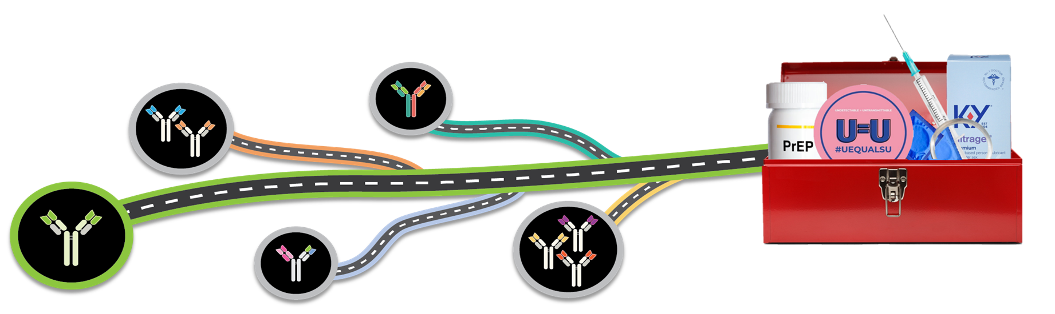
The way forward for bnAb research
The AMP Studies laid the foundation for future prevention efficacy bnAb studies.
We are conducting research on newer bnAbs, including combinations, that are more potent and have broader coverage than VRC01.
Notes:
The studies taught us that in order to better prevent HIV, we need an antibody or a combination of antibodies that can prevent acquisition of more strains of HIV. Scientists call this better breadth, and they are working to enhance some of the antibodies that we already know about so that they will have even more breadth of coverage against HIV. We also want to find combinations that would allow using smaller doses of antibody because they have greater potency.
Fortunately, we have already been identifying broader, more potent antibodies, and potential combinations of these antibodies and using them in phase 1 studies while the AMP studies were in progress. One of the goals of the AMP studies, in addition to proving the concept that bnAbs could be effective, was to inform future research so that we could improve the efficiency of studies to advance bnAbs as another HIV prevention tool, and we have accomplished that. Future studies will be working to find the best individual and/or combinations of antibodies to move ahead, hopefully to our HIV prevention toolbox one day.

Slide 16

Questions?
?

Slide 17
Acknowledgements
Gail Broder, HVTN and Jonathan Lucas, HPTN
The AMP Study protocol teams
  Chairs Dr. Larry Corey, HVTN and Dr. Mike Cohen, HPTN
  Co-chairs Dr. Sri Edupuganti, HVTN and Nyaradzo Mgodi, HPTN
  Protocol Team leaders Dr. Shelly Karuna, HVTN and Phil Andrew, HPTN
Lisa Donohue, Graphic Designer

