Slide 1
Introduction to Tuberculosis

Slide 2
The HVTN is expanding to tuberculosis (TB) vaccines!
In 2019, HVTN renewed its grant from the NIH for another 7 years
This new grant cycle includes vaccines for tuberculosis (TB)
“In partnership with ACTG and IMPAACT Network … to enhance the TB vaccine field globally by evaluating the safety and immunogenicity of TB vaccines for all age groups”
Notes:
“Tuberculosis” is often abbreviated as TB.
The HVTN was directed by our funders at the NIH to expand our scope of research to include TB vaccines, as well as HIV vaccines. We will work collaboratively with the ACTG network on studies for adults, and with the IMPAACT network on studies in children and adolescents.

Slide 3
Outline
Introduction to TB
Compare HIV with TB
What is TB disease?
Diagnosis and treatment
TB vaccine and recent clinical trials
Upcoming HVTN/ACTG TB vaccine trial
Glossary of new terms
Notes:
This is a brief outline of this presentation. The goal is to introduce you to what TB is and why the HVTN is starting up in this field. I want to go over some basics to introduce you to the topic.

Slide 4
Kinds of pathogens
Viruses
Examples:
HIV, Ebola, Zika, SARS-CoV-2
Parasites
Examples:
Malaria, leishmaniasis, toxoplasmosis
Bacteria
Examples:
E.coli, gonorrhea, tetanus, Mycobacterium tuberculosis
Notes:
You are all familiar with the virus called HIV and HIV vaccines.
But viruses are just one kind of pathogen. A pathogen is a microbe that causes disease, including viruses, parasites, and bacteria.
(click to have the arrow fly in to point to MTB)

Slide 5
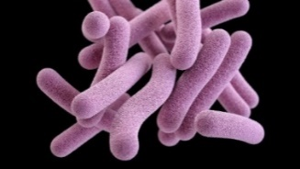
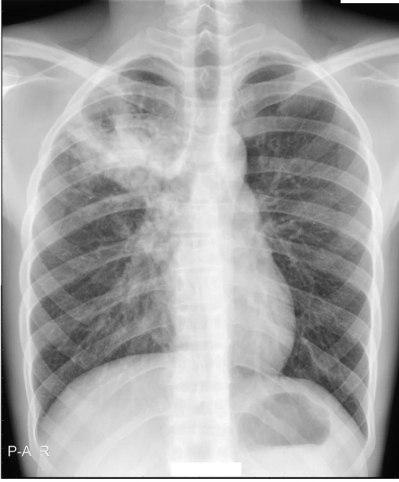
Mycobacterium tuberculosis
Mycobacterium tuberculosis is a bacterium that causes TB disease
Mycobacterium tuberculosis is often abbreviated to M. tuberculosis or Mtb
Mtb is the organism
TB is the disease caused by the organism
Mtb is unique and different from many other bacteria that cause disease (e.g. E. coli, Strep, cholera)
Mtb is spread through droplets when a person coughs, speaks, or sings
CDC
Notes:
Here are some basic definitions of words you will hear, and that are used in this presentation.
You’ll see the name of this bacterium written/spoken all three ways: Mycobacterium tuberculosis, M. tuberculosis and Mtb
Organism/disease: just like HIV is the name of the virus that causes the disease called AIDS, and SARS-CoV-2 is the virus that causes the disease called COVID-19, Mtb is the bacterium that causes the disease called TB.
Mtb is a bacterium, and is shaped a bit like a medicine capsule or a long jelly bean (shown here in purple).
The disease, TB, looks like a cloud in a person’s lungs when seen on an x-ray.

Slide 6
A little TB history
Mtb was identified in 1882 by Dr. Robert Koch in Berlin. At that time, TB killed 1 out of every 7 people in the US and Europe. Today it causes about 2 million deaths globally each year.
Mtb is thought to have originated in East Africa about 3 million years ago.
The disease has been known by many names: consumption, wasting disease, white plague.
The BCG vaccine against TB was first given to a person in 1921.
Notes:
[read slide]

Slide 7
HIV vs. Mtb
 | HIV | Mtb
Type of microbe | Virus, viruses | Bacterium, bacteria
Size | 0.1 micrometers | ~1 micrometers (10 times bigger)
Number of genes | 9 | ~4,000
Virus:
Soccer ball
Bacterium:
Elephant
Notes:
Let’s put Mtb in context with what we already know about HIV.
It is a different kind of microbe. Both get referred to as both singular and plural.
Mtb is 10 times bigger than HIV.
The envelope is the main gene/protein of HIV targeted by HIV vaccines, but MTB has 4000 genes/proteins! That in itself makes the vaccine development process complex. Scientists have to decide WHICH gene/protein to choose for use in a vaccine.

Slide 8
Comparing sizes: virus, bacterium, human cell
Virus:
Soccer ball
Bacterium:
Sperm whale
Human cell:
Tower of Pisa
Bacterium
size in
comparison
to the cell
Notes:
Here is another way to compare the size of a virus particle, a bacterium, and a human cell. While TB is substantially larger than a virus, it is still substantially smaller than a human cell.

Slide 9
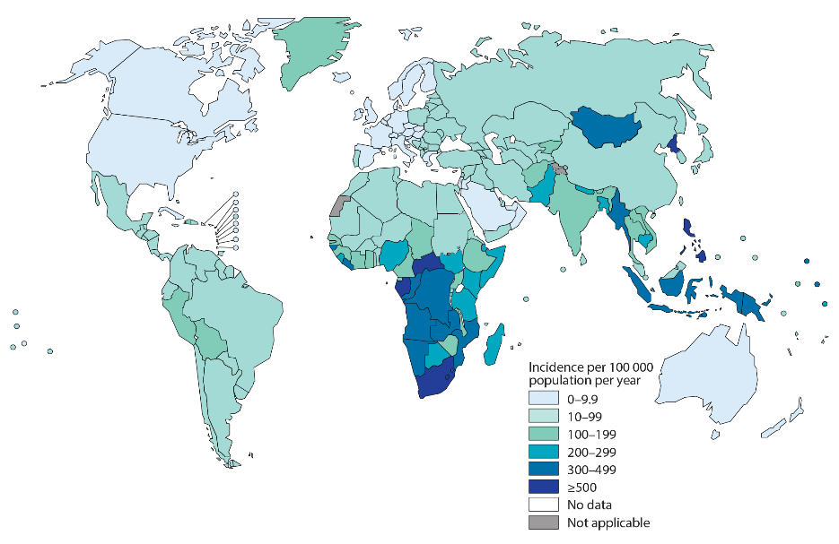
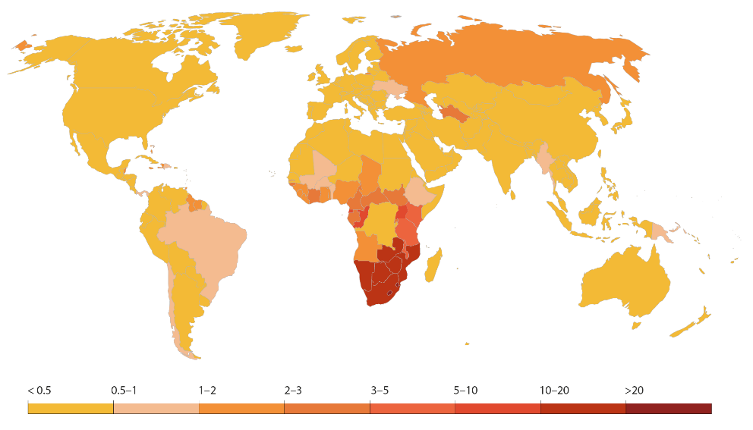
Comparing TB and HIV epidemics
TB
HIV
In 2019:
10 million people got TB
1.2 million deaths
In 2020:
1.5 million new cases
680,000 deaths
CURABLE with antibiotics
NO CURE
2021 UNAIDS Update; 2020 edition of the WHO Global Tuberculosis Report
Notes:
As you can see in these maps, where the darker colors show more cases and more deaths, similar regions of the world are affected by these 2 diseases, especially sub-Saharan Africa. For TB, the Indian subcontinent and Southeast Asia are also heavily impacted.
[Read the numbers of cases and deaths aloud]
It is important to note that some of these deaths are people co-infected with both illnesses.
It is also important to note that there IS a cure for TB, which is treatable with antibiotics, but we still do not have a cure for HIV, although there is active research underway.

Slide 10
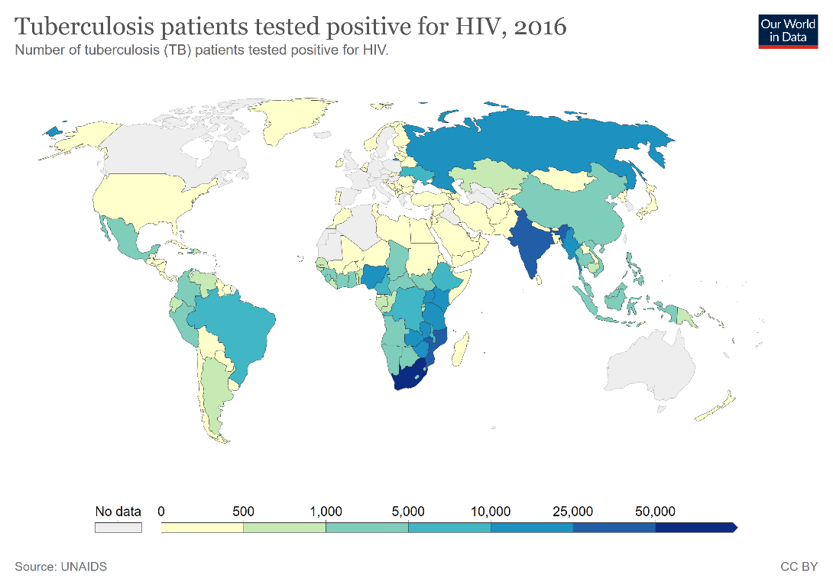
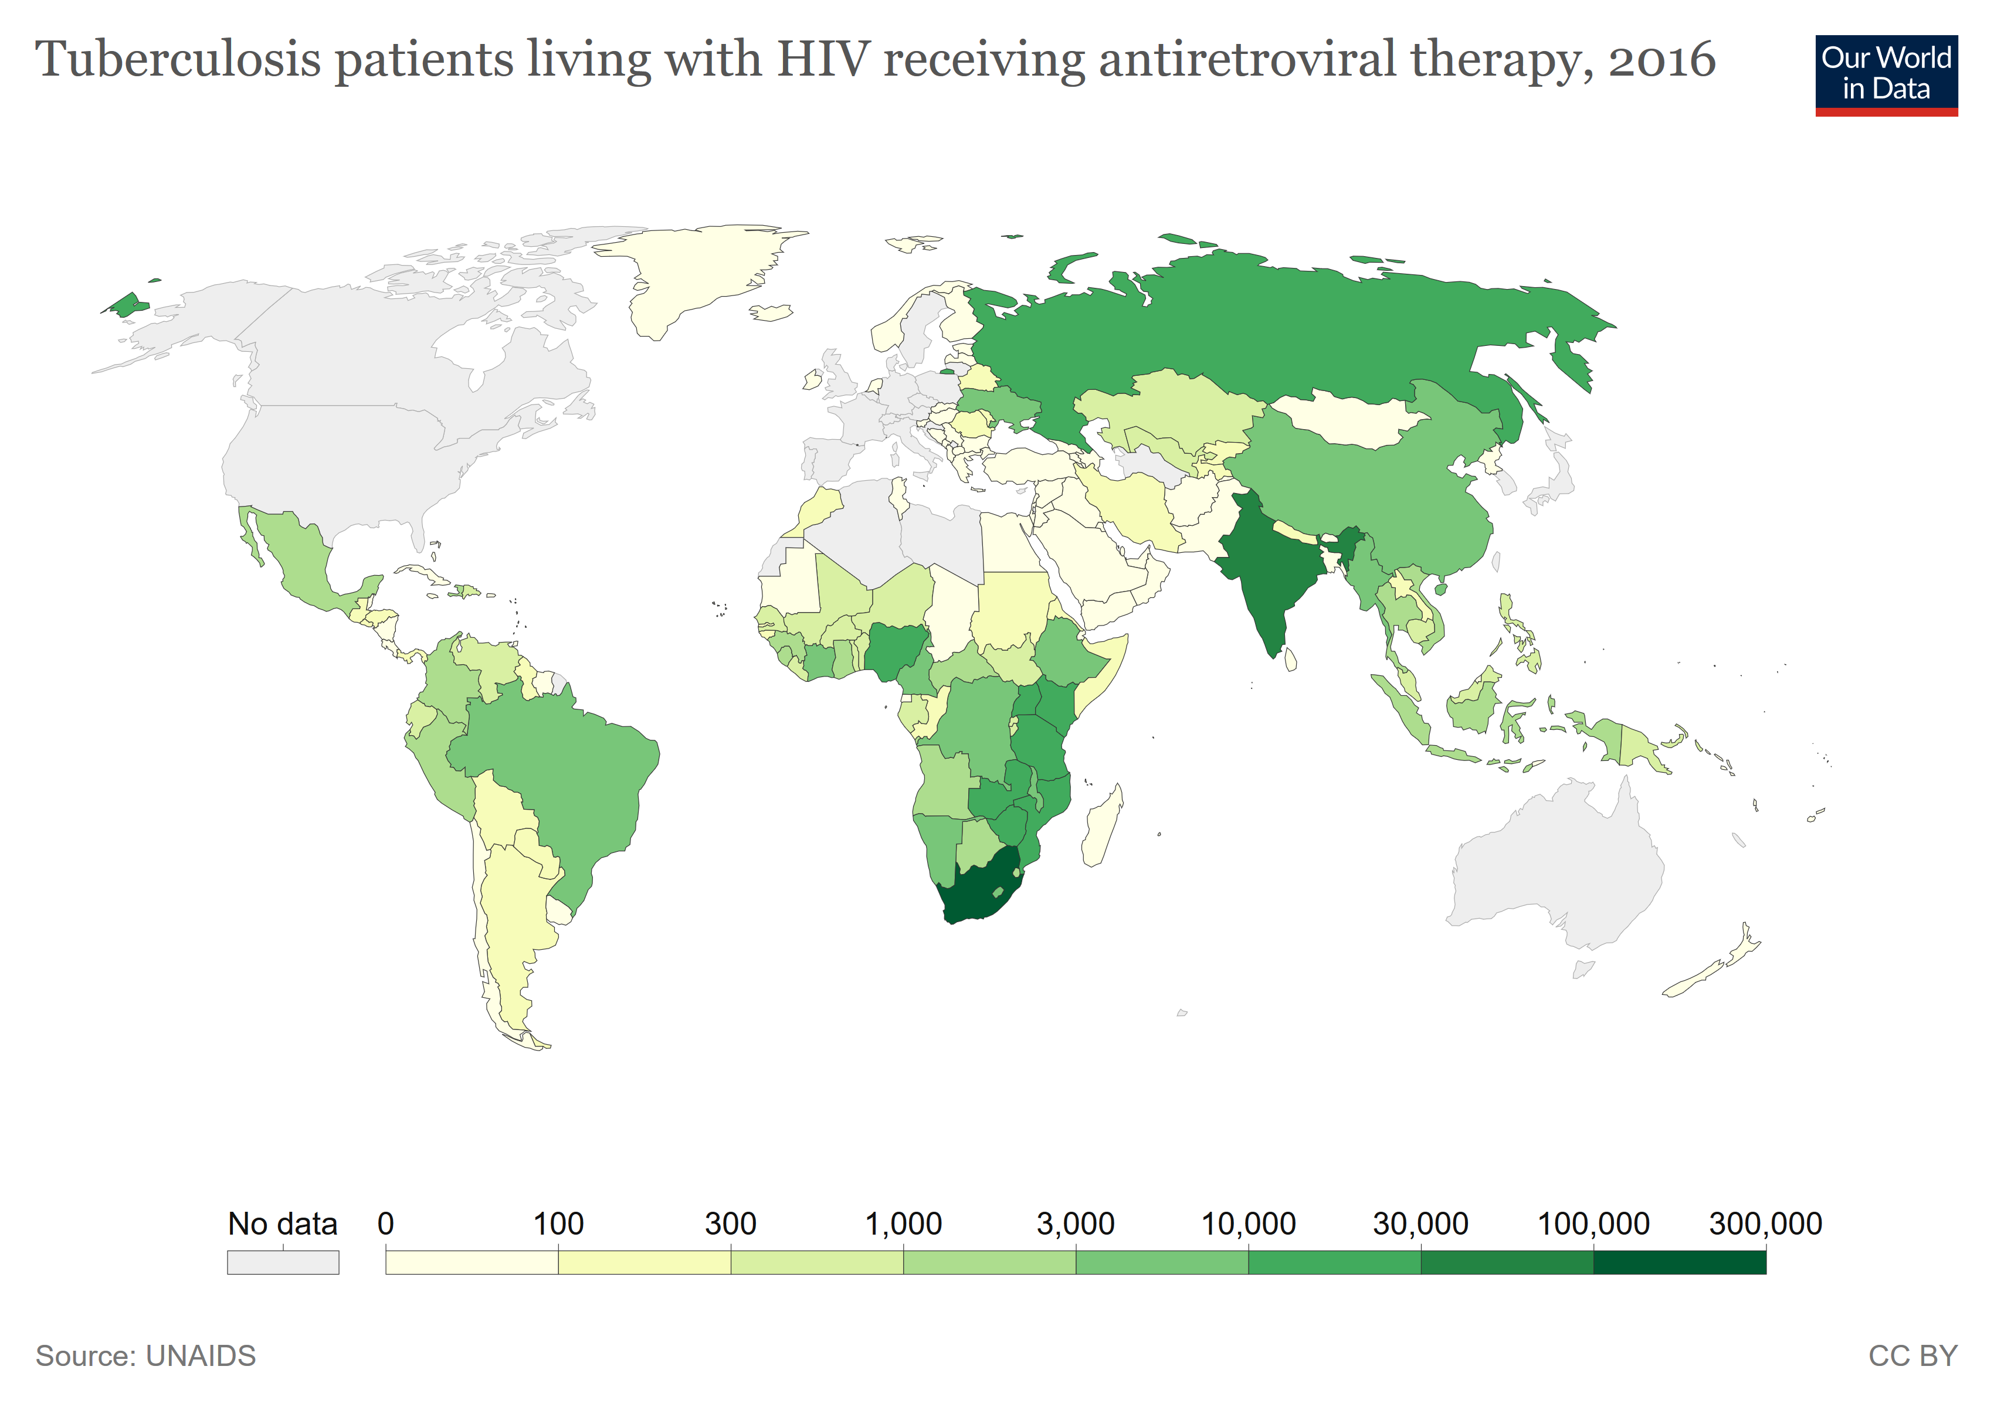
TB in people living with HIV (2016)
https://ourworldindata.org/hiv-aids#tuberculosis-among-people-living-with-hiv
Notes:
These maps should look quite familiar. Just as the burden of HIV is greater in Africa, Asia, and Latin America, the rates of TB among people living with HIV are similarly greater.

Slide 11
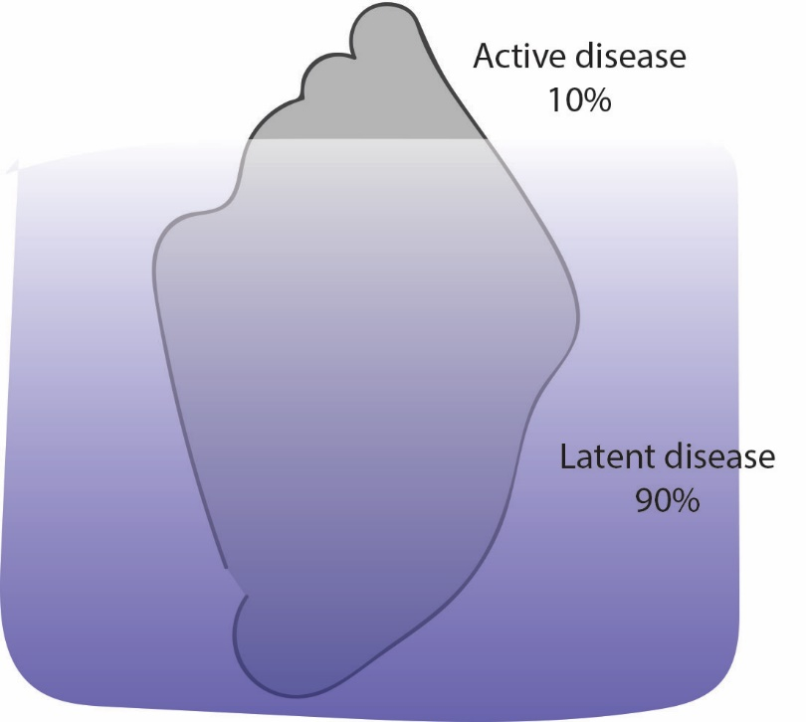
TB disease spectrum – the iceberg
Active disease (200 million people)
Clinical symptoms (cough)
Contagious
Latent disease (1.8 billion)
Infected, but no symptoms
NOT contagious
May go on to develop active
disease in the future
25% of the world population =
2 billion people infected!
Notes:
It is important to consider the size of the impact of these 2 diseases. 2 BILLION people are estimated to be living with Mtb.
A common analogy for describing TB disease is to compare it to an iceberg. This is because most of those 2 billion people have LATENT DISEASE (which means silent or dormant, or ‘sleeping’) – this is the “hidden” part of the iceberg.
This includes people who may be have an infection but do not show symptoms, who are not contagious. They may develop active TB disease in the future though.
The tip of the iceberg is the smaller percentage of people who have active disease, which is only about 10% of the 2 billion people. These people have symptoms, usually a cough, and they are contagious.
It is also important to consider that while 10% seems small, as a proportion of 2 billion people, that is still a lot of people!

Slide 12
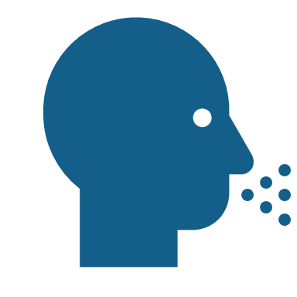
TB disease
Mtb is inhaled (like SARS-CoV-2)
Bacteria then live in the lungs
Symptoms:
Bad cough (sometimes bloody)
Pain in the chest
Loss of appetite
Drenching night sweats for a week or more
Unintended weight loss
Also: fever, weakness, chills
Notes:
Now let’s talk about what TB disease is. [read slide]

Slide 13
TB pathogenesis
https://www.cdc.gov/tb/publications/slidesets/selfstudy/default.htm
Notes:
Once Mtb bacteria enter the body, they can travel anywhere. While must commonly impacting the lungs, Extrapulmonary TB disease can also occur in the kidneys, brain, and bones, including the spine.

Slide 14
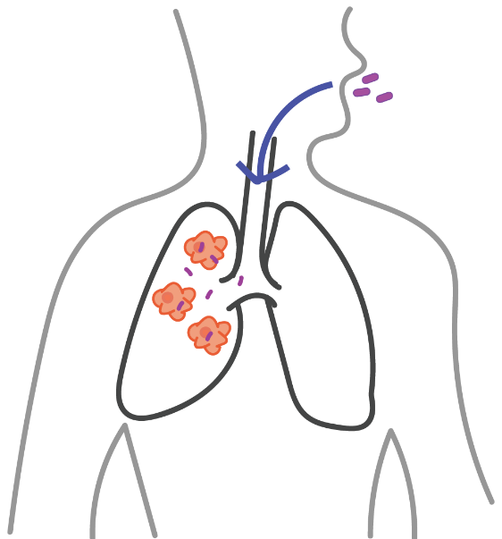
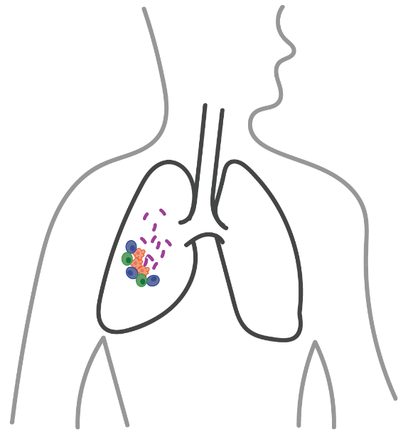
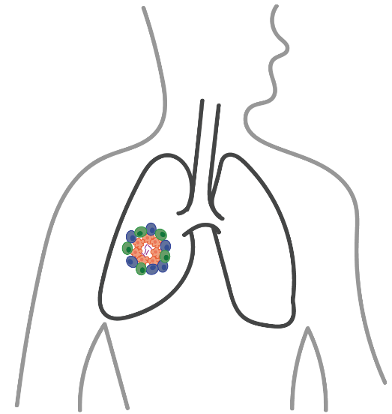
Stages of TB disease
Infection
Latency
Active disease
(10%)
The risk of progressing from latent to active TB disease is estimated to be 20 times higher in people living with HIV (PLWH)
Notes:
People inhale droplets carrying TB bacteria, and the bacteria travels to the lungs.
Bacteria get “eaten” by macrophages (immune cell that means ‘big eater’). But some bacteria hide out inside the macrophages, and don’t actually get destroyed. You can think of this like a garbage disposal that isn’t working well – some garbage (bacteria) gets broken down and washed away as it should, but some garbage is left sticking to the inside.
Most people then get latency – the bacteria get surrounded by immune cells in a kind of “cave” called a granuloma. I’ll say more about this in a moment.
About 10% of people will go on to get active disease. This is because the bacteria break thru the immune cell cave.
One thing to keep in mind is that risk of progressing to active disease is 20 times higher in people living with HIV. Because these 2 diseases so often occur together, this is why NIAID has directed HVTN to get involved in the search for a TB vaccine.

Slide 15
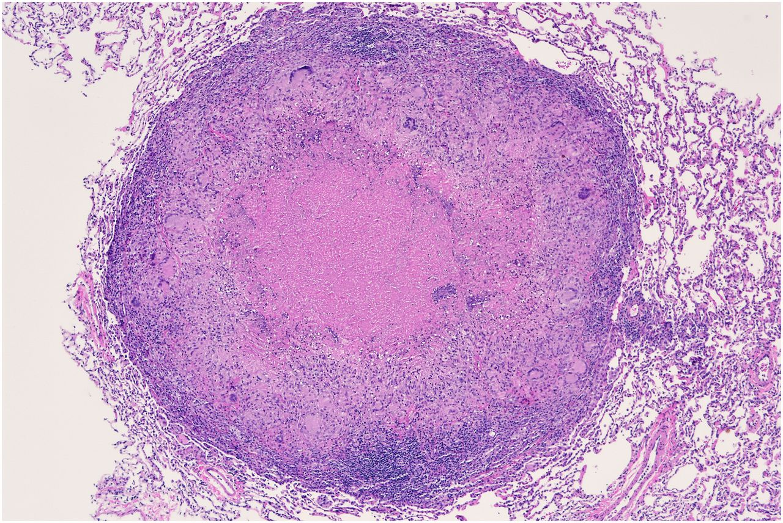
Latency and granulomas
Immune cells in someone’s lungs create a “cave” that seals Mtb inside:
Philana Ling Lin and JoAnne L. Flynn. The End of the Binary Era: Revisiting the Spectrum of Tuberculosis. J Immunol November 1, 2018, 201 (9) 2541-2548;
Notes:
The immune system responds to Mtb by surrounding it, creating a space like a “cave” inside the lungs, called a granuloma.
Shown on the right is an actual picture of a granuloma seen thru a microscope:
All of the purple dots are immune cells (T cells, macrophages, etc.)
The pink center has Mtb, but you can’t see them here (the microscope isn’t zoomed enough)
The surrounding squiggly-looking parts are normal lung tissue

Slide 16
Latent TB Infection (LTBI) vs. TB disease
https://www.cdc.gov/tb/publications/slidesets/selfstudy/default.htm
Notes:
Someone who has latent TB infection, or LTBI, has some differences from a person with active TB disease, as shown here. Key differences include whether they are contagious, whether they feel sick or have symptoms, and what can be detected on chest x-rays. But it is important to note that both will have positive lab tests that are able to detect the bacteria.

Slide 17
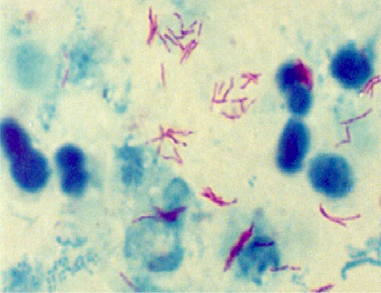
Diagnosis
Diagnosis:
For infection: skin test (quick, cheap, not always correct); blood test (quick, not as cheap, correct); lots of new rapid tests
For disease: sputum and/or chest x-ray
Sputum under
the microscope
Left: https://www.who.int/tb/advisory_bodies/impact_measurement_taskforce/meetings/prevalence_survey/psws_laboratory_examination_weir.pdf
Right: Murphy, K., Habib, S.S., Zaidi, S.M.A. et al. Computer aided detection of tuberculosis on chest radiographs: An evaluation of the CAD4TB v6 system. Sci Rep 10, 5492 (2020). https://doi.org/10.1038/s41598-020-62148-y
Notes:
There are several ways to diagnose TB infection:
Skin test on the inside of your wrist. These are not always correct, meaning there can be ‘false positives,’ where people who aren’t actually infected show a positive test result.
This is NOT the same as VISP! This is a reflection of the skin tests just not being as accurate as we would like them to be.
And there are newer tests being developed all the time to improve on older methods
For detecting disease, there are two methods of testing. First is using sputum, which is mucous/saliva that you cough up. In the image on the left, you can see the pink TB bacteria in this sputum sample under a microscope. The second way of testing is by taking an x-ray, where TB appears like a cloud within the lung.

Slide 18
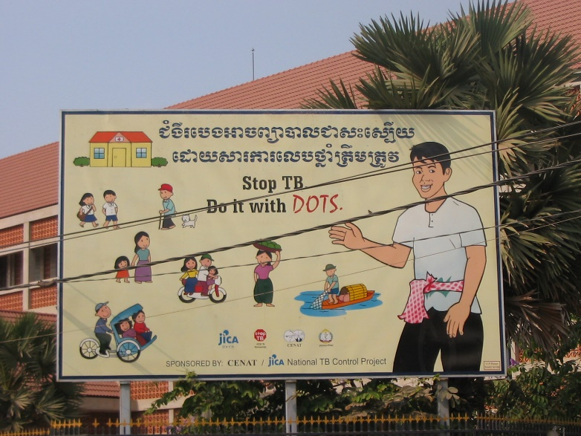
Treatment
Treatment
Person takes 4 different antibiotic medications for 6 months
There are some side effects and adherence can be hard
Some programs use Directly Observed Therapy (DOT)
Drug resistance is a huge problem
MDR TB (Multi Drug Resistant)
XDR TB (Extremely Drug Resistant)
Notes:
Like other bacterial infections, TB infection is treated using antibiotic medications. Almost all other bacterial infections have a 7 to 10 day course of treatment using one antibiotic (like taking penicillin for a urinary tract infection). But TB requires treatment for 6 months, using 4 different antibiotic drugs taken every day. This is done to help prevent having TB that becomes resistant to a single medication. Research has shown that adding these additional drugs helps to prevent the infection from becoming resistant to any of the medications. Additionally, in some parts of the world, drug manufacturing is not as well regulated, so low quality medicines can be a problem.
Obviously taking so many medications daily for 6 months can be very challenging for someone to adhere to, so a lot of treatment programs use DOTs. That’s where a community health provider will visit a patient’s home and watch them take their medicine. (Photo shows a promotional sign for DOTs from Thailand.)
However, these antibiotics are very old medications which some people develop resistance to, and there are few new antibiotics being developed. There are two main kinds of drug resistance: mdr and xdr. MDR and XDR TB infections require more drugs for taken for years, which can be toxic. Also, they both have a high fatality rate, where about 40-60% of people will die. This underscores why having a preventive vaccine is so important!

Slide 19
Duration of treatment
Treatment
Why 6 months?
Why 4 antibiotics?
Because of Doubling Time:
(How long does it take the bacteria to copy itself?)
1
2
 | Doubling time | Number of bacteria after 24 hours
Average bacteria | 1 hour | 17 million
Mtb | 20 hours | 2
4
8
16
Notes:
Why does TB treatment take 6 months and the use of 4 drugs? In addition to preventing drug resistance, one of the main reasons is because Mtb replicates VERY slowly, and antibiotic medications are designed to halt active replication. It’s as if the medications don’t “see” the bacteria because it is moving so slowly, so the drugs think the bacteria is inactive. Since MTB takes nearly a full day to replicate itself, you need to use multiple medications to make sure you are getting everything, and that none of the bacteria are missed because the medications think they are inactive.

Slide 20
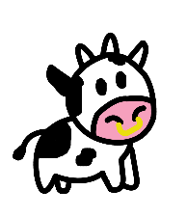
TB prevention with a vaccine
Prevention
There is a vaccine for TB already called bacillus Calmette-Guerin (BCG)
Live Attenuated vaccine
It is made with Mycobacterium bovis which is from cows
Very similar to Mtb, but it lacks some genes that are necessary to cause disease in humans
Used around the world since 1921
Notes:
BCG is a live attenuated vaccine. That means the virus used to make the vaccine is alive, and has been weakened and weakened and weakened to the point where it won’t cause disease.
BCG is made from M. bovis that causes TB in cows (“bovis” is related to the word “bovine”).
This is similar to the way the smallpox vaccine was made. That vaccine used a cowpox virus very similar to human smallpox virus.
BCG vaccine has been used around the world since 1921, primarily in the geographic regions where TB is common.

Slide 21
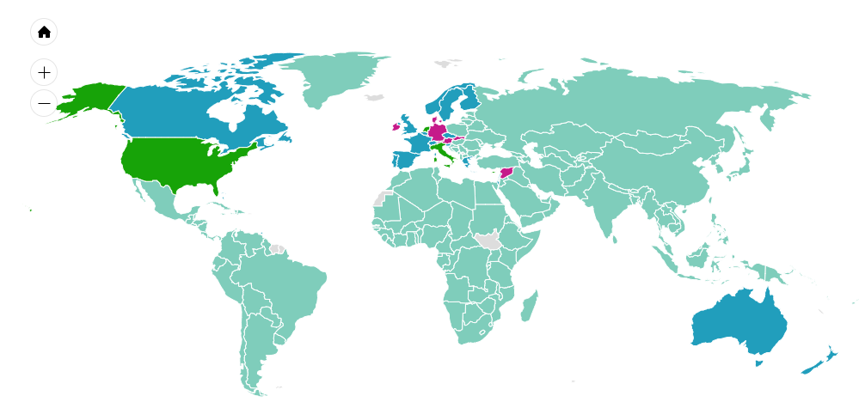
Who gets vaccinated with BCG?
A lot of the world gets BCG as babies
National BCG vaccination
Past BCG vax, now special groups
Past national BCG vax
BCG vax for special groups
http://www.bcgatlas.org/
Notes:
The countries shown in light green vaccinate infants with the BCG vaccine. The countries shown in other colors either used BCG vaccine in the past, and/or they only vaccinate certain at-risk individuals.
If you were born in one the light green countries, you may have a scar on your shoulder from getting the BCG vaccine when you were a child.

Slide 22
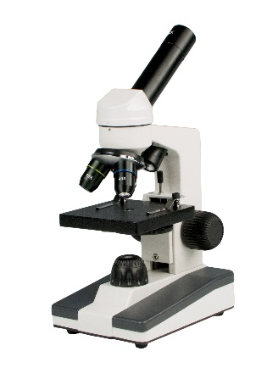
Why do we need a new TB vaccine and other new tools for TB?
BCG is fairly effective against severe childhood TB, but it is not very effective in adults.
BCG vaccine has highly variable efficacy in adults, ranging from 0-87%.
BCG is more than 85 years old, and is not safe for use in people living with HIV.
The lab test is more than 100 years old, and detects less than half of the world’s cases.
Not all of the antibiotics used to treat TB are compatible with anti-retroviral therapy, and there have been no new drugs for TB in more than 40 years.
Source: TB Alliance
Notes:
The BCG vaccine works pretty well to protect against severe TB in children, but it does not work as well in adults. The efficacy in adults can range from nothing up to 87%. Scientists aren't sure of the reason for this, It may be due to the protection waning over time, but there could be many factors involved. Scientists don't know for sure whether kids who are vaccinated with BCG could still get infected later in their lives, and they also don't know whether the vaccine would work very well if it was given to adults.
This is why there is strong interest in finding another, better vaccine against TB.
Additionally, new diagnostic lab tests and new antibiotics are needed. The current tests and drugs are quite old, not taking advantage of the latest technologies and scientific advances, and they are not meeting the needs of the global population.

Slide 23
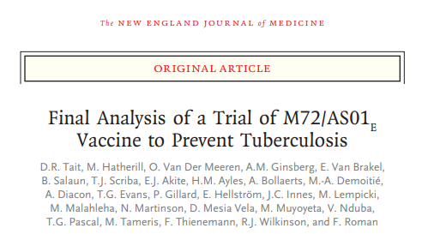
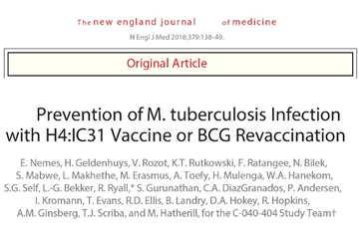
2 recent vaccine trials are promising
Kenya
Vaccine to prevent
TB disease
Zambia
South Africa
Vaccine to prevent
infection
South Africa
Notes:
Two recent TB vaccine clinical trials have reenergized the field. Both took place in sub-Saharan Africa, as shown here.
The M72 trial took place in Kenya, Zambia and South Africa with the goal of preventing DISEASE.
The H4 trial took place in South Africa with the goal of preventing INFECTION.

Slide 24
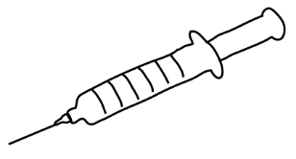
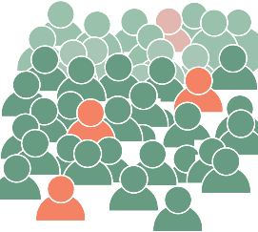
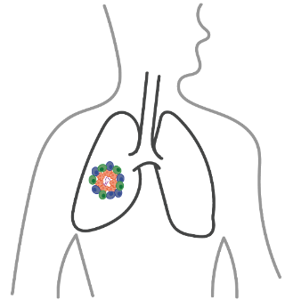
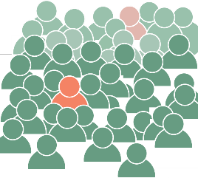
Trial #1: M72/AS01_{e} to prevent disease
39 Adults with Latent TB
Active disease
Kenya
Zambia
placebo
South Africa
26 participants
Study result: 50% efficacy
vaccine
13 participants
Notes:
In the first study, the name of the vaccine is M72, and it is given with the adjuvant AS01e. (Side note – you may recognize the name of the adjuvant, AS01e. HVTN has tested a related adjuvant, AS01b, in several HIV vaccine studies.)
Participants who were enrolled had latent TB infection. The study looked at whether or not they progressed to developd active disease.
The results showed 50% efficacy. 13 people who got the vaccine developed active disease, compared to 26 people in the placebo group.

Slide 25
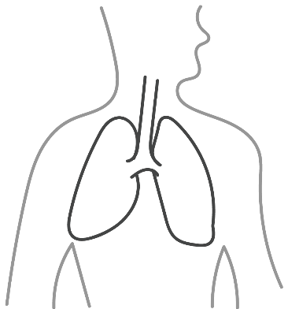
Trial #2: H4:IC31 or BCG to prevent infection
82 Healthy adolescents
Results:
36 participants
acquired TB
South Africa
placebo
BCG revaccination
21 participants
acquired TB
45% efficacy
H4 vaccine
25 participants
acquired TB
Not statistically
different
Notes:
In the second study, the vaccine was called H4 and it was given with an adjuvant called IC31.
This study enrolled healthy adolescents who had received the BCG vaccine in childhood. They were divided into 3 groups: people who got the H4 vaccine with the adjuvant, people who were revaccinated with BCG, and people who got the placebo. The study followed the participants to see if anyone acquired TB. There were infections among 36 people who got the placebo, among 21 people who got revaccinated with BCG, and among 25 people who got the H4 vaccine.
The results showed that getting revaccinated with BCG was about 45% effective. Getting vaccinated with H4 was not statistically different. So while the experimental vaccination didn’t do so well, we learned about the importance of revaccinating with BCG.

Slide 26
Next: HVTN 602 was based on the adolescent trial in SA
CD4⁺ t-cells recognize Mtb and help cells communicate with each other, calling the killers into action
What did we learn?
Antibodies that bind to Mtb recruit other cells that kill Mtb-infected cells
CD8⁺ t-cells kill Mtb
Notes:
In the HVTN, we have also started to look at TB vaccines. We have completed HVTN 602, which followed up on the South African study of H4 and had a similar design. It enrolled 84 adolescents in South Africa.
The study looked at immunogenicity and measured several different immune responses: CD4+ t-cells, CD8+ t-cells, and antibodies. It found that the vaccines produced several different immune responses.
The study also supported the Lab Program to develop new assays for measuring immune responses that may help in future trials.
(Side note: the HVTN’s studies of TB vaccines will use 600-series numbers.)

Slide 27
Upcoming trial: ACTG 5397/HVTN 603
ID93 vaccine with GLA-SE adjuvant
ID93 vaccine has 4 Mtb proteins
For example, Rv2608 is one of the proteins (NOT the same “Rv” as RV144!)
Phase 2a/b
Therapeutic vaccine to reduce recurrent disease after using antibiotic treatment
Collaboration with ACTG
Notes:
In the upcoming collaboration with the ACTG, the study is planning to enroll about 800 people who are living with HIV, who have previously had TB and completed antibiotic treatment. The goal of the study is to prevent people from having TB disease again. This will be a phase 2a/b study.
The vaccine is called ID93, and uses GLA-SE adjuvant, which HVTN has used before with HIV vaccines. This vaccine uses 4 different proteins from Mtb. The names of these proteins can be a bit confusing, because some of the names begin with the letters Rv. This is not the same as the landmark HIV vaccine study called RV144, known as the Thai Trial!!

Slide 28
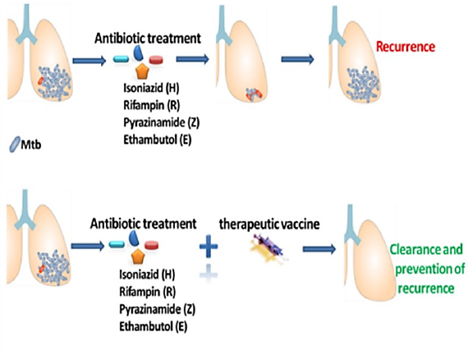
Planned design of ACTG 5397/HVTN 603
A person with TB
Hypothesis: can the vaccine prevent recurrence in a person who was treated and recovered from TB
Notes:
Here is a diagram to explain the trial design of ACTG 5397/ACTG 603.
The top row shows what might happen to a person with TB: they take a 6-month course of 4 antibiotic medications, and their TB disease is treated. But sometimes there are still some bacteria left behind in the lung, and those people can go on to develop TB disease again. This is called ‘recurrence’.
The bottom row shows what the study is trying to do: adding a vaccine after someone completes their antibiotic treatment in an effort to prevent recurrence.
The ACTG is leading the development of this study, and all of the details are not fully confirmed at this time. It is on track to begin later in 2022.

Slide 29
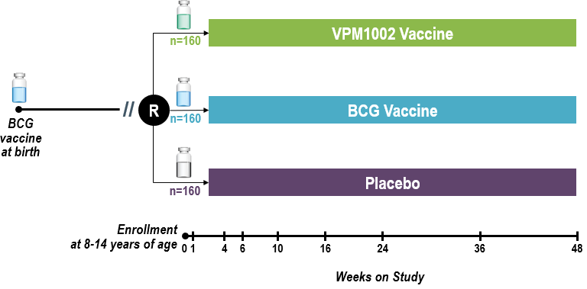
Also in development: IMPAACT 2035/HVTN 604
Phase 1/2 trial looking at safety and immunogenicity
Notes:
A second HVTN TB vaccine study that is in development will be a collaboration with the IMPAACT network. This trial will test a variation of the BCG vaccine called VPM1002 that has been modified to have better immunogenicity. This means the live attenuated vaccine will still not cause any disease (remember, BCG doesn’t cause disease in humans), but may stimulate a better immune response.
It will enroll about 480 children aged 8-14 years old who already got the BCG vaccine when they were born. Some may be living HIV, and some may be uninfected. Those who are living with HIV will be using ART and will have a suppressed viral load (be “undetectable”). 1/3 of the participants will get a single shot of placebo, 1/3 will get revaccinated with BCG, and 1/3 will get the new vaccine VPM1002. Participants will be followed for 1 year after getting their study injection.
The study is expected to start in the first part of 2023.

Slide 30
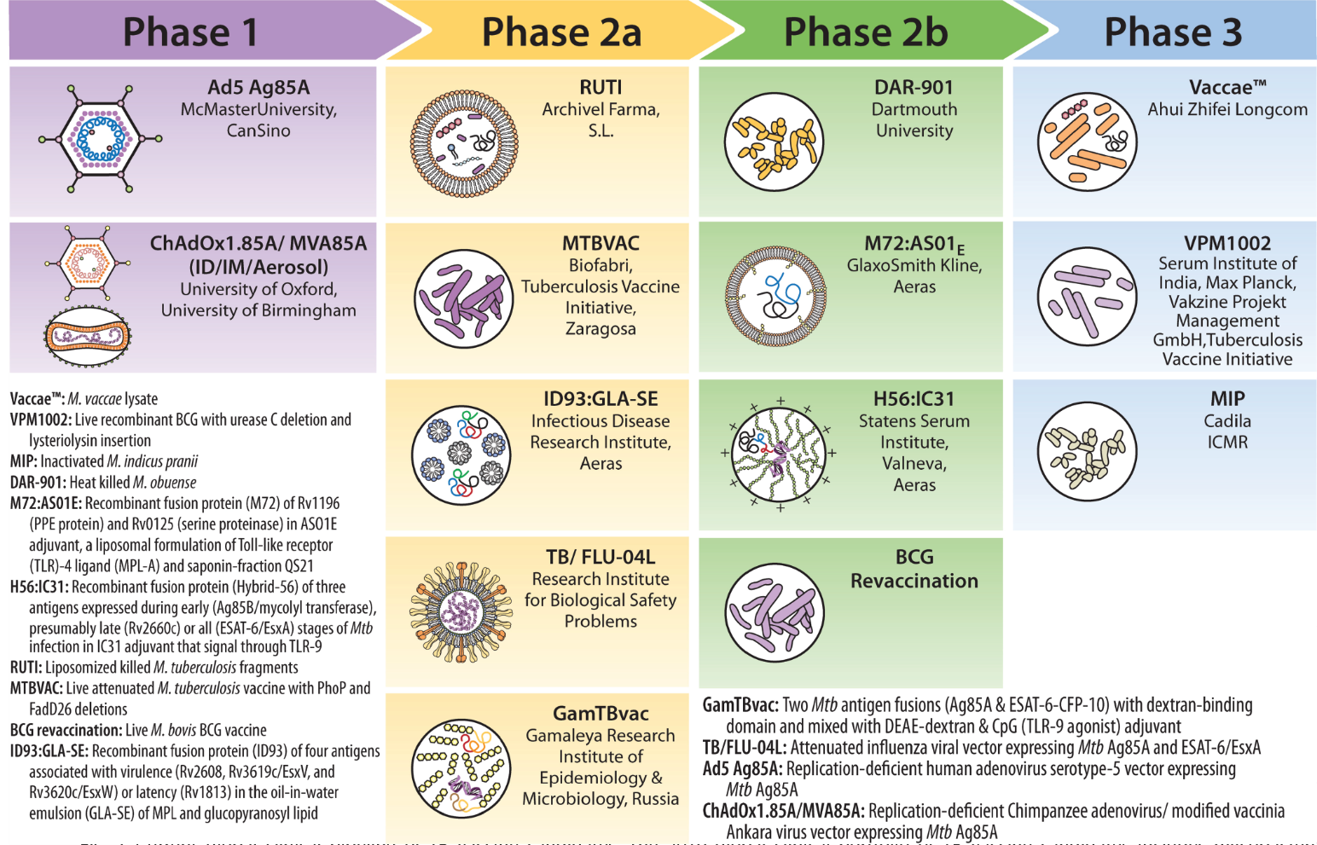
Current TB vaccine candidates
Sable SB, Posey JE, Scriba TJ. Tuberculosis Vaccine Development: Progress in Clinical Evaluation. Clin Microbiol Rev. 2019 Oct 30;33(1):e00100-19. doi: 10.1128/CMR.00100-19. PMID: 31666281; PMCID: PMC6822991.
Notes:
There are a number of TB vaccines in development, so we may be seeing some of these in future studies. There is a lot of work represented here, so stay tuned!

Slide 31
Glossary
Bacteria – type of organism that can cause disease (bigger than a virus)
BCG –TB vaccine currently in use
DOT – directly observed therapy
Granuloma – cave-like structure made of immune cells in the lung where latent TB lives
Latent – silent or dormant
MDR, XDR-TB – multi-drug resistant or extremely drug resistant TB
Recurrence – after TB disease is treated, sometimes it comes back
“Rv” + 4-digit number (e.g., Rv2608) – the way a lot of Mtb proteins are named
Sputum – saliva/mucous you cough up
Notes:
Here is a glossary of the TB-related terms used in this presentation for your reference. Let’s review just to make sure these new terms are all clear.
[Note: this could be provided as a handout for people to keep]

Slide 32
Acknowledgements
Dr. Mindy Miner, PhD – HVTN Core

