Slide 1
An Introduction to VISP: Vaccine Induced Sero-Positivity
What is it and why does it matter?
The HIV Vaccine Trials Network is supported through a cooperative agreement with the National Institute of Allergy and Infectious Diseases

Slide 2
Overview
What is VISP?
Why is it important for participants to understand this concept?
How do the HVTN and study sites support participants with VISP?
Notes:
During this presentation, we will discuss the following [read slide]

Slide 3
What is VISP?
First, a reminder:
Creating an antibody response is the goal of an HIV vaccine. But…
...Most common HIV tests detect HIV antibodies.
VISP = Vaccine-Induced Sero-Positivity
VISP occurs when the antibodies created by HIV vaccine candidates cause a reactive result on HIV antibody tests.
Notes:
[READ SLIDE]
Within the HVTN we use the term VISP, or Vaccine-Induced Seropositivity, to talk about this experience of developing antibodies. Technically, though, the tests are showing a reactive result, not a positive result, so you may see the term VISR instead of VISP (but VISR is mostly just used in laboratories). Using “reactivity” may also help reduce some of the fear and stigma associated with a “positive” diagnosis, but so far we have found that most people are okay just using the term “VISP.”

Slide 4
Why we worry about VISP
Because of the potential for social harms
Misunderstandings with family and friends
Inaccurate reporting of test results
Challenges with insurance, military service, blood/tissue donation, immigration
Because of the possibility of “unblinding”
Notes:
[READ SLIDE] We worry about VISP because we live in an era when HIV testing is becoming very routine. Routine HIV testing is good for individuals and good for communities. However, for HIV vaccine study participants, routine testing outside of the study clinic can lead to possibly incorrect diagnoses (based on antibody tests alone) which can cause stress and unnecessary complications for study participants.
Testing outside of the clinic can also lead to something called “unblinding” which can compromise the study data. To ensure the highest standard of research data, study participants and clinic staff are not told who gets the vaccine and who gets a placebo, (or fake vaccine). This is called “blinding” and it is done to make sure that the participants and staff don’t unintentionally change their behaviors based on what someone received.
“Unblinding” would occur if a participant, who knew that he or she had absolutely no exposure to HIV, went and got a routine HIV test. The vaccine antibodies could cause the test to show a “positive” result. Further tests would show the person was HIV negative, which means that the positive antibody test was likely caused by the vaccine. In this situation, the participant would be “unblinded” because they would know they got the vaccine and may unintentionally, or intentionally change their behaviors, which would lead to inaccurate data.

Slide 5
How common are VISP results?
They vary by study vaccine
As of 2021, approximately 52% of particpiants in HVTN vaccine protocols had VISP at the end of the study (Data: Nicole Espy, HVTN Diagnostics Project Manager)
But specific studies can have much higher rates:
HVTN 100: 0% - 0.5% depending on study group
HVTN 702: 0%
HVTN 705: 97% - 99%% depending on number of vaccine doses
(Data: Nicole Espy, HVTN Diagnostics Project Manager)
Notes:
[READ SLIDE]
The rates of VISP depend on what study products are given and also the amount, or combinations of products a participant receives. The rates could therefore be different for participants based on which study arm (or group) they were assigned. And of course, VISP is seen only in participants who got actual vaccine products, and not in participants who got placebos.

Slide 6
Duration and Transmission of VISP
It is difficult to predict how long VISP will last.
Some participants have had transient experiences with VISP (antibodies come and go)
You cannot pass VISP antibodies through sex
Notes:
We DON’T know how long VISP lasts.
We DO know:
The antibodies can come and go.
You can’t pass the antibodies through sex or kissing.
One way we’re hoping to learn more about the effects of VISP is through a study called HVTN 910 that opened in 2011. As of May, 2014 over 600 participants who had finished their main study had enrolled in HVTN 910. They are providing valuable data on how long VISP stays in the body and what social problems VISP may be causing participants. The study also allows the site to be in regular contact with the participants so that they can help them with any issues that come up. If a participant does not want to join HVTN 910, they can still return to their study site for appropriate HIV testing as long as it is needed.

Slide 7
How does HVTN’s HIV testing work?
End of Study or Evaluation of Seropositivity Testing
VISP defined as 1 or more reactive HIV antibody tests without evidence of true HIV infection
Examples of antibody tests:
3 different methods:
Abbott HIV-
½ Ag/Ab
combo, CMIA
CMIA (chemiluminescent microparticle immunoassay)
BioRad HIV
combo
Ag/Ab, EIA
EIA (enzyme immunoassay)
Participant’s blood sample
MultiSpot
HIV-1/2,
Rapid
Rapid (manual)
Notes:
So what is special about HVTN’s HIV testing? Multiple tests are selected to give the broadest range of methods and to best represent the kinds of tests commonly found in clinical testing. The laboratory starts with 3 different types of antibody kits most commonly found in the community where the participant would seek testing. This slide shows an example of different test kits that may be used. As testing changes or improves, the tests used will adapt too.
This testing is done every time a participant has an HIV test (at each vaccination visit and at their last study visit). During the study, the lab returns HIV test results to the site that say “HIV infected” or “uninfected.” They don’t tell the site whether a participant has VISP or not until after the study has been unblinded.

Slide 8
Example 1: 3 negative (non-reactive) tests
Abbott HIV-
½ Ag/Ab
combo, CMIA
RESULTS =
NO evidence of HIV Infection
NO evidence of VISP
Examples of antibody tests:
3 non-reactive
screening tests
BioRad HIV
combo
Ag/Ab, EIA
Examples of antibody tests:
Participant’s blood sample
MultiSpot
HIV-1/2,
Rapid
Notes:
[show handout 1]
This first example shows a situation where a participant’s blood sample is tested using 3 different tests, and all of them get a “non-reactive” result. This person does not have detectable HIV antibody reactions, and we can safely say that they do not have HIV infection and do not have VISP.

Slide 9
Example 2: 1 or more reactive tests and…
Abbott HIV-
½ Ag/Ab
combo, CMIA
?
HIV-1 NAT negative
and WB negative, indeterminate, or positive based on vaccine response
Examples of antibody tests:
1 or more
reactive tests
Western blot and HIV-1 nucleic
acid testing (NAT)
BioRad HIV
combo
Ag/Ab, EIA
Participant’s blood sample
MultiSpot
HIV-1/2,
Rapid
RESULTS =
NO evidence of HIV Infection
CONSISTENT with VISP
Notes:
If any of the 3 antibody tests are reactive, a Western blot and an RNA viral load test are done. The Western blot is a more detailed antibody test which may help distinguish between vaccine and infection based on the blot antibody patterns. The Nucleic Acid Test (also called RNA Viral Load test) is run to look for the presence of HIV virus instead of antibodies.
[show handout]
If the Nucleic Acid test is negative (shows no virus), and the Western Blot test is either negative, indeterminate, or positive in a way that is consistent with the study vaccine the participant received, then we can safely say that the person does not have HIV infection, and their test results are just showing VISP.

Slide 10
Example 3: 1 or more reactive tests and…
Abbott HIV-
½ Ag/Ab
combo, CMIA
?
1 or more
reactive tests
Western blot and HIV-1 nucleic
acid testing (NAT)
HIV-1 NAT positive
and WB consistent with HIV infection
Examples of antibody tests:
BioRad HIV
combo
Ag/Ab, EIA
Participant’s blood sample
MultiSpot
HIV-1/2,
Rapid
RESULTS =
Re-draw blood from participant and confirm HIV infection
Notes:
If HIV infection is suspected based on the nucleic acid or Western blot test results, the lab will ask for a new blood sample and will repeat all of the tests on that new sample. The new blood sample is necessary to rule out any problems with the original sample or the initial testing. It may also provide additional information, such as an evolving Western blot pattern or confirmatory viral load levels.

Slide 12
How can we support participants?
At the site:
offering accurate testing
reminding participants to “opt out” of testing in the community
helping participants explain VISP to partners, family and friends, and testing centers or other medical providers
In the community:
Outreach and awareness to medical providers, health facilities and testing centers
Notes:
[Read slide]
“Opt-out” testing just means that a person speaks up and tells their doctor or medical provider that they do not want to be tested for HIV, and need to get only get HIV testing at the study site. This is a big deal in the US, where doctors routinely test everyone as part of a regular medical exam without necessarily asking the patient first. Different areas have different rules, so it’s important to know what the laws are in your area.
To make this situation easier, the HVTN has brochures and handouts to give to participants that they can share with their friends, family and medical providers to help explain the situation. [show examples]. The HVTN also created a website that you can direct people to.
However, it is also important that the site itself works to explain this situation to clinics, medical centers, and other providers of HIV testing in the area. It is an essential part of a site’s community education plan to educate the community so that a participant is not left to do this all by themselves.

Slide 13
Brochures for participants about VISP
Notes:
[Pass around several examples to group]
These brochures can include site-specific contact information. The small brochure provides essential information about getting the right testing for HIV vaccine trial participants. The larger brochure provides answers to detailed Frequently Asked Questions about VISP.

Slide 14
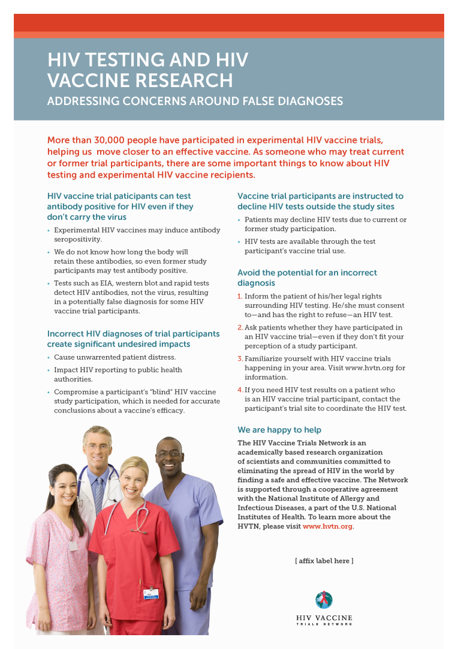
Handouts for providers about VISP
Notes:
[pass around an example]
This is the type of handout that sites can send out and share with testing centers and medical providers in the area.

Slide 15
Internet resources for participants http://www.hvtn.org/visp/
Notes:
This informational page is on the HVTN website and is intended for study participants and potential participants who have access to internet resources.

Slide 16
Internet resources for Health Providers https://www.hvtn.org/en/participants/visp-hiv-testing/provider-information.html
Notes:
This webpage is designed to provide more information to medical providers and testing centers about why study participants need appropriate HIV testing.

Slide 17
How can we support participants?
Through HVTN Core:
VISP Testing Service/Registry
Materials to distribute, webpages
Other resources ????
Notes:
In addition to the brochures, handout and webpages, HVTN Core is working on a broad level to support participants.
One way is through the HVTN 910 study. The results from this study will help in the design of future studies and to figure out collectively how to best support participants.
Another way is through a regional testing service that can help former study participants get appropriate testing, if they are no longer near their study site. This service was recently started in the US and is under development in southern Africa.
Finally the question marks on the slide indicate that the HVTN is always trying to figure out what additional resources are needed. If you have ideas, you should always feel free to pass them along to a HVTN Core staff member.

Slide 18
The VISP Testing Service provides:
Free HIV testing for current and former HIV vaccine trial participants who no longer have access to their site (e.g. site has closed, or participant has moved away from the site)
Mitigation of social harms (e.g. providing letters to health care and insurance providers verifying HIV and/or VISP status)
Pre- and post-test counseling
Provision of resources and referrals related to VISP and/or HIV to participants as needed
Notes:
These are the services that the testing service provides, but sites are also able to provide these services.

Slide 19
Testing Service so far…
Reasons why participants used the Testing Service (as of October 2013)
Testing Service transferred to the HVTN from the US Division of AIDS, August 4, 2010.
As of June 2017, the Testing Service has provided testing to over 170 participants, including many repeats!
Notes:
This chart shows the type of support the HVTN has been able to provide through the testing service for former participants who are no longer able to access testing services and support from their study site. The HVTN is working with colleagues in South Africa to develop a similar testing service for the region but in the meantime, the sites can provide this support themselves.

Slide 20
Discussion
How would you explain VISP to potential participants or fellow CAB members?
What do you see as the biggest challenges with VISP in your communities?
Notes:
[leave this slide up but let trainees know you will hold the discussion after one more activity]

Slide 21
Acknowledgements
Genevieve Meyer
Carissa Karg
Constance Ducar
John Hural
Gail Broder

Slide 22
THANK YOU

